Slide 1
Revision retrieval clock
Student’s revise 12 different topics in 3-4 minute time periods.
Teacher or student choose topics
Students fill each section with info, key words or pictures of what they can remember.
Then look at class notes, text to fill in gaps in knowledge

Slide 2
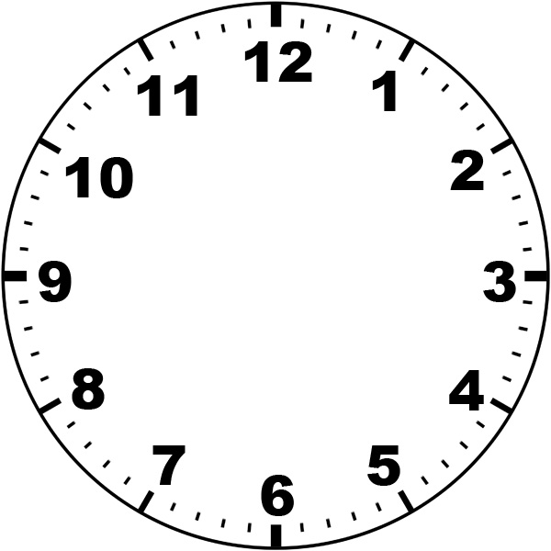

Slide 3
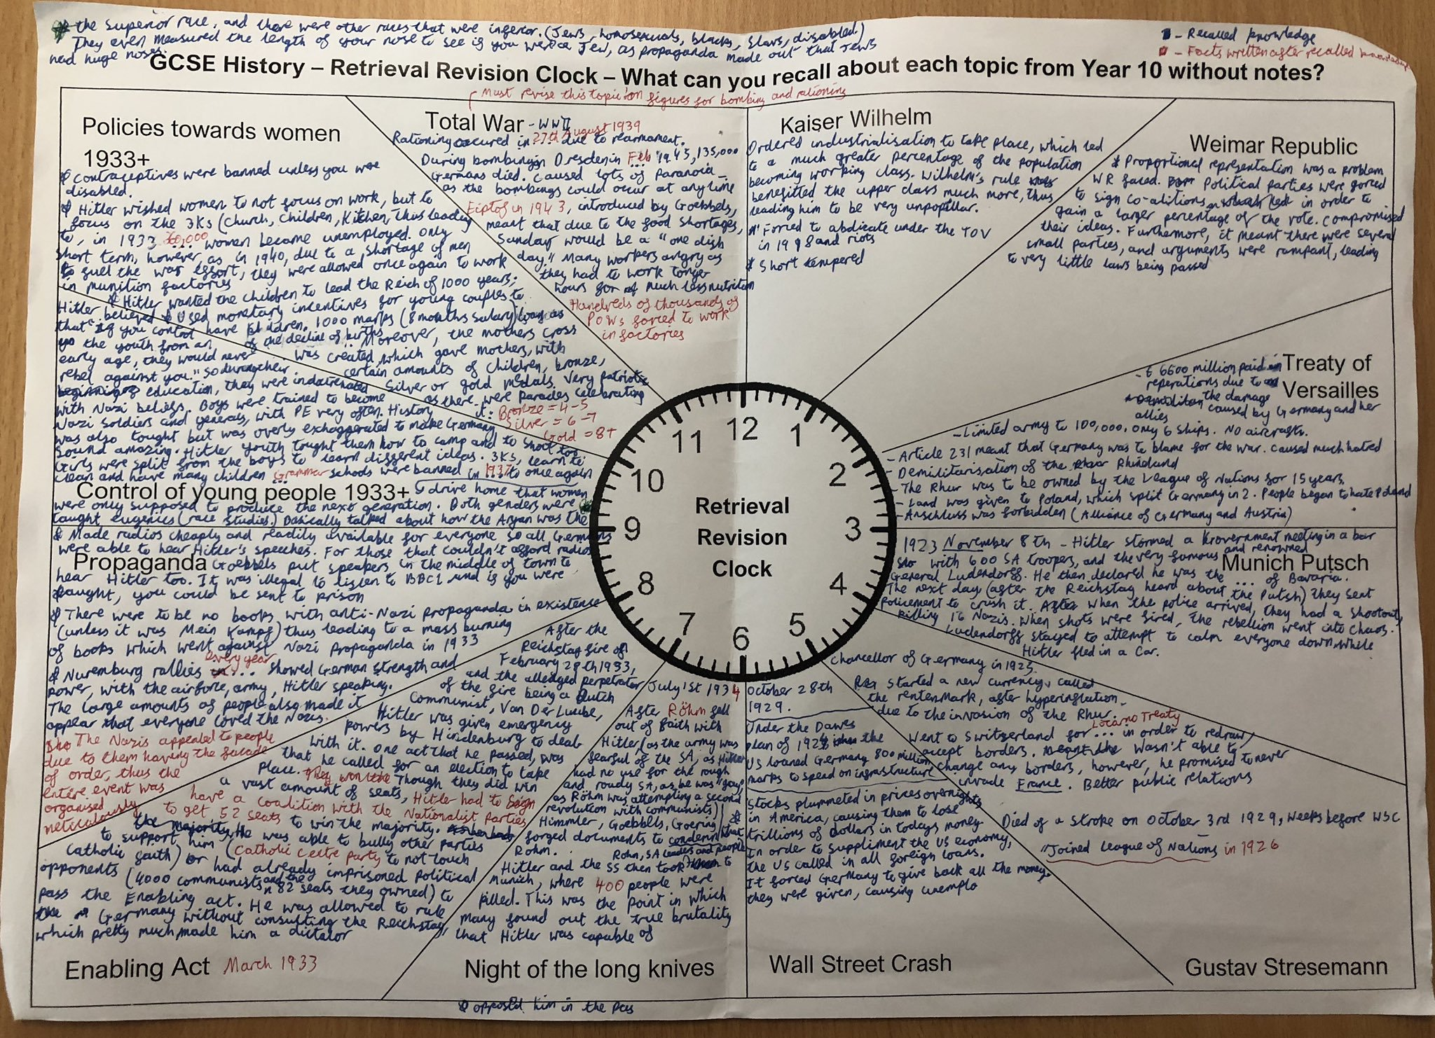

Slide 4
Round the Clock Revision
Round the Clock Revision
Round the Clock Revision
Round the Clock Revision
Round the Clock Revision
Round the Clock Revision
Notes:
Revision retrieval clock attached. Student’s revise 12 different topics in 3-4 minute time periods. You or they choose the topics, They then fill each section with info, key words or pictures of what they can remember.

