Slide 1
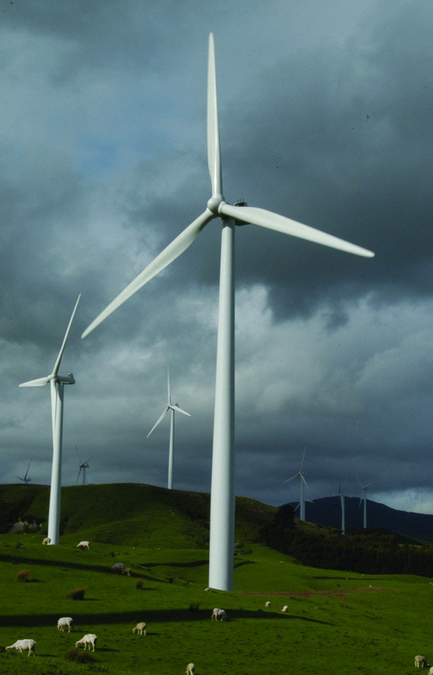
WHO is impacted? | WHAT are the pros and cons?
WHERE are they sited? Which countries use them? | WHEN are they active?
WHY are they a good option? | HOW do they work?
Wind turbines

