Slide 1
Migration
Year 3
Notes:
I’ve tried to give you some text with images to generate discussion
Teacher notes FYI, not intended for students
Mike Stone

Slide 2
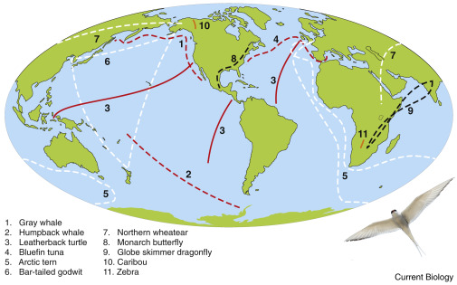
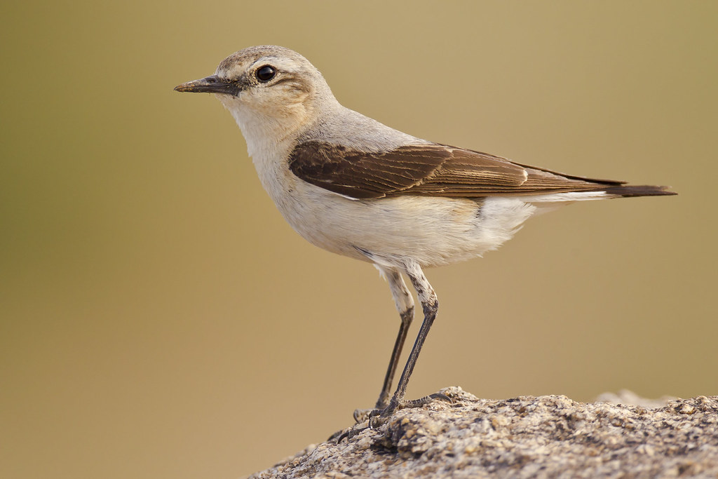
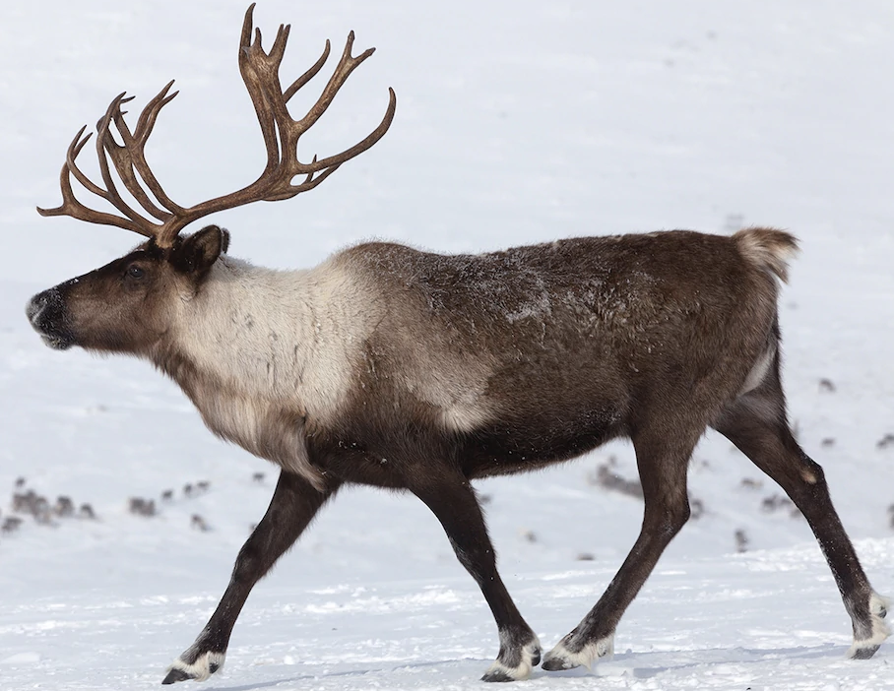
What is migration?
When an animal travels long distances from one place to another, often from one country to another and over the sea. It includes the return back home.
Notes:
Lower LHS: Northern wheatear - a small songbird, like a thrush, eats insects https://www.flickr.com/photos/paulbjones/8016618709
Lower Middle: Caribou, also known as reindeer https://kids.nationalgeographic.com/animals/mammals/facts/caribou
Lower RHS: Arctic tern
Can you name some other migrating animals you know?
only 3 birds here, there’s lots of others
some eels, lobsters, crabs, wildebeest

Slide 3
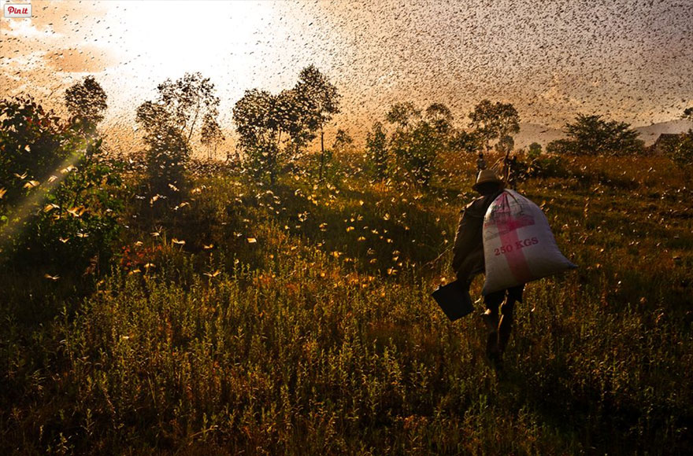
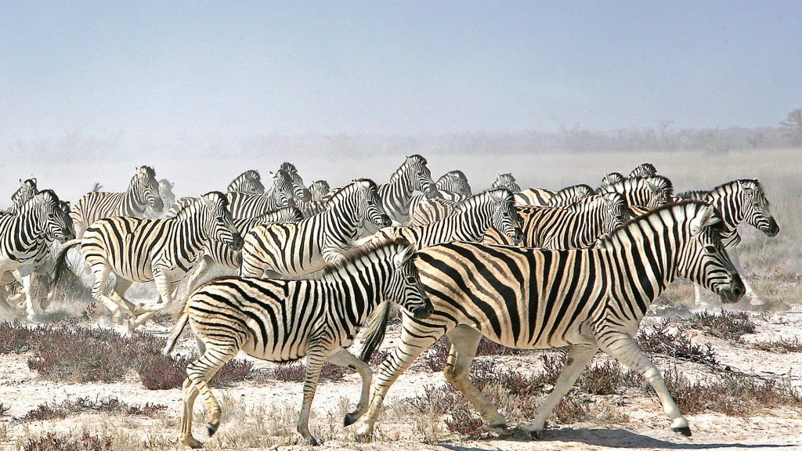
Why migrate? 1. Food
Some animals live in places where the weather gets really cold in the winter, and there isn't enough food around for them to survive. So, they fly to warmer places where there's more food.
British birds fly south to find warmth, NZ birds fly north.
Notes:
Warmth at the equator. “Fly south for winter”
What continent are both of these animals in?
Why might food be a problem animals need to travel for here?
What other problem may cause migration here?
Video of wildebeest migration https://www.youtube.com/watch?v=7NdMLa8L5a8
Zebra: https://www.refinedtravellers.com/explore-top-10-animal-migrations-with-beyond/
Locusts: https://www.boredpanda.com/animal-migration-photography

Slide 4
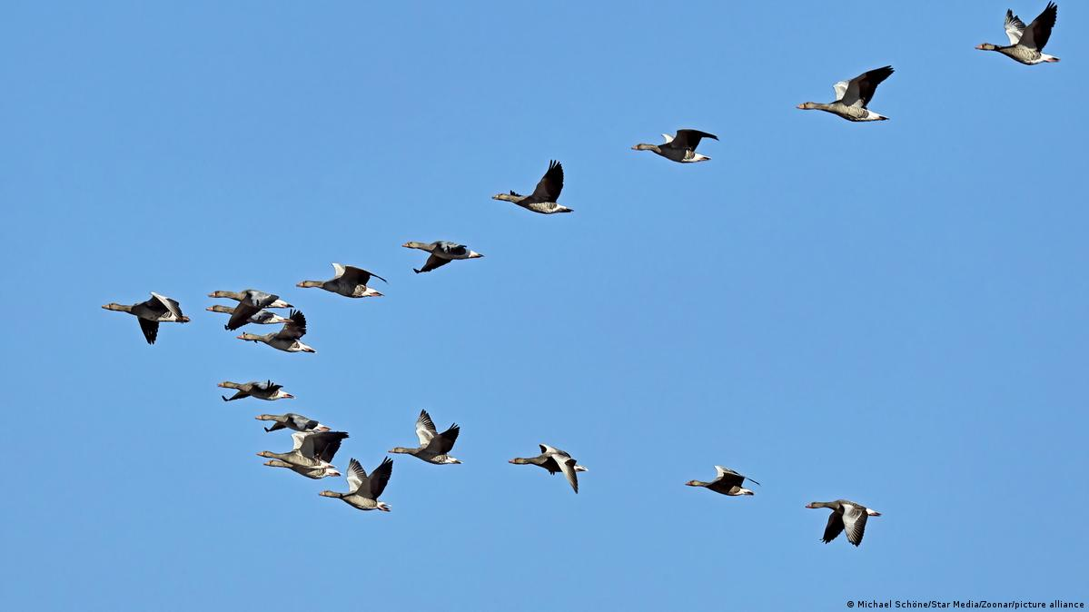
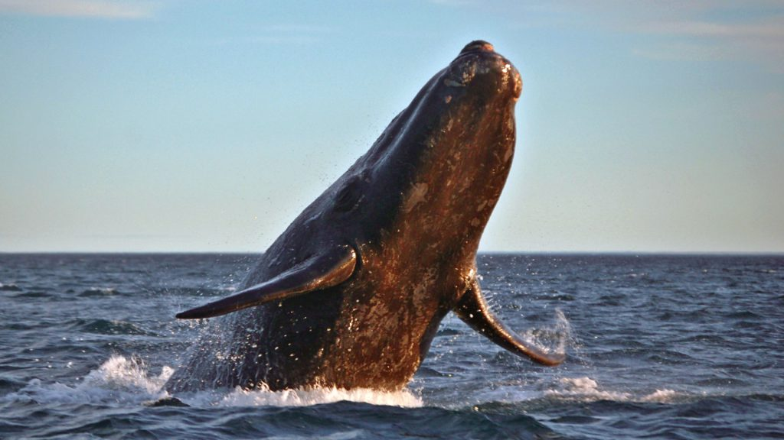
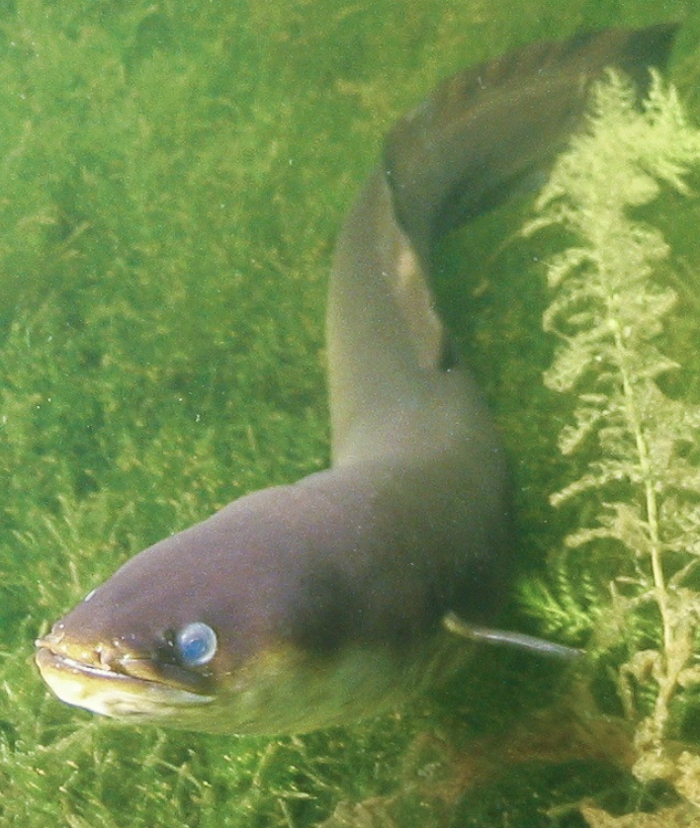
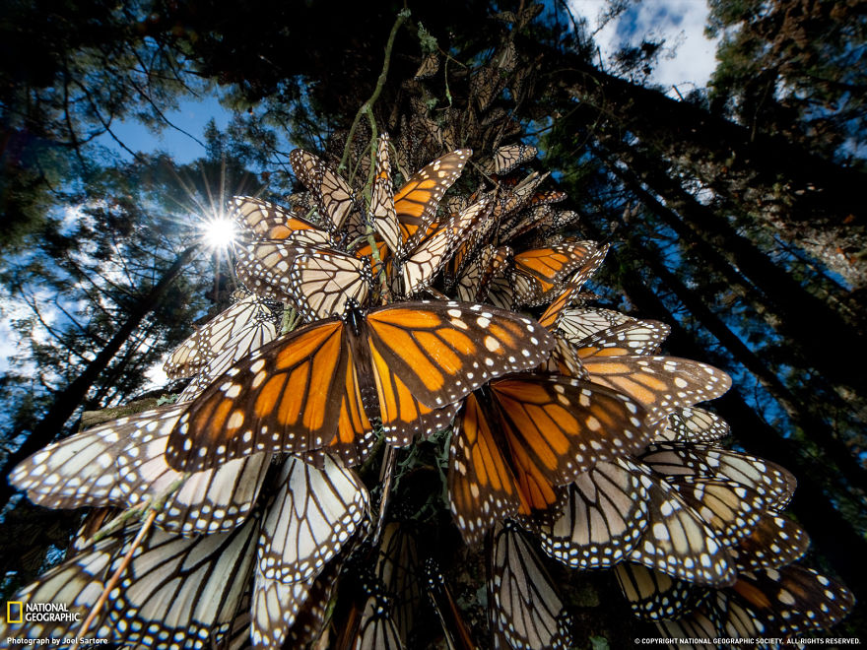
Why migrate? 2. Breeding
Some animals need special conditions, like certain kinds of plants or seas and lakes, to lay their eggs and raise their chicks. So, they fly to places where these conditions are just right.
Notes:
Can you name these animals?
Whale: https://www.refinedtravellers.com/explore-top-10-animal-migrations-with-beyond/
Butterfly: https://www.boredpanda.com/animal-migration-photography
Geese: https://www.dw.com/en/the-perilous-life-of-migratory-birds/a-61710214
Eel: https://niwa.co.nz/our-science/freshwater/tools/kaitiaki_tools/species/tuna

Slide 5
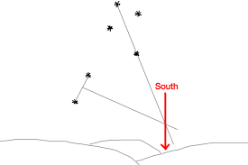
How do they find their way?
Birds use stars at night, sun during the day. Some have a built-in compass
Animals in the sea often use a sense of smell. Chemicals in the water smell different, and they can find their ‘home’
Animals on land use sun and stars too
Notes:
Built in compass can detect the earth’s magnetic field.
Image shows how humans can find south
Investigate – can steel structures send birds off in the wrong direction? Check it out with a compass and a steel structure (e.g. table frame? Metal stand).
Video on navigating methods https://www.youtube.com/watch?v=sHmdzXjgrHA
A video for kids about earth’s magnetic field https://youtu.be/VFzg9XH0dv8
Instructions for modelling the Earth's magnetic field using foam ball, a neodymium magnet and staples.
https://www.exploratorium.edu/theworld/iceland/magnetism.html

Slide 6
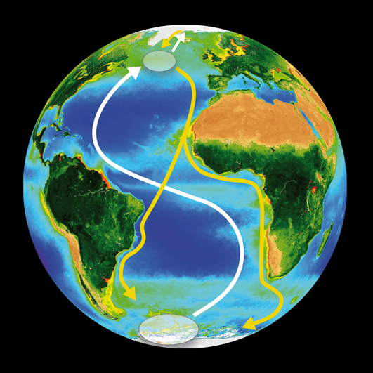
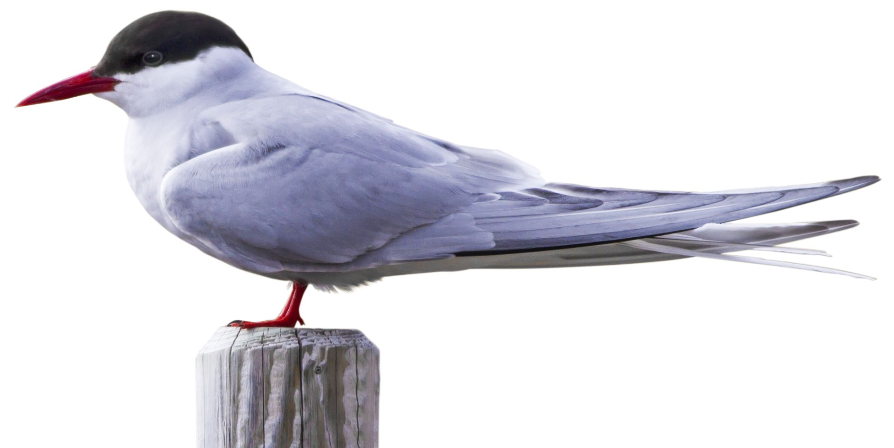
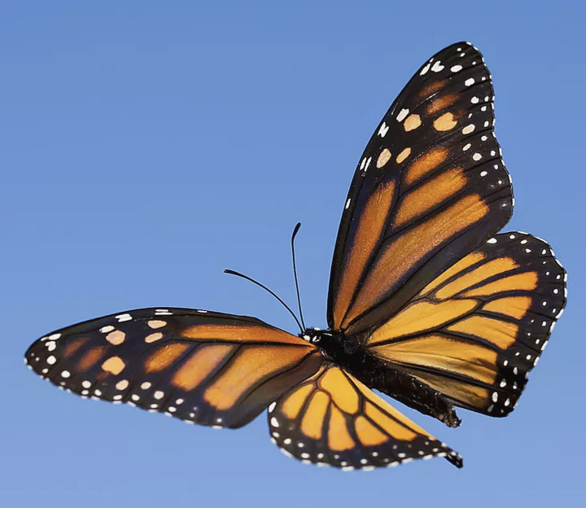
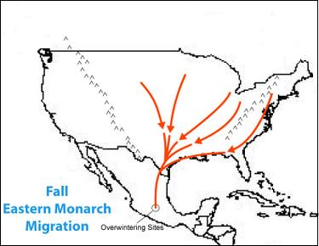
Record holders
Arctic tern – 71,000 km
Monarch butterflies – 5,000 km
Godwit – 12,000 km non-stop
Notes:
The 1st 2 are quite small and light creatures
AT – from pole to pole
MB – from USA to Mexico
G – from NZ to Alaska (see last slide)
https://www.thoughtco.com/monarch-butterfly-migration-1968018
https://www.glorious-butterfly.com/migration-route.html
https://www.dkfindout.com/us/animals-and-nature/birds/arctic-tern/
https://phys.org/news/2010-01-arctic-terns-longest-animal-migration.html

Slide 7
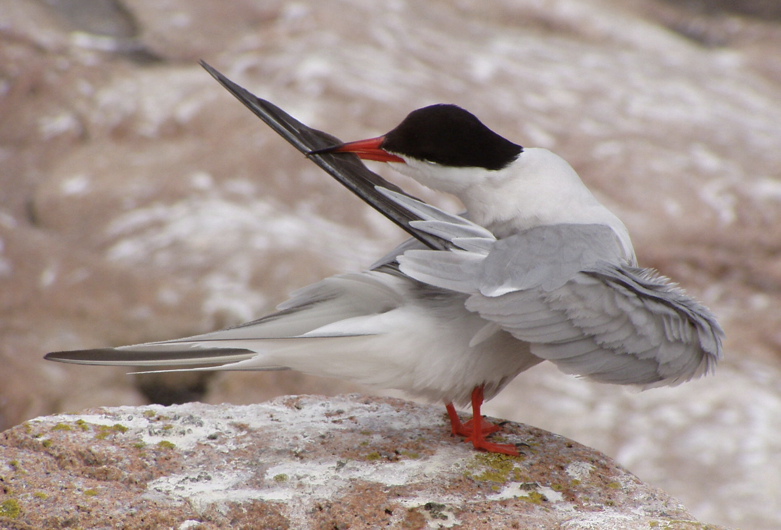
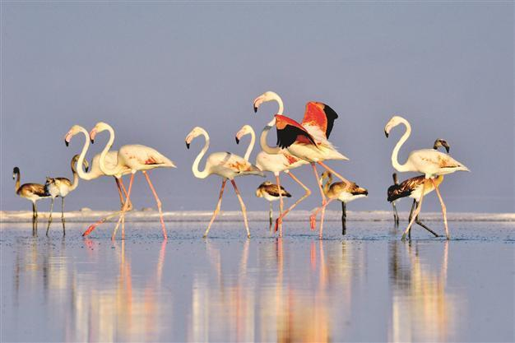
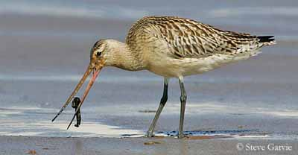
How might they prepare?
This long journey is going to take a lot of energy. Where do animals get their energy from? So how might they get ready?
What else might they need to do?
Notes:
How do we get ready for long trips?
Feed and store fat.
Preen to get rid of broken feathers and spread oil so waterproof.
Practice take offs.
Godwit https://www.oiseaux-birds.com/card-bar-tailed-godwit.html
Arctic tern https://www.flickr.com/photos/usfwsnortheast/4188099002
Flamingos: https://www.hurriyetdailynews.com/flamingos-prepare-to-take-flight-on-southward-journey-52812

Slide 8
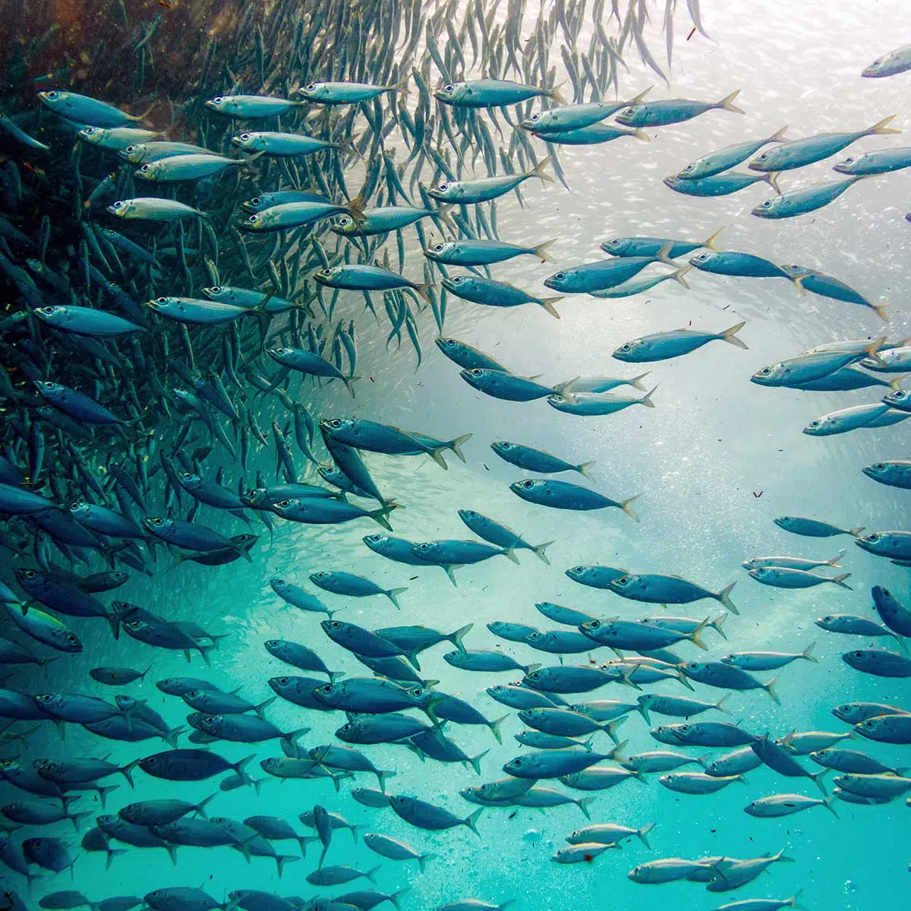
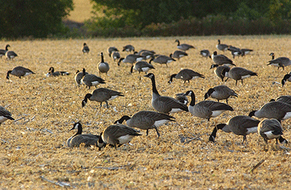
What do they need on their journey?
Some might need favourable currents.
Some might need places to rest and feed.
Notes:
Currents in the air and in water

Slide 9
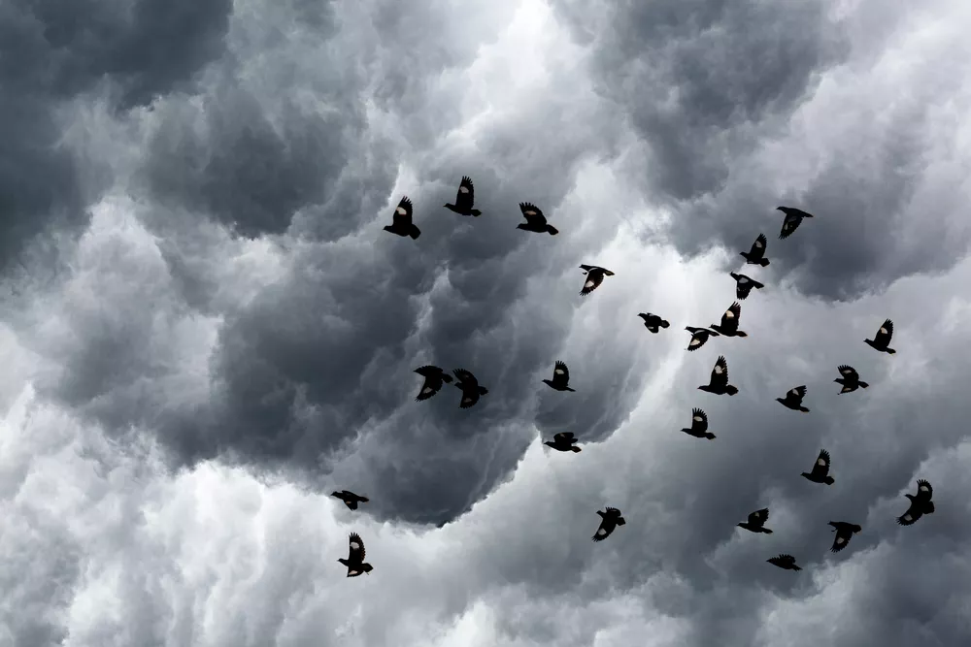
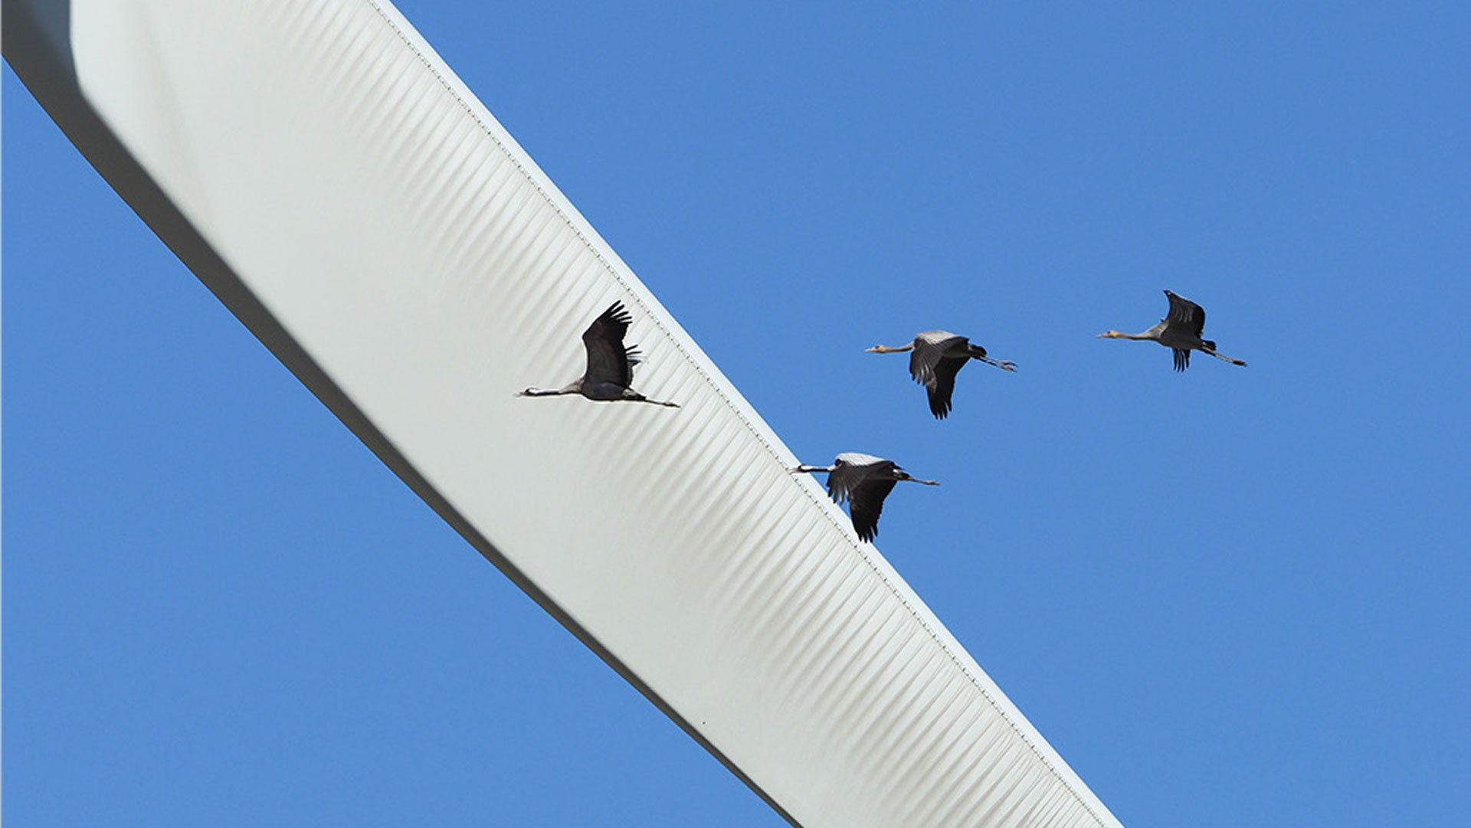
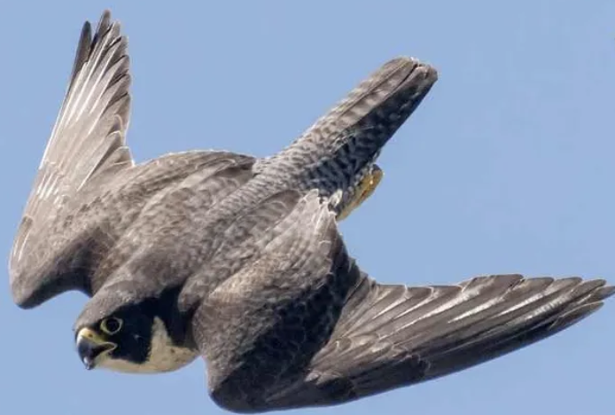
What difficulties might they face?
Stormy weather
Predators
Tall buildings and other structures
Notes:
Flocking gives some protection from predators
Falcon https://birdsandwetlands.com/do-falcons-attack-humans/
Cranes https://group.vattenfall.com/press-and-media/newsroom/2020/birds-are-good-at-avoiding-wind-turbine-blades

Slide 10
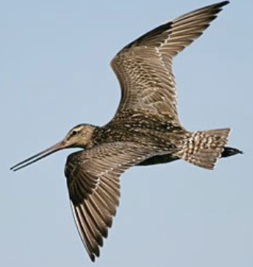
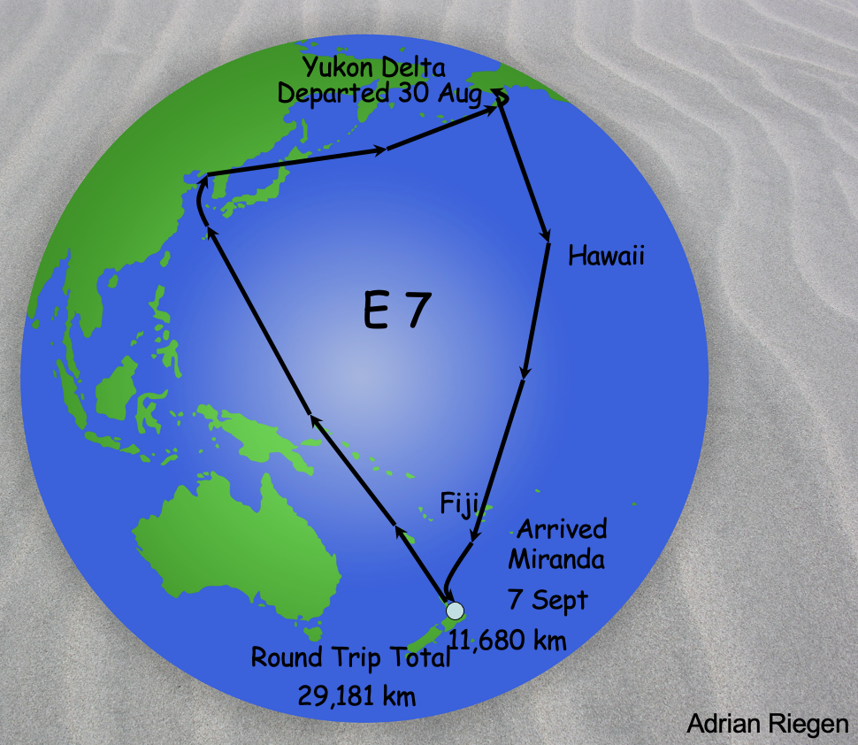
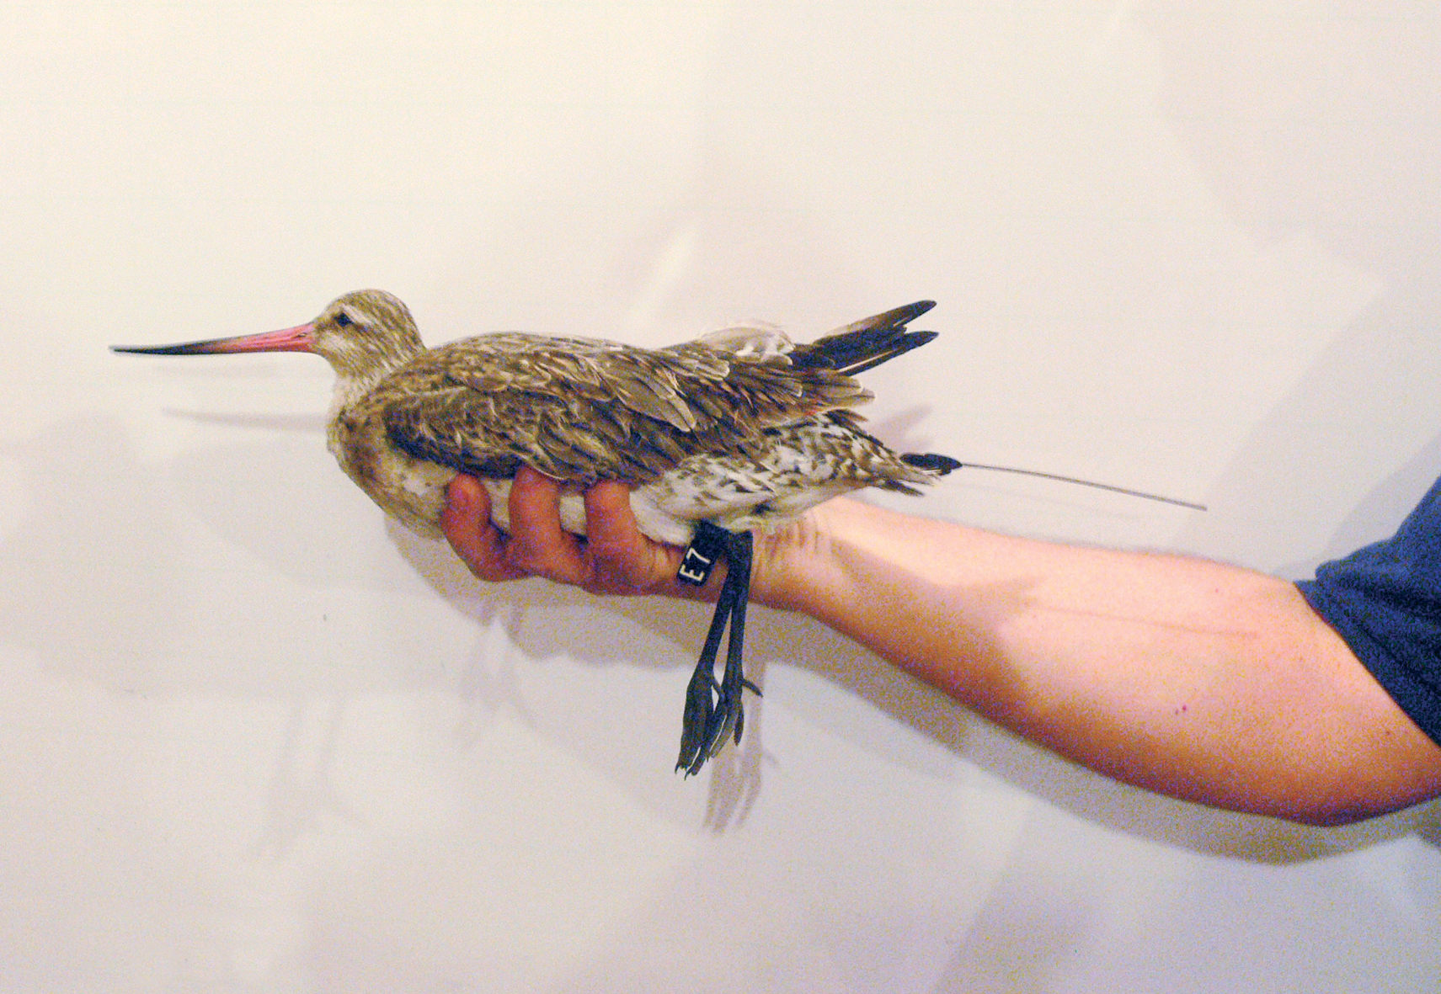
Godwit E7
Bar-tailed godwit
Travels to Alaska and back
12,000 km one way
Outward journey bird stops in Korea to feed
Return journey is non-stop
Notes:
E7 with radio transmitter attached. Hand gives an idea of scale
How many days did E7 take to fly home?
Can you figure out the distance for the whole trip?
Want to know more? Keith Woodley at Miranda Shore Bird Centre is involved in this research. Might talk with kids online keith@shorebirds.org.nz

Slide 11
To think about
Can you name 10 animals that migrate. Circle those from NZ
Coastal mudflats are good places to observe some of our migrating birds. Where is the nearest to us?
People migrate too. What might their reasons be?

