Slide 1
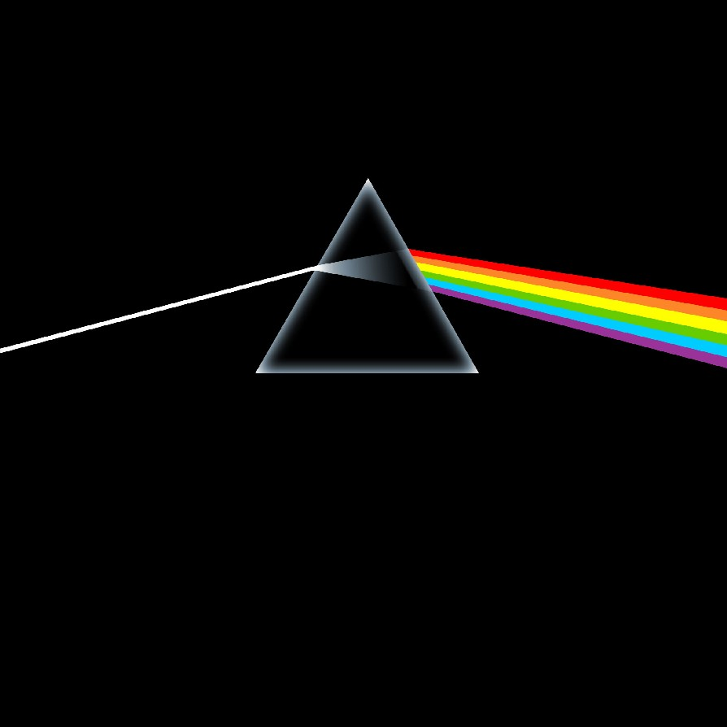
Investigating is more than just fair tests
Mike Stone
Nov 2023
Notes:
Ask students to make a list of 10 different experiments / investigations / practical activities they can remember doing at school

Slide 2
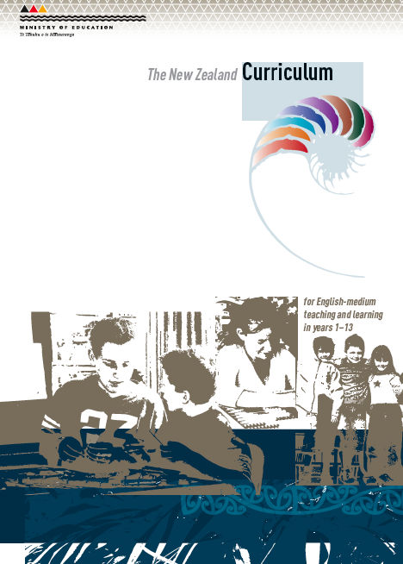
NZC Science Aim
Investigating in science:
Carry out science investigations using a variety of approaches: classifying and identifying, pattern seeking, exploring, investigating models, fair testing, making things or developing systems.
Notes:
The NZ curriculum talks about all these different types of investigations. Which ones have you heard of?

Slide 3
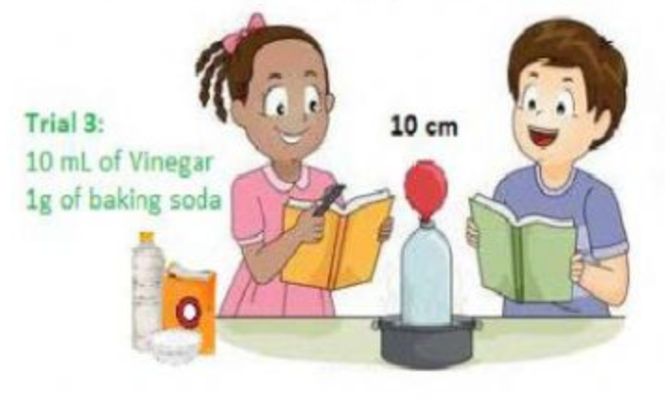
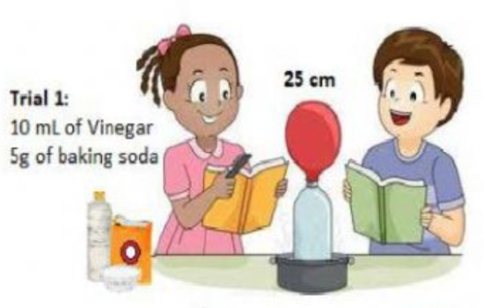
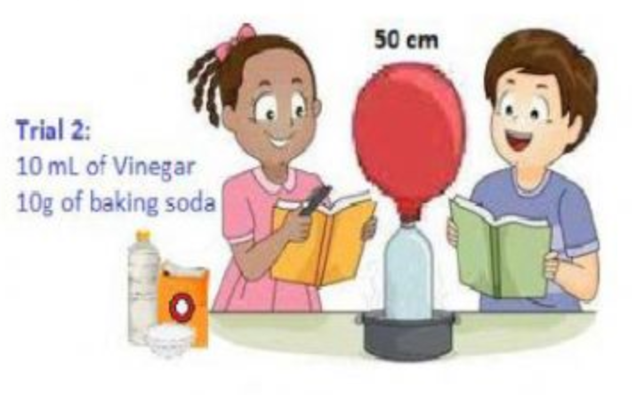
Fair test investigations
Notes:
Fair tests we are familiar with.
Here’s one example. What do you think they are trying to investigate?
What is the last fair test that you did?

Slide 4
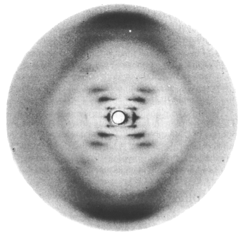
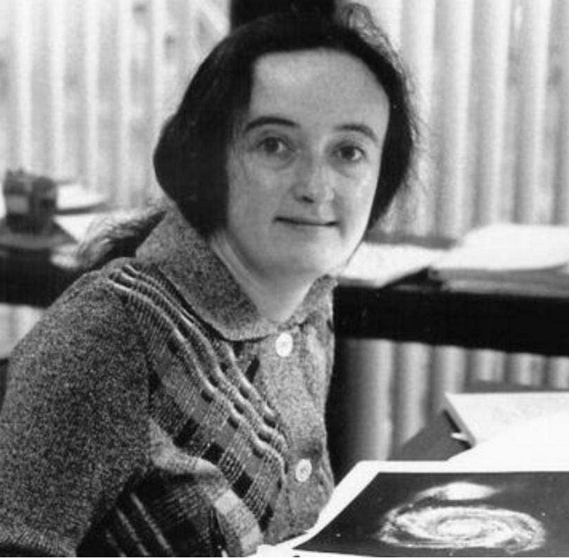
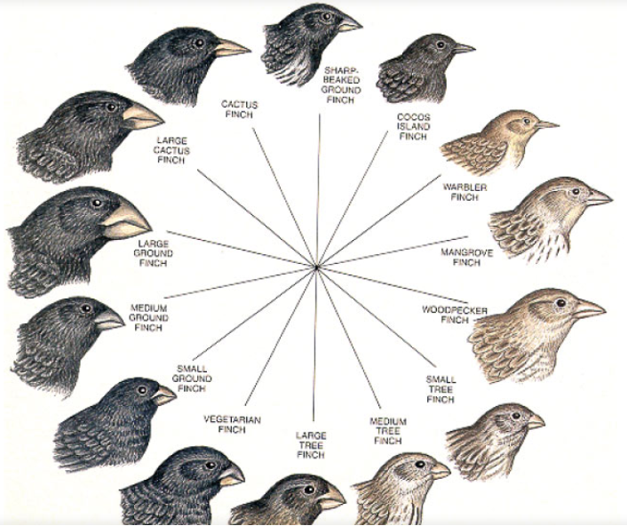
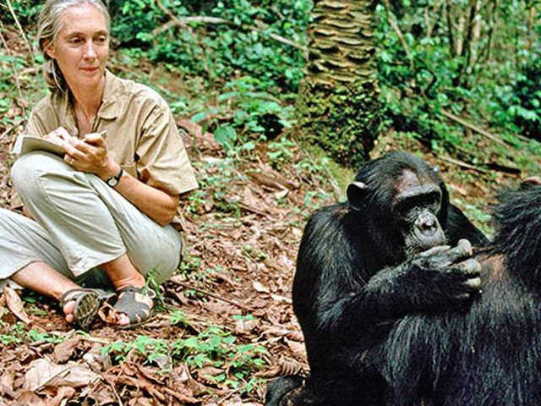
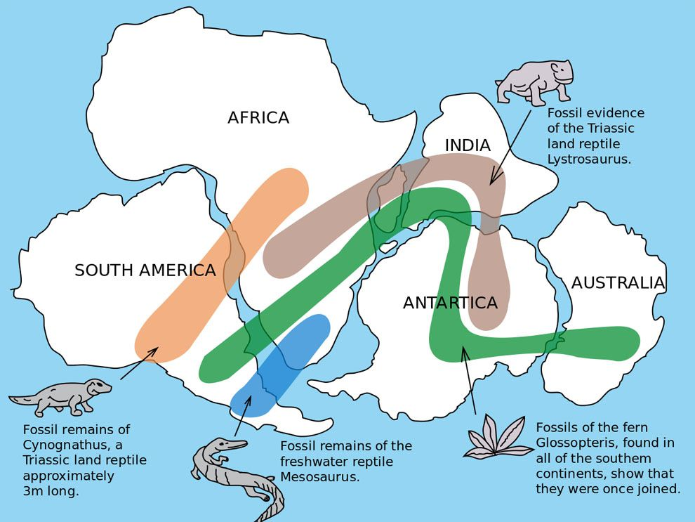
Not all scientists do fair tests
Geologist’s & astronomer’s investigations are based on looking for patterns in extensive observations
Other scientists such as Charles Darwin & Jane Goodall routinely used observational (qualitative) approaches
Notes:
So what patterns might an astronomer look for?
What patterns might a geologist look for?
What did Charles Darwin observe?
What did Jane Goodall observe?
Can students identify the images here?
Johannes Kepler 1571 – 1630 German astronomer, Best know for laws of planetary motion
Beatrice Tinsley 1941 – 1981 UKborn, NZ astronomer, cosmologist, prof of astronomy at Yale Uni, best known for Ug how galaxies evolve, grow and die.
Rosalind Franklin’s Xray crystallography pattern of DNA
Wegener’s evidence for Continental Drift
Jane Goodall
Darwin’s finches

Slide 5
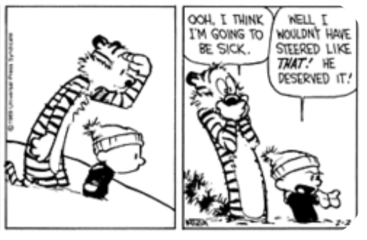
There is no such thing as “the” scientific method
State the aim
Observe & research
Form an hypothesis
Devise a method
Collect data
Analyse data
Draw conclusions
Notes:
Once we see that not all scientists do fair tests we start to see that different scientists experiment in different ways. There is no one scientific method that all scientists use.
So to talk a bout THE scientific method as if there was only one is misleading.
McComas 2014 – “it is a method, it works, but it is not THE method”

Slide 6
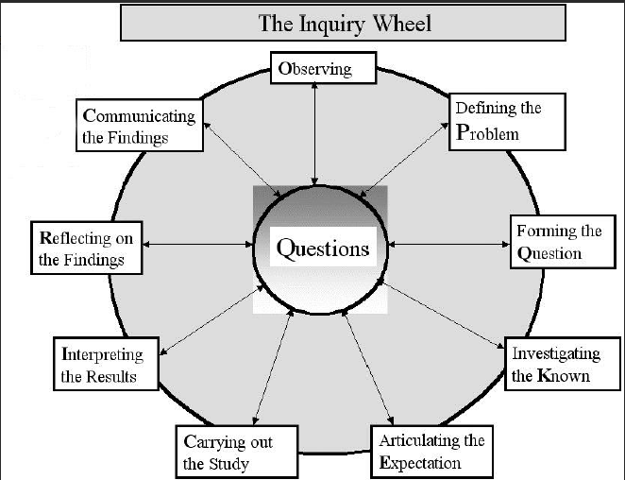
Notes:
Another way to think of the scientific method sees that there are lots of different spokes to the wheel. At the heart, all scientists seek to answer a question. But they way they go about it might be different. So scientists select the steps that work best for them, they choose the spokes on their wheel.
scientists share many common practices. They all
use careful & appropriate methods
record & accurately report data
rely on induction & deduction
But there is no single shared step-by-step scientific method
So lets look at some of the different methods

Slide 7
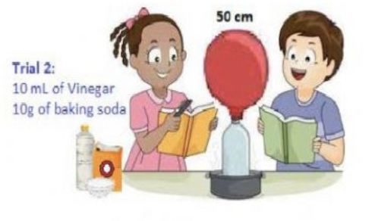
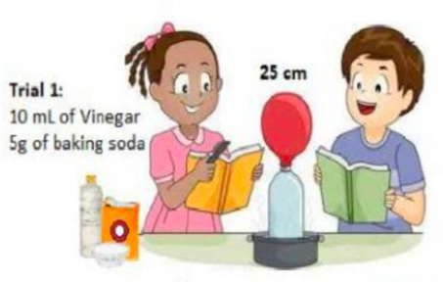
Fair testing investigations
An investigation where only one variable is changed while all others are kept the same (controlled), observing or measuring the effect on another variable
E.g.
Measuring strength of flax fibres
Other examples?
Notes:
Here is a fair test
Name a fair test that you have done, build a list on the board
So what are the general principles of a fair test? What do they all do?
[Change 1 variable to see its effect on another variable keeping everything else the same.]
Designed to show cause and effect
Add to the list of examples on the board
Yeast & balloon fair test image https://www.liveworksheets.com/yi1197401ov

Slide 8
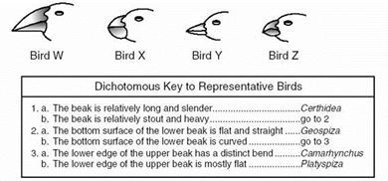
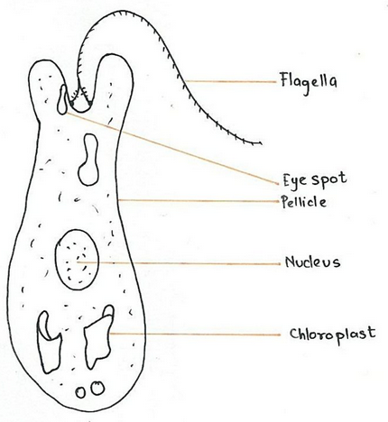
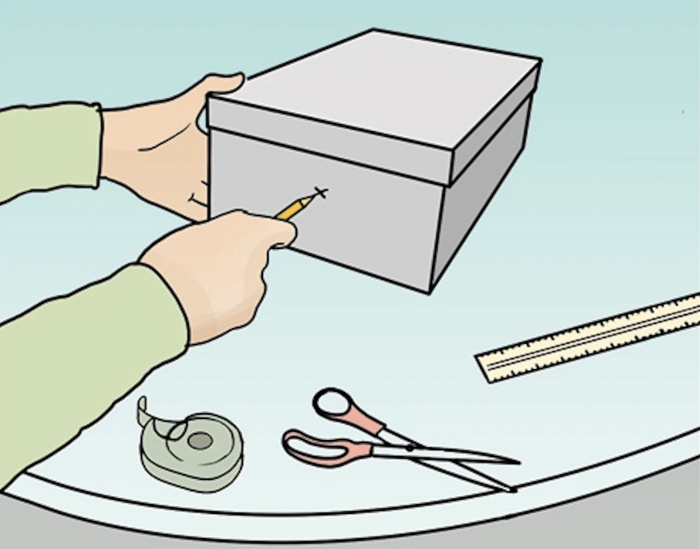
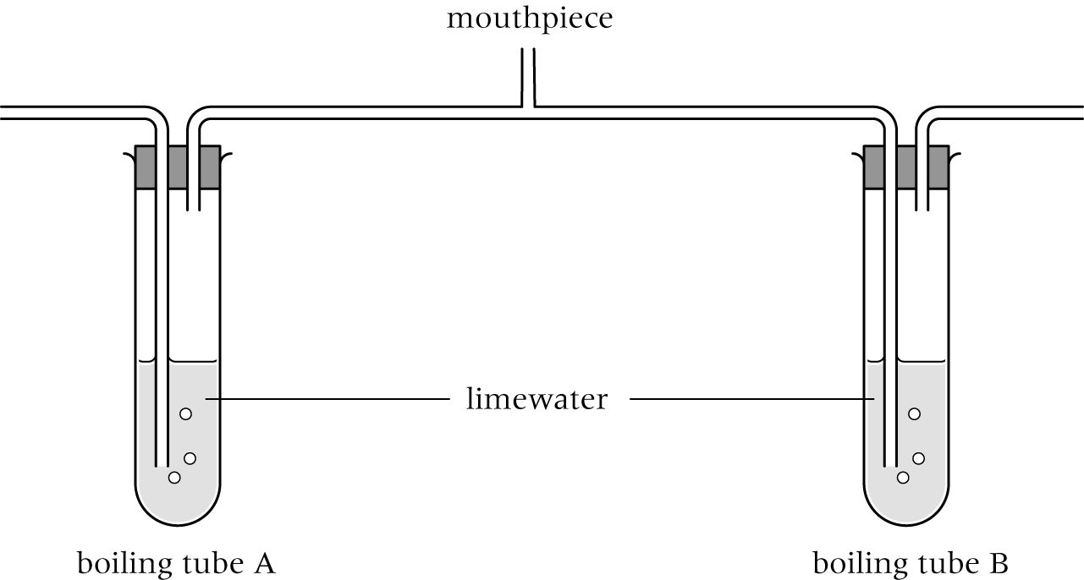
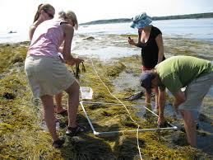
Other types of investigations
Modelling
Pattern-seeking investigations
Exploring
Classifying and identifying
Making things or developing systems
Notes:
There are other types of investigations that we will look at. Can you match the picture to the type? Don’t worry if not

Slide 9
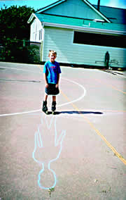
Pattern-Seeking Investigations
Find relationships between variables that can’t be controlled or manipulated to suggest causal links
E.g. field work – in geology, astronomy, ecology meteorology.
E.g. using data sets – in any science
E.g. Sampling activities eg zonation on shore or salinity levels upstream from estuary; Vitamin C or pH in fruit/veges; apparent movement of Mars in the night sky; movement of a fault-line across sedimentary beds; link between moon phase & fishing success.
Looking for patterns in data: average temperature at different latitudes; no. of C atoms vs melting point;
Notes:
We have talked about patterns in geology and astronomy.
What do we mean by the terms ecology and meteorology
What patterns might we see in ecology?
What patterns might we see in meteorology?
What questions might scientists be trying to answer when they
Sample cats eyes on the rocky shore?
Sample salinity in a stream (check they understand salinity)?
Observe the movement of Mars in the night sky?
Observe a faultline across multiple beds of sedimentary rock?
Record moon phase and numbers of fish caught?
Can you think back to experiments you have done (or look at the list on the board). When did you do a pattern-seeking investigation? Try to add to the list
Discuss chromatography, if you have done it, how does it fit here?
Add to the list of examples on the board

Slide 10
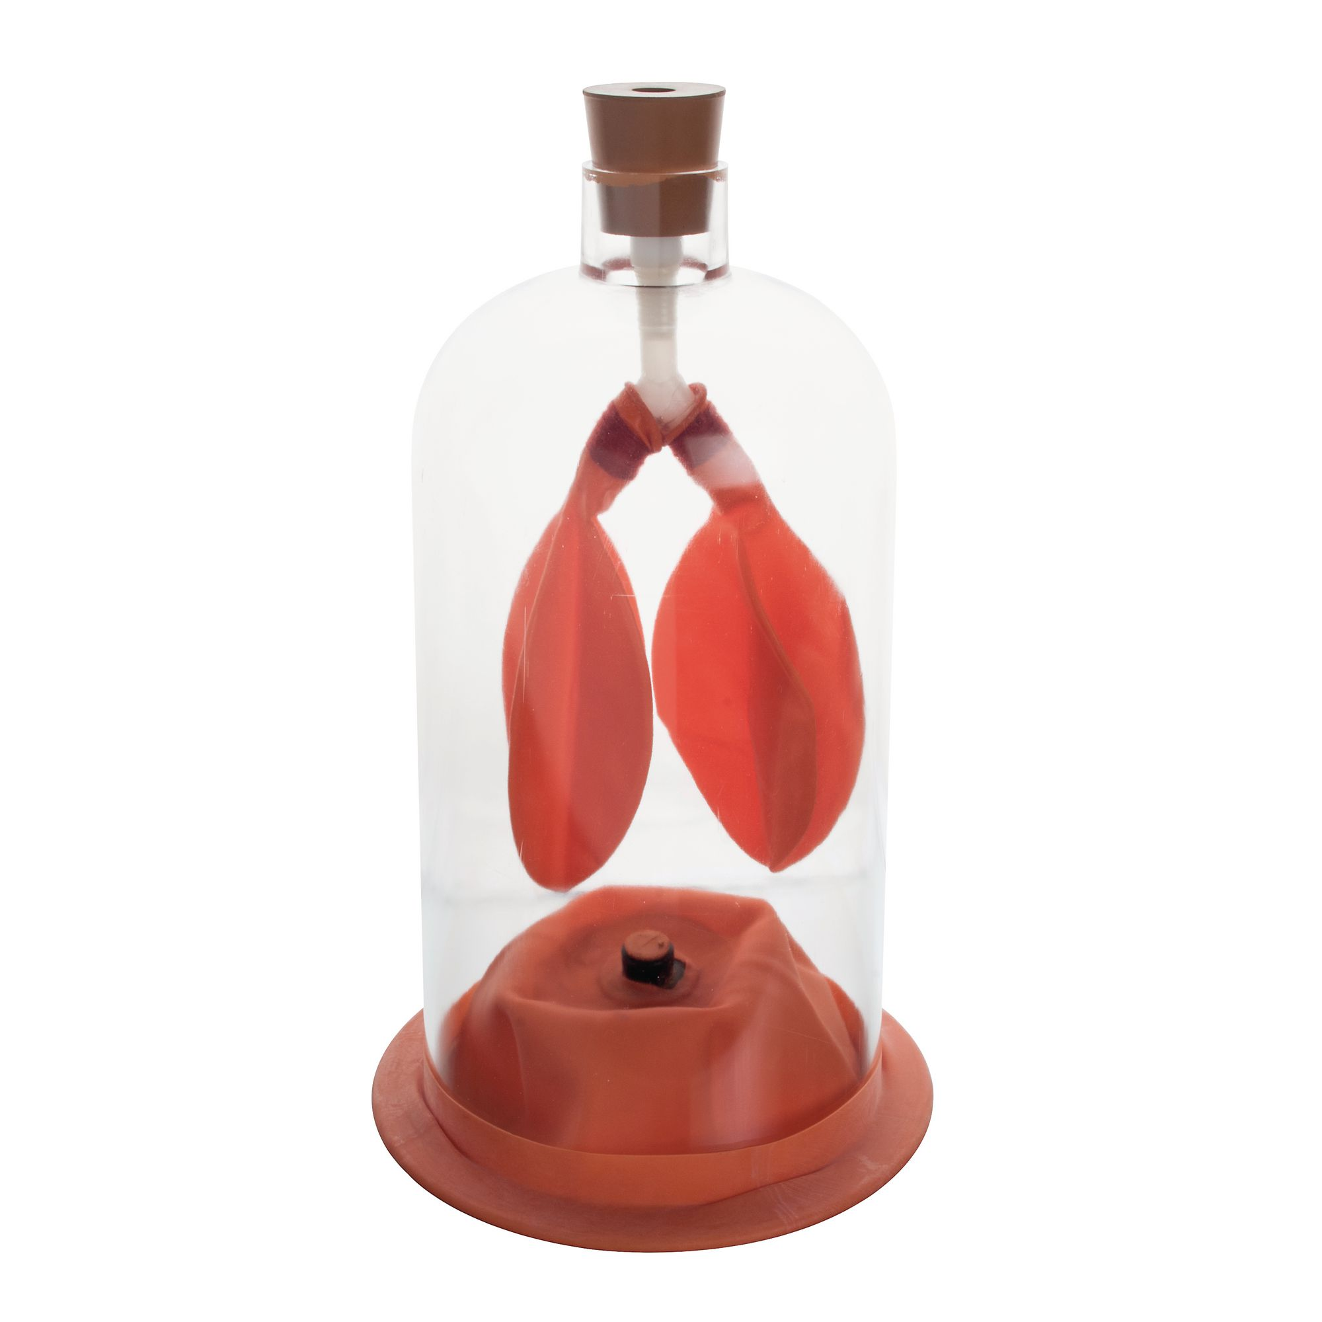
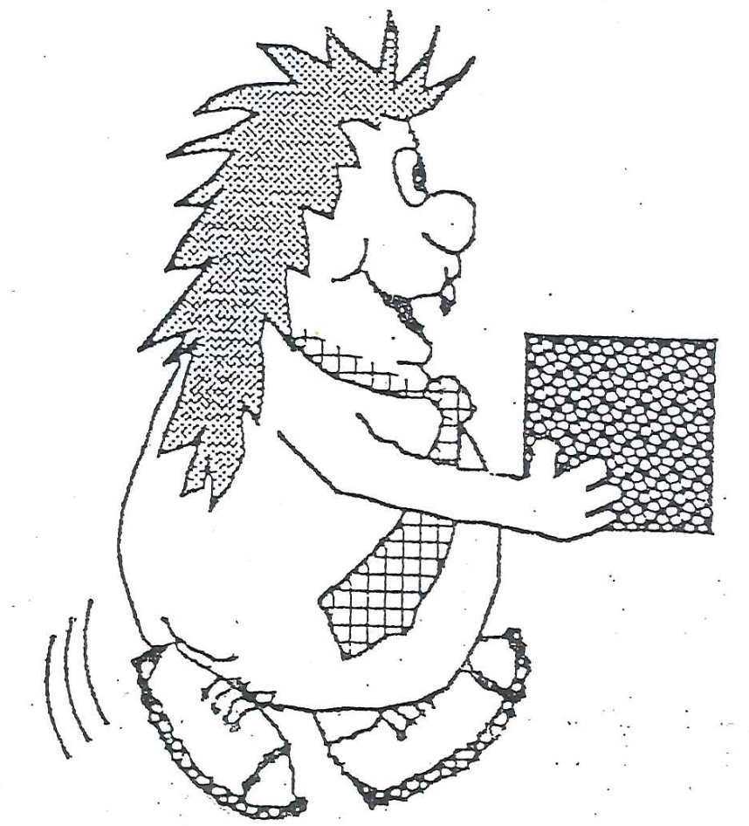
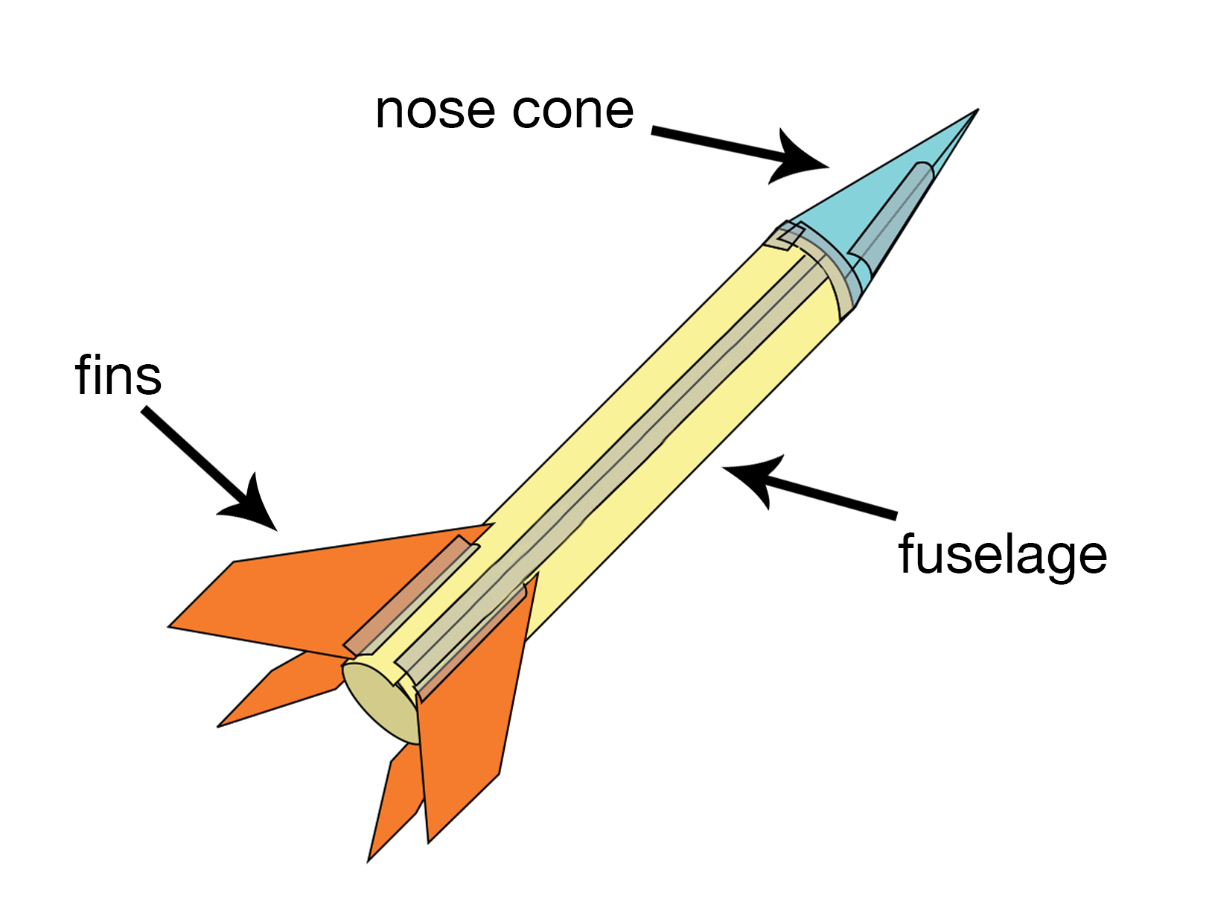
Modelling investigations
A model is a visual representation of a science idea - digital, diagrammatic, physical, or imaginary
E.g. Current (munchkins, water flow); atom; states of matter (beads on speaker); bell-jar lung model; weather map; planet distances
Students can
Make a model
Discuss the uses and limitations of the model
Explore the effect of changing a part of the model – this is the investigation
L1 modelling investigations must collect data / observations
observing effect of a disinfectant on an agar plate full of bacteria
collecting data from a PhET investigation
comparing the temperature of a beaker of hot water in an insulated cardboard ‘house’ with an uninsulated one
testing different model waka in water – hull shape, sail shape
Notes:
Middle image, Munchkins, visualizes current carrying voltage
Can students give an example of visual representations of a science idea?
Think about the top image. Do students know what it is a model of (breathing)? What happens when the rubber cap is pulled down (balloons inflate)? Why? How does it represent the real thing (lungs fill with air when diaphragm descends)? What part does it not represent well (movement of ribcage). How might you change a part of this model to see its effect?
Ask the same questions of the bottom image?
What other models might students have made or used?
You may want to give students exposure to a PhET simulation
Add to the list of examples on the board

Slide 11
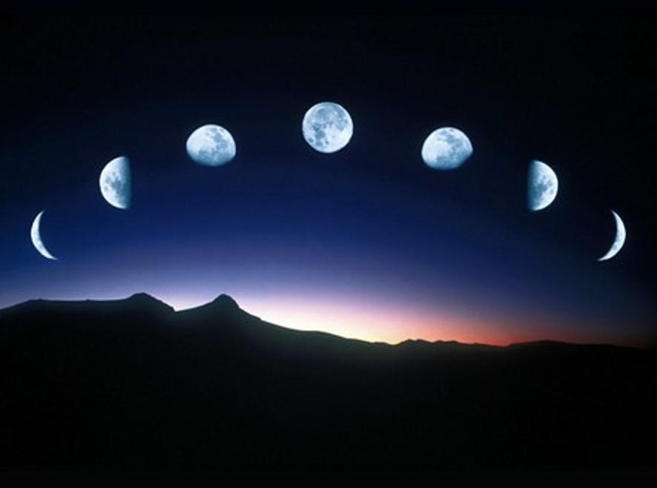
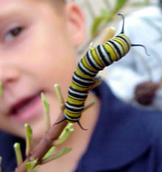
Exploring investigations
Record careful observations of events or objects
May look for changes in 1 variable over time
Eg change in moon shape over a month; life history of a monarch butterfly,
Often includes visual image – a labelled drawing or photograph eg microscopic observations
For example
Observing the outside of a glass of water water cooling
Comparing adult and juvenile forms of a native plant
Observing a single-celled organism like Euglena feeding
Observe the effect of thick/thin lenses & mirrors on light rays
Observe precipitation reactions
Notes:
Can you think of other examples?
Add to the list of examples on the board

Slide 12
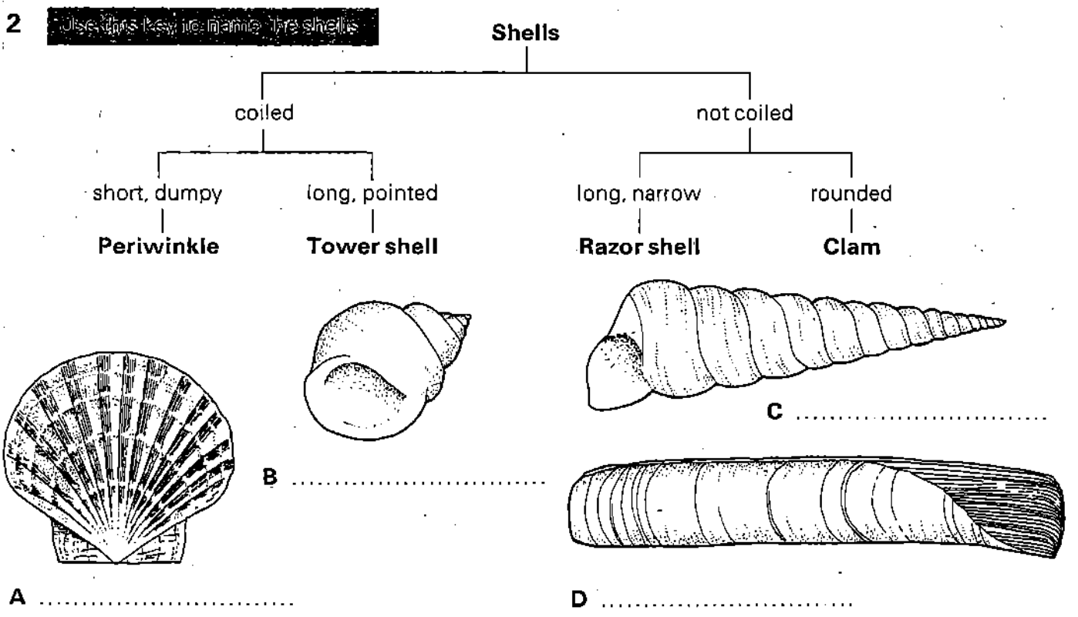
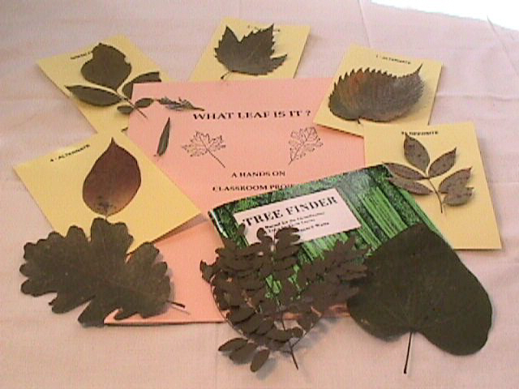
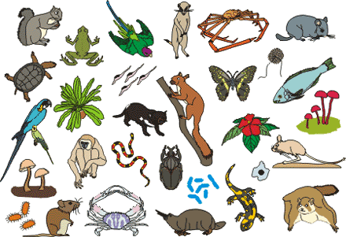
Classifying & identifying investigations
Classify = arrange into groups
Identify = find the group a thing belongs to, naming it.
Students may need to explore/observe before classifying
Use a key – Refine a key – Design a key?
This approach can be used in the study of leaves, rocks, invertebrates, metals, molecules …
E.g.
Identify type of molecule modelled by molymod
Identify the acids and bases in a set of unknowns
Develop a way of identifying common whelks
Classify macroinvertebrates seen in a stream
Notes:
Classifying is a process of arranging things into groups. Eg take these leaves and sort them into groups
Identifying is a process of recognising things as members of particular group, and allocating names to them. E.g. using a key to find out the name of the leaves
We often use keys to help?
When have you had to classify and identify anything in science?
Add to the list of examples on the board

Slide 13
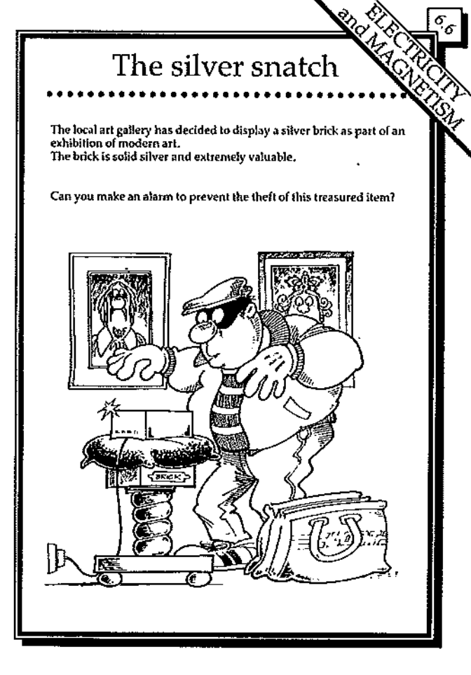
Investigate by making things or developing systems
Design an artefact or system to meet a need
Eg
make a lizard-friendly habitat
BP Technology Challenges
make flax baskets for a hangi
design a system to show a series of energy changes
Notes:
Image: Silver snatch BP Technology challenge
Pin-hole camera
BP technology challenges may be in the science staff librray – a series of A4 paperback booklets
When have students had to make things or develop systems in science
Add to the list of examples on the board

Slide 14
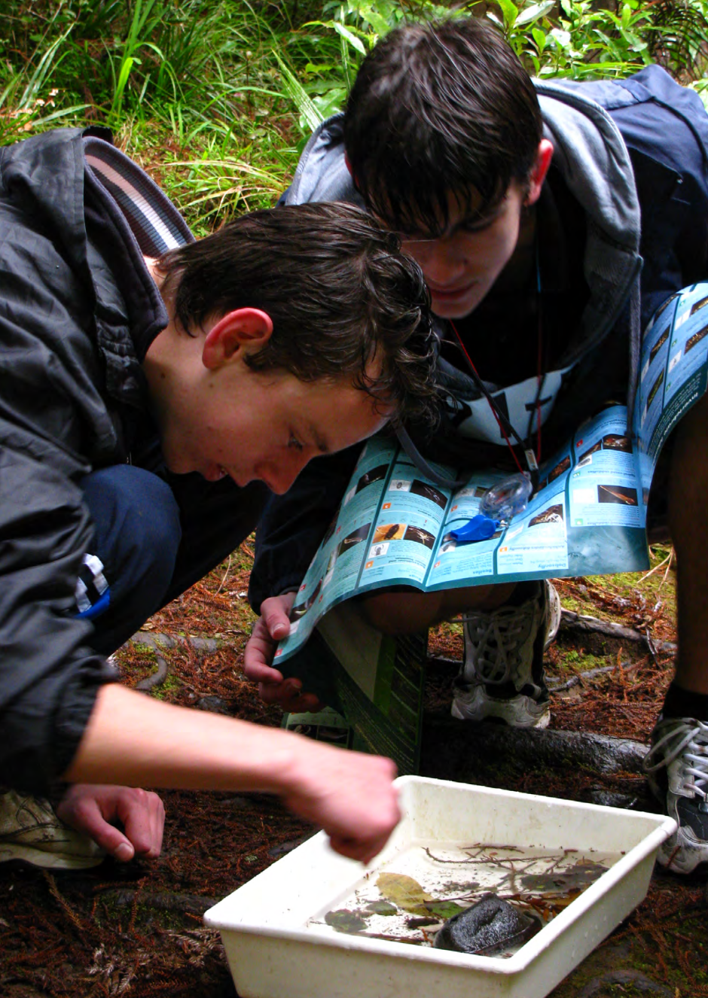
Multiple approaches in 1 activity
Forest study
Key of plants – native vs non native
Transect lines – pattern-seeking investigation
Comparison of two stream sites
Key to identify organisms
Explore - draw organisms with labels
Pattern-seeking investigation
Geological study
Explore & observe rocks present
Classify rocks
Look for a pattern in strata or landforms
Notes:
This can work well in field investigations, local place-based activities
Field work can be taken over several chunked time periods – as can all investigations.
Initially observe - Later collect samples - Look for patterns
Have students any experiences of joining investigations together like this?
Now we will look at some places that may help us

Slide 15
Let’s try some
Science Learning Hub
Education Perfect Investigations
ARBs: https://arbs.nzcer.org.nz
Science online tki https://scienceonline.tki.org.nz
PhET simulations
UK’s STEM Learning
Notes:
SLH useful resources
Video and article about scientists using different investigation types including in a te ao Māori context
https://www.sciencelearn.org.nz/image_maps/111-ways-of-investigating-in-science
And https://www.sciencelearn.org.nz/resources/418-the-investigating-in-science-strand
Education Perfect: As well as paid revision resources those under Science Alive Mātauranga are free.
Join this EP platform for free here. https://hsl.educationperfect.com/science-alive-matauranga-registration
Then go to cross curricular resources and look for science alive mātauranga and look under te taio. Several different investigations there
PhET https://phet.colorado.edu/en/simulations/filter
STEM UK is free to join. Then go here https://www.stem.org.uk/elibrary/resource/28910 The Beyond Fair Testing pack is a set of prac inv of diff types

Slide 16
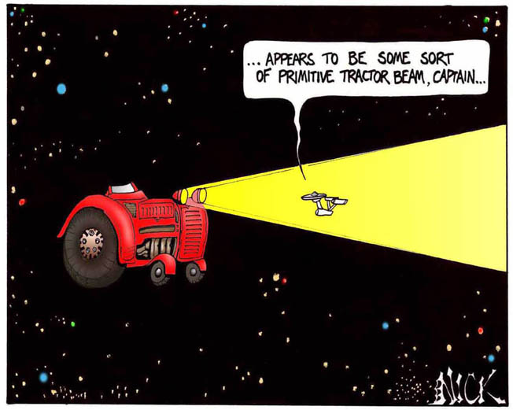
Do we recognise them?
From what direction does the wind tend to come at my school?
How can I test an explanation of how pollen travels from flower to flower?
How can I find the best method to separate Raro crystals from sand and shells?
How can I find the name of common spiders in my home?
How does the appearance and location of comet change over several days?
Which native plant extract has the strongest effect on E coli bacteria?
Classifying & identifying
Exploring
Fair testing
Modelling
Making things &
developing systems
Pattern seeking
Notes:
Wind – pattern seeking
Pollen – modelling, fair test
Separation - make things, develop systems
Spiders – classify and identify
Comet – exploring
Rocket – fair test
What quantities of baking soda and vinegar make the rocket go the furthest?
In whakawhanaungata, who had done an expt other than a fair test????

Slide 17
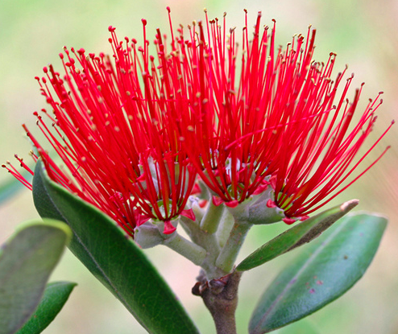
The End
Notes:
Option of support with these issues?

Slide 19
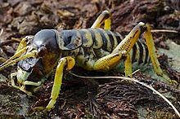
Education Perfect Investigations
https://www.educationperfect.com join up for free
→ Science Alive Mātauranga → Te Taiao Investigations
Bioplastic: Eco-friendly with Hangarua (make a bioplastic, adapt recipe)
Growing from a seed: Te Kākano (best soil for growing beans)
Living between the tides: Te Ara o Hinekirikiri (observe where different organisms grow on the shore)
Pests or pals: Tiro ma riha rāwaho (identify and count insects)
Powered by the sun: Tamanuiterā (make a solar oven)
Strata: Layers of history in Papatūānuku (observe strata locally)
Student resources and teacher guide for each
Notes:
As well as paid revision resources the SAM are free.
Join this EP platform for free here. https://hsl.educationperfect.com/science-alive-matauranga-registration
Then go to cross curricular resources and look for science alive mātauranga and look under te taio. Several different investigations there
Weta image: https://en.wikipedia.org/wiki/Hemideina_maori
Other sources
Science capabilities: https://scienceonline.tki.org.nz/Science-capabilities-for-citizenship/Science-capabilities-resources/Search-resources?SearchText=&Capability=all&NOS=Investigating+in+science&Strand=all&Level=all&SearchButton=]
ARBs: https://arbs.nzcer.org.nz
Scienced online tki https://scienceonline.tki.org.nz
SLH: https://www.sciencelearn.org.nz/resources/418-the-investigating-in-science-strand
We did talk about these, but quickly

Slide 20
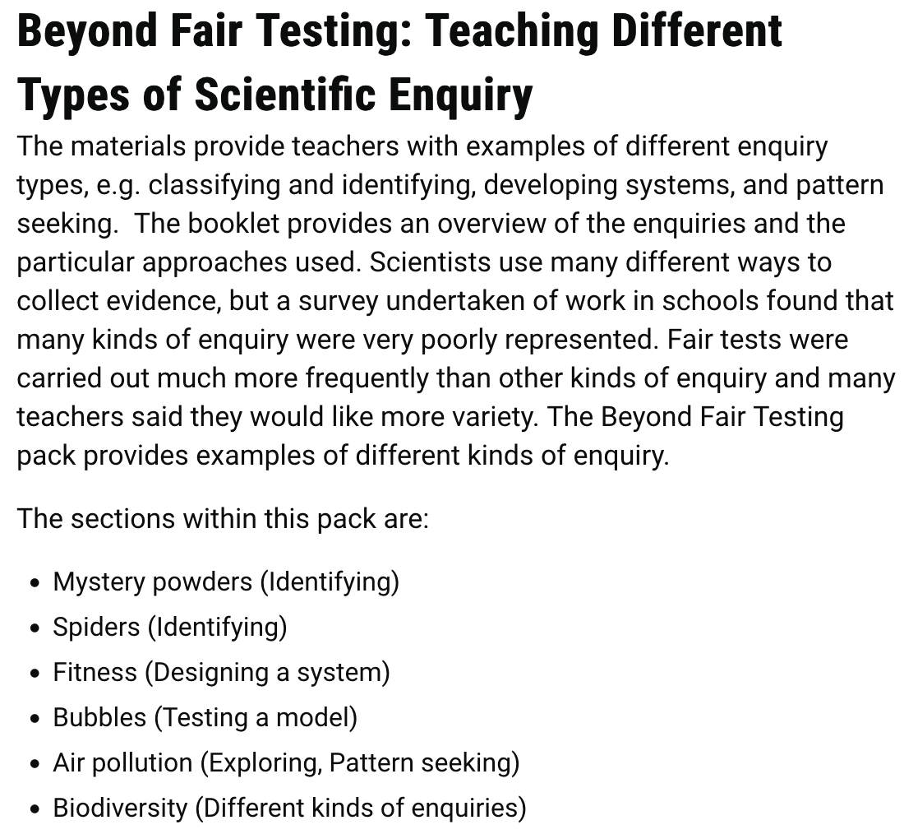
https://www.stem.org.uk/elibrary/resource/28910
UK – PLD, resources
Free to join
Lesson plans, handouts
Notes:
LI: A (used to be uoa) PW: full ma (used to be halfma)

