Slide 1
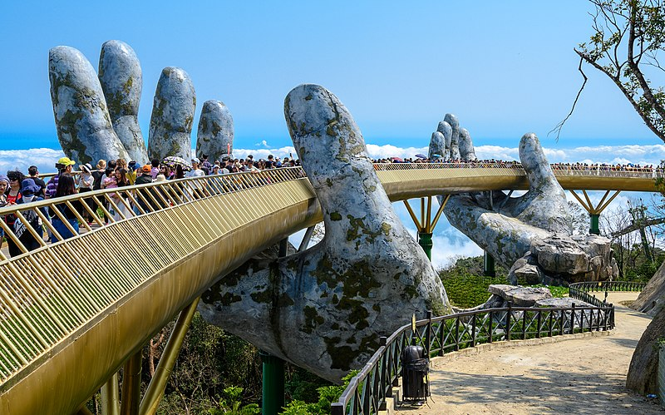
Support
NZASE’s resources – from L1 Science pilot (April) and 4 planned units (Nov)
Science Learning Hub
NZASE’s 4 webinars of teachers from pilot schools talking about the L1 Science stds https://nzase.org.nz/nzase-network-expertise/
Ange Whitlam’s Google Drive folder where teachers share resources for the new L1 stds. angela.whitlam@waimea.school.nz
BEANZ, ESSE, NZIP, SCENZ, HATA – PLD, resources
L1 SciPADs for new L1 stds
My weekly newsletter of bullet points https://www.mikesnews.co.nz/
NZASE newsletter https://nzase.org.nz/
NCEA Implementation Facilitators, Science first.last@education.govt.nz
Rachel Chisnall, Sci/Ch, Dunedin
Nicola Foote, Sci/ESS, Hamilton
Paula Calver, Sci/Px, Auckland
Linda Haycock, Sci/Bi, Auckland
Notes:
NZASE resources from L1 pilots and planned units both available at https://nzase.org.nz/nzase-network-expertise/
SLH https://www.sciencelearn.org.nz/
Webinars
S1.1 Science-informed response to a local socio-scientific issue https://youtu.be/GSsam_Hksnw
S1.2 Scientific investigative approaches https://youtu.be/xtwooIEBjiI
S1.3 Development of a scientific idea https://www.youtube.com/watch?v=-zC35OOURFg&t=0s
S1.4 Validation of science claims https://youtu.be/MXVBm2-pj54
Resources for L1 Chem/Bio and Physics/Earth Science are the responsibility of other subject associations (& found on their websites).
SCENZ has teaching outlines and resources for CB 1.2 & 1.4 available for anyone. Assessment tasks will be for members only.
ESSE has unit examples in process, expect something in early December
HATA has been running PLD on L1 for AgHort teachers and additional resources will be released early December under members-only resources.
Some BEANZ regional workshops explored resources for microbes. Genetics resources are in development
NZIP has made some videos (https://www.youtube.com/@newzealandinstituteofphysi5806) and sample assessment tasks (subscribers only) about energy for PES 1.4. They are seeking teachers interested in developing more resources, apply here by Nov 30 (link to https://forms.office.com/r/Xf0XrxU5wU)

