Slide 1
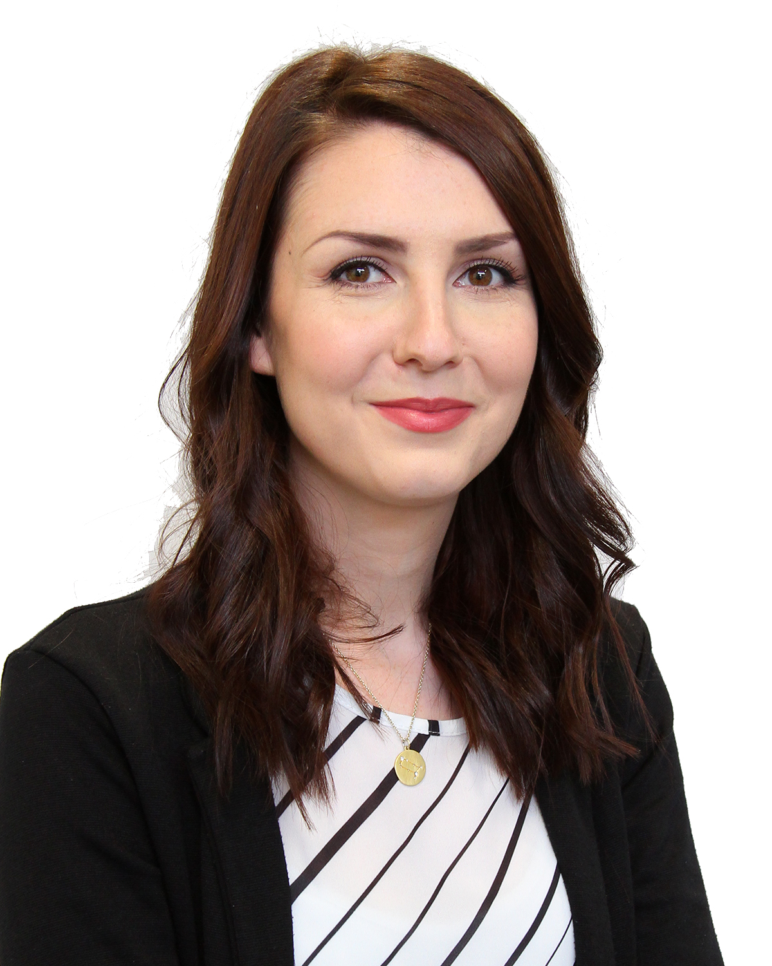
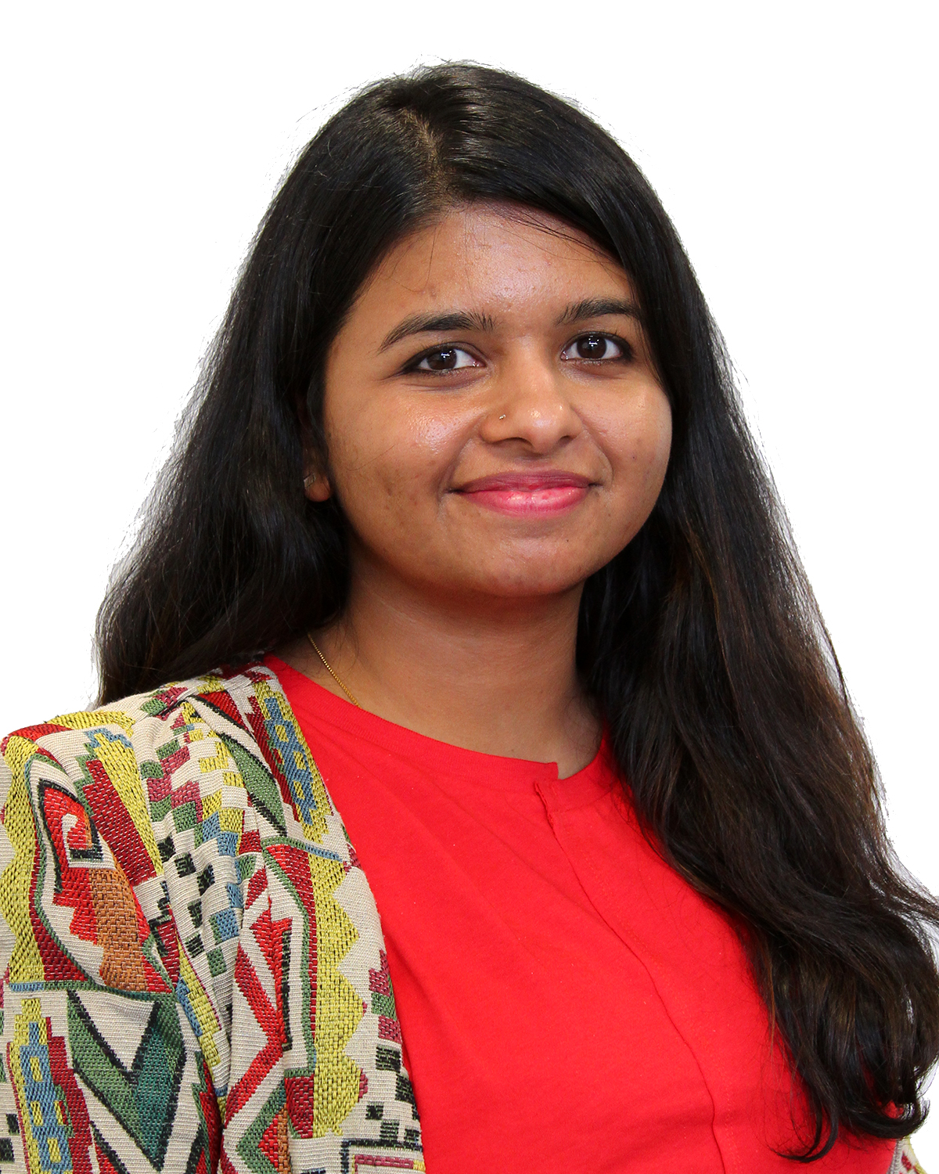
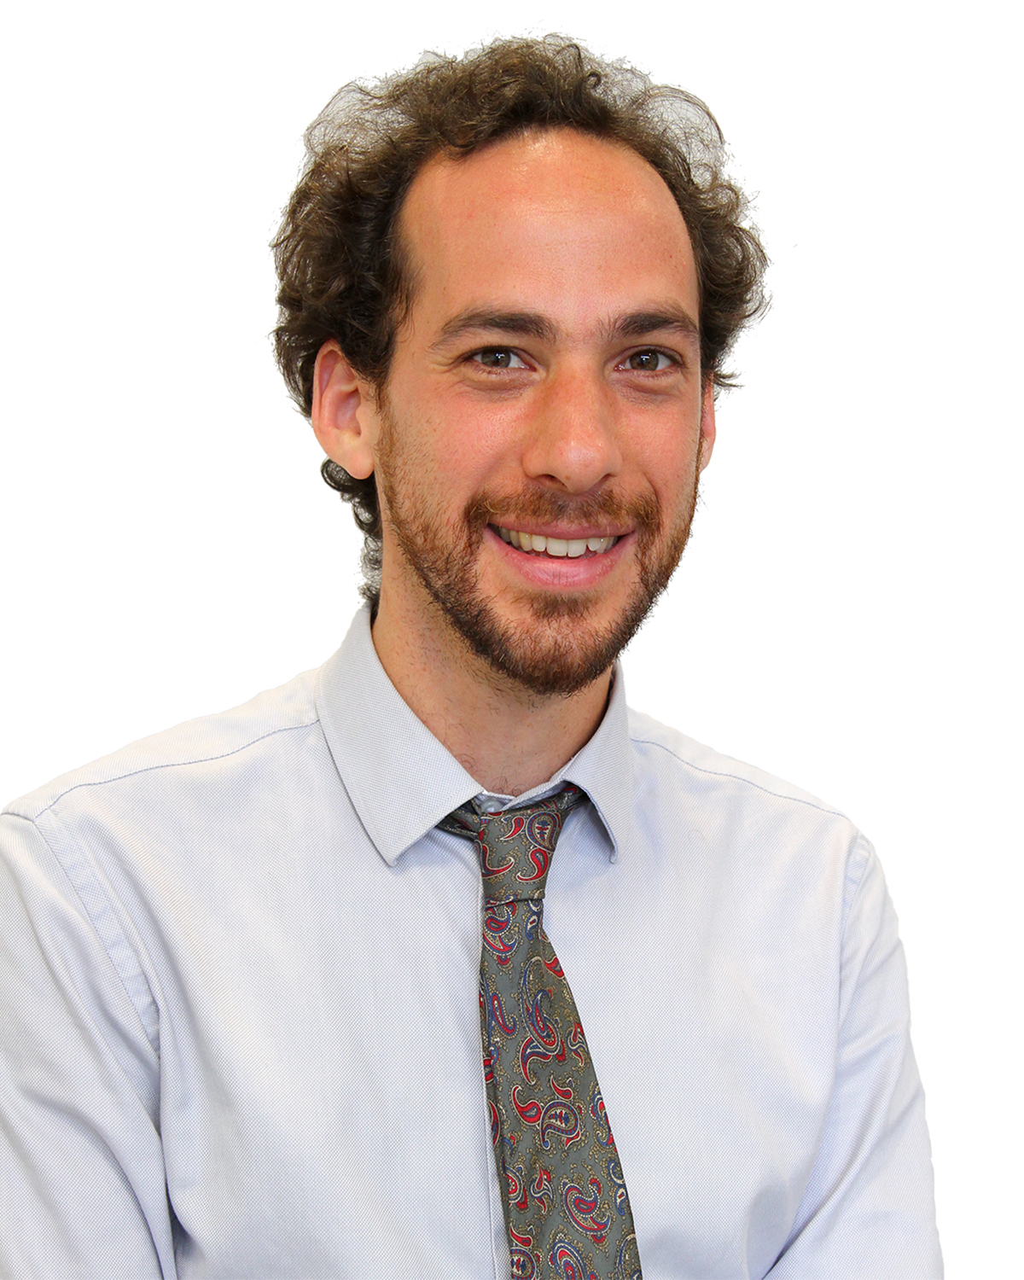
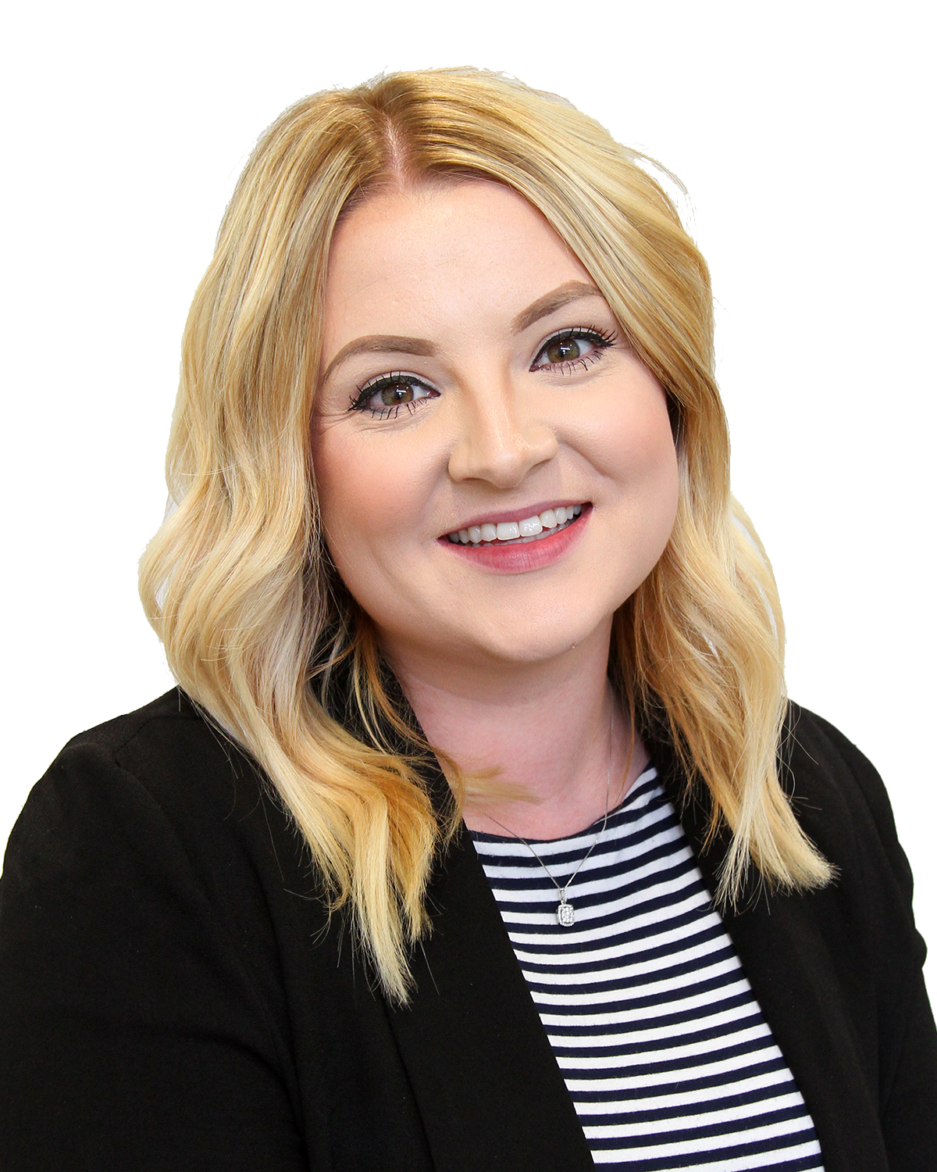
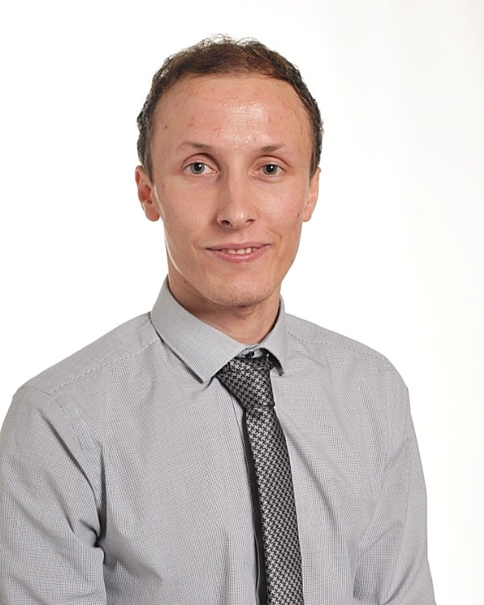
Top Tips from previous new staff!
Hannah Winter, Technology
Be organised! Leave your room set up and ready for the next day so that you are completely prepared when you come in the next morning.
Teaching is what you make of it – so make the most of all the amazing lessons you will have and don’t dwell on the bad ones!
Gayathri Sanal, Maths
Try to do marking during the week to have a free weekend.
Always ask to have staff to come in observe you if there is a problematic class.
It’s ok to ask for help!
Do your printing in the evening to escape the morning printing queue.
Martin Berger, Music
Don’t forget the staff room! Enjoy the time socializing with colleagues and sharing experiences, make new friends!
But also: don’t disregard the time you can spend with the pupils (like extracurricular activities, or simply opening your room at lunch or break times to help students with homework). It’s an excellent opportunity to help you know your students and let them know you. You’d be surprised on the huge impact that it has on creating relationships with your students, and contributing to a better classroom climate…
Grace Fenton, Science
Make a spread sheet of the date when you mark a set of books, so you can see what date they are due again. I did it for all my classes so I could see which books were due that week.
Also get the pupils to do as much as possible, for example adding up their own test scores, cleaning up the classroom and marking their own work when appropriate.
Tom Fraser, English
Talk to people if you’re having issues or concerns, staff are happy to listen and advise if they can. Also, talk to people to celebrate what went well!
Notes:
https://drive.google.com/file/d/1A5q0MJasLsnK6tsdBcy-xJDq3bo9wZrE/view

Slide 2
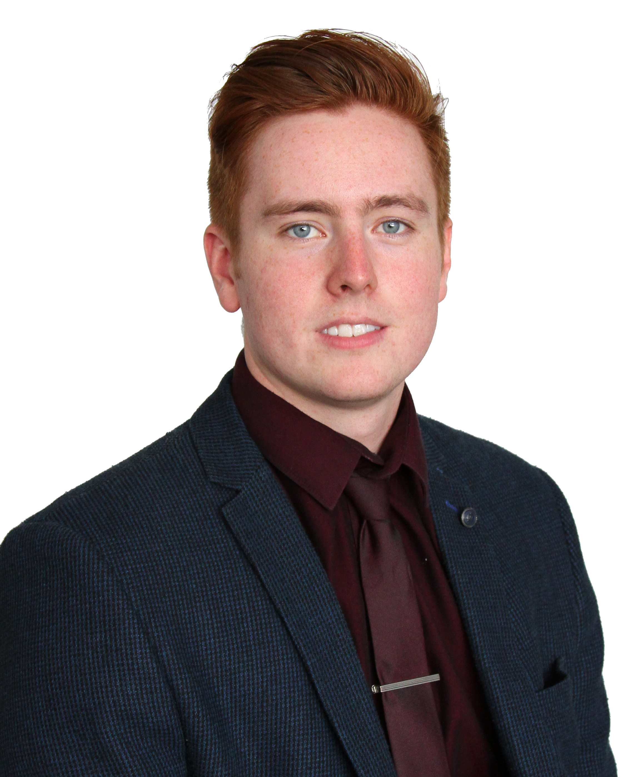
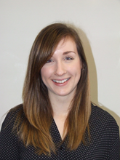
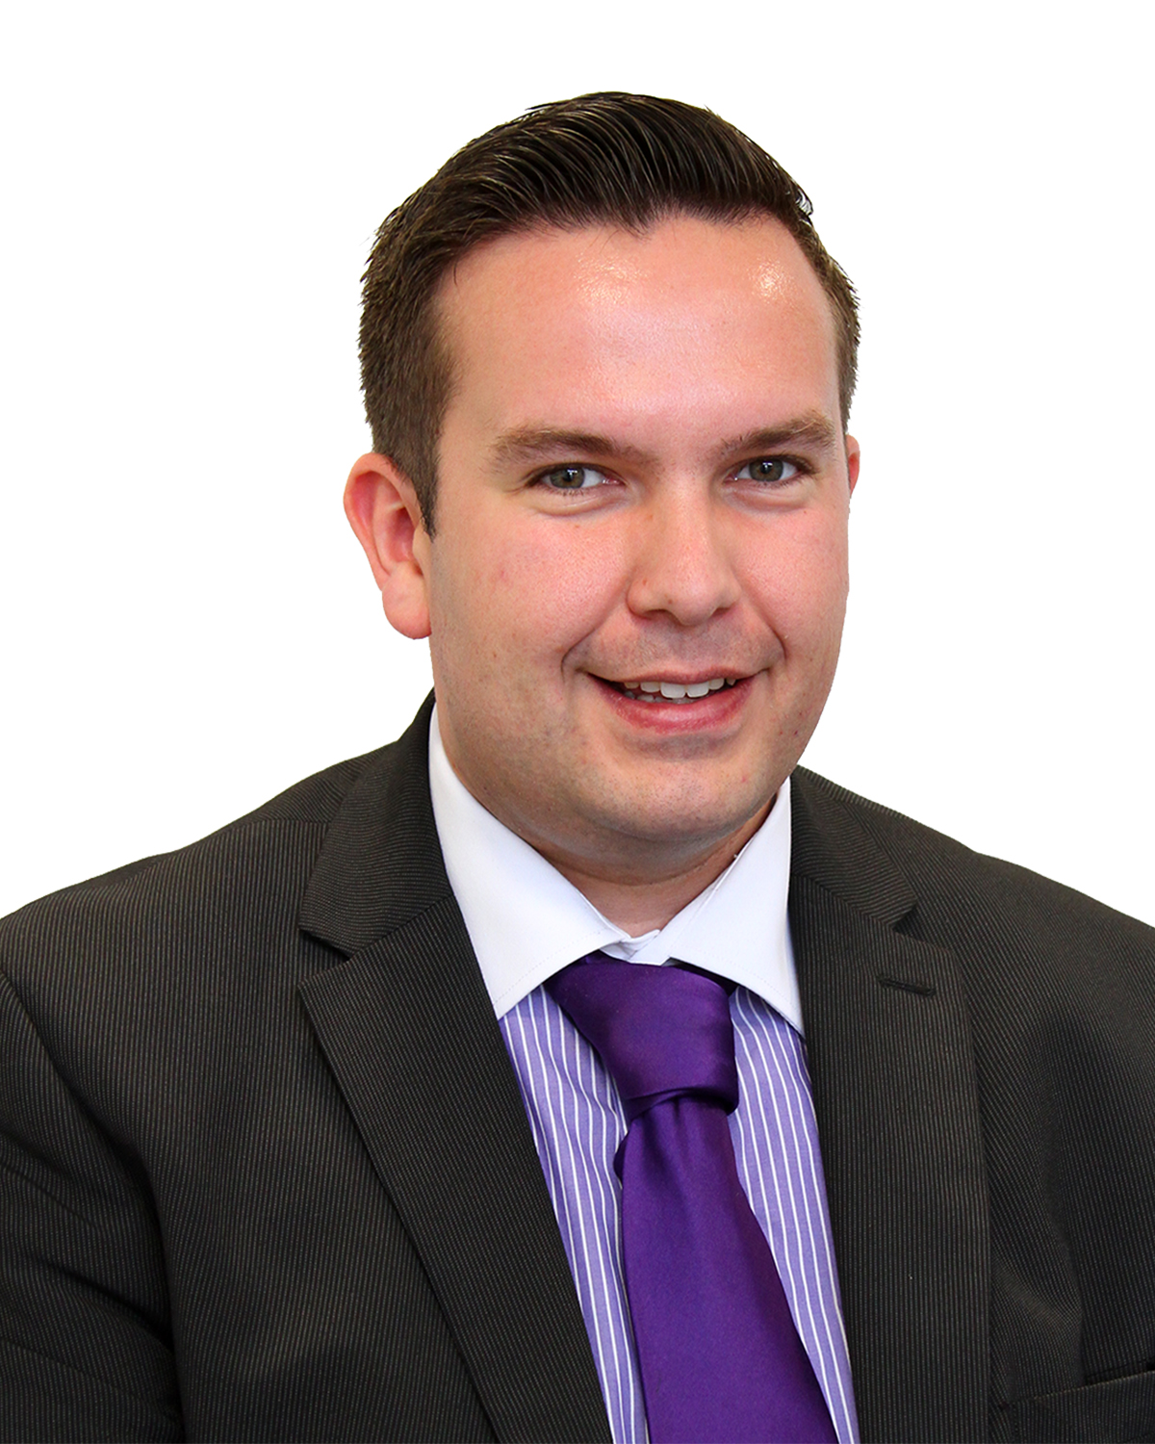
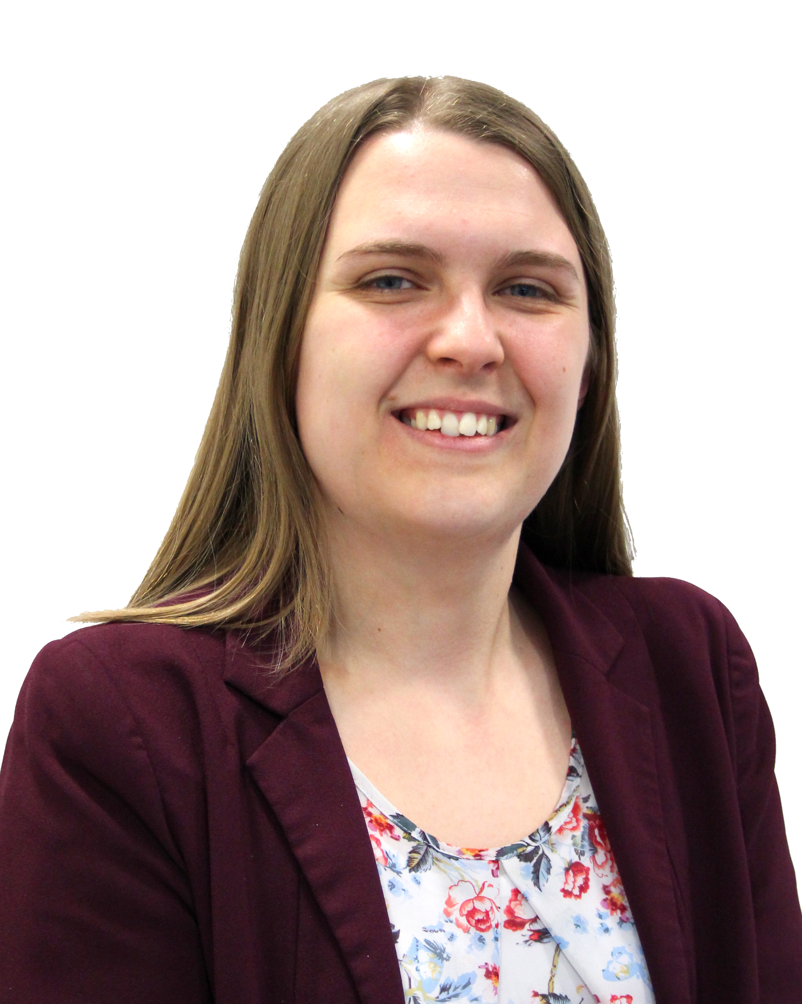

James Smith, Science
Get involved in something outside of your department (detention duty in my case). As a new member of staff it made my presence more known to pupils that I don’t teach, it also meant that I learned the names of other staff quite quickly too.
Catherine Snowball, Drama
Go to all the PLD you can, As a newly qualified teacher you are left to your own devices in the classroom much more and PLD is a great way to refresh your toolkit. It is also a fantastic opportunity to discuss techniques with other teachers which can provide new insights into your own teaching style.
Ben Latham, English
Enjoy every moment in the classroom. Even if you are having one of 'those days,' just remember that every thing you are doing has a positive impact on our young people.
Amy Norman, History
Get to know the students and their names as quickly as you can. The students really like it when staff show an interest in their lives.
Be clear and consistent with the expectations you give. If not, students will take advantage!
Ask the staff in your department if you have any questions/ anything you are not sure about. They are very helpful and will always be willing to go through anything with you.
Shaun Day, Maths
Use all non-contact time wisely. Get out and see other members of staff teach (obviously with permission, don’t just rock up unexpected!). You’ll get all sorts of amazing ideas. Reflect on the positives, don’t get bogged down in (or around) negativity.

