Slide 1
Why study Biology?
Notes:
A collection of ideas to kick off a biology course from Mike Stone.
Sources:
Tki https://seniorsecondary.tki.org.nz/Science/Rationale/Why-study-biology
Britannica https://www.britannica.com/question/Why-is-biology-important
US uni https://www.northcentralcollege.edu/news/2021/11/12/why-study-biology-why-biology-important
Bio explorer https://www.bioexplorer.net/importance-of-biology.html/
Allen overseas https://www.allenoverseas.com/blog/biology-in-daily-life-uses-importance-and-facts/
Scientific World https://www.scientificworldinfo.com/2022/09/why-study-biology-the-importance-of-biology.html

Slide 2
What is Biology?
Write your own definition of biology. Share to come up with a class definition
What are the different sorts of things scientists might study in biology?
Why do you want to study biology?
Notes:
Address these 1 at a time
Encourage students to give their own ideas rather than just looking it up.
Students answering in groups is less threatening to those who do not feel confident
Then share group findings with the class or think pair share.
If students come up up with a wide variety for the 3rd question you may not even need to use the rest of the ppt.
Alane Lim, writing on LiveScience, says: “Biology is the study of life. In general, biologists study the structure, function, growth, origin, evolution, and distribution of living organisms.” What’s missing?
Some fields of study
Cellular Biology – Microbiology, cytology and Molecular biology
Medicine – anatomy & physiology
Marine biology
Botany, zoology, mycology
Genetics and Evolutionary biology
Ecology and Environmental biology

Slide 3
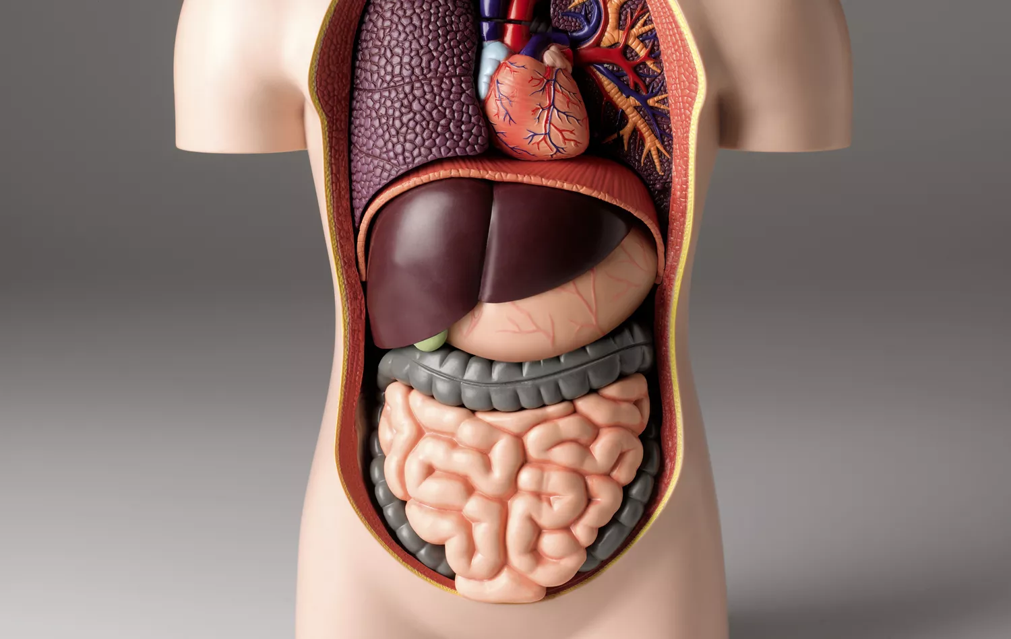
Why study biology? 1. to better understand our body
Notes:
interpret changes in the human body
develop new medicines and treatments
For how many is this the main reason they are studying biology this year?

Slide 4
Why study biology? 2. to help us grow our food
Notes:
Imp for NZ as an agricultural and horticultural country
For how many is this the main reason they are studying biology this year?

Slide 5
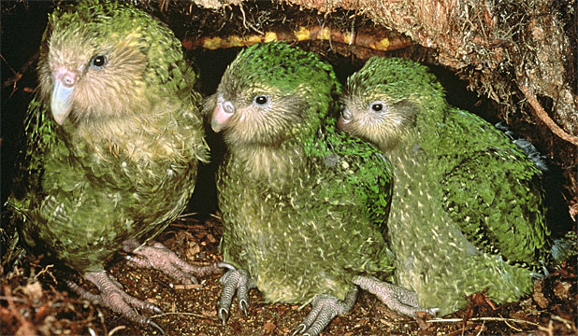
Why study biology? 3. to understand & preserve biodiversity
Notes:
interconnectedness of living things
significance of NZ’s unique fauna and flora and distinctive ecosystems.
NZ is at the forefront of conservation research
For how many is this the main reason they are studying biology this year?

Slide 6
Why study biology? 4. to give us insight into the past & help shape the future
Notes:
Genetics and evolution
For how many is this the main reason they are studying biology this year?

Slide 7
Why study biology? 5. biology is at the heart of many social & economic issues
Notes:
What other issues have bio at their heart?
For how many is this the main reason they are studying biology this year?
Can you think of any other places where biology is important / reasons why study bio?

Slide 8
Biology provides many careers
Look at a list of some careers in biology
Choose one.
Find out about it. E.g. https://www.careers.govt.nz
Summarise what the job entails for a PowerPoint slide.
Put the slides together and go through them
Notes:
List as a poster
e.g. https://www.prospects.ac.uk/careers-advice/what-can-i-do-with-my-degree/biology
https://millthorpeschool.co.uk/careers-resources/
May want to discuss the things we want to find out for the ppt slide to give some uniformity to the slides
Time limit – 15 mins?
The image used here is a science image so also has chem & phys and Earthsci careers.

