Slide 1
Explore & Observe
Using your senses to notice and record what is happening
Used For
General understanding
Identifying the big picture
Discovering new information
Describe what is happening
Questions
What happens when … ?
What happens to … when …?
How does … change?
What happens to … over time?
What is … ?
What does … look like?
Types of Data
Observations
Diagrams
Images
Descriptions
Tables
Tally Chart

Slide 2
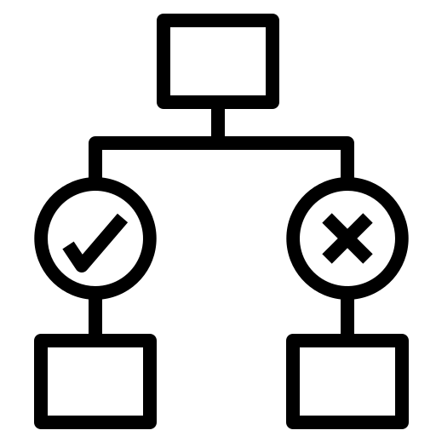
Identify & Classify
Using systems/criteria to sort objects or events into groups or categories
Used For
Describing, comparing, and contrasting
Grouping similar objects / events
Visual / characteristic identification
Understand connections between things
Using criteria to sort objects / events
Questions
How similar is … to … ?
What else has … ?
What else does … ?
Is … the same type as … ?
Types of Data
Observations
Images
Descriptions
Dichotomous Key
Lists

Slide 3
Pattern Seeking
Recording natural events
Carrying out experiments where the variables can’t easily be controlled
Used For
Finding relationship / patterns where variables are hard to control
Identifying general trends
Gathering information for other methods (e.g. modelling or classifying & identifying)
Questions
What happens when … ?
What happens to … when …?
How does … change over time?
What happens in the … cycle?
Types of Data
Observations
Diagrams
Images / Video
Descriptions
Tables / Graphs

Slide 4
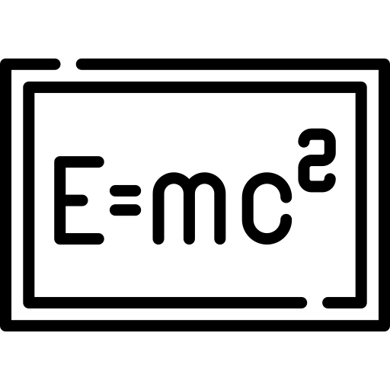
Modelling
A representation of ideas / processes that can be manipulated to predict outcomes
Used For
Representing ideas (usually too big, small, long or short to show in other ways)
Test ideas
Predict possible future outcomes / events
Questions
What does … look like?
What might happen if … changes?
What happens when … interact?
What could happen in the future if … ?
Types of Data
Simulation
Physical Model
Equation
Diorama
VR / AR
Animation

Slide 5
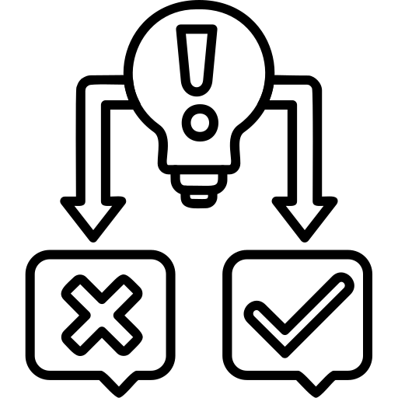
Fair Test
Finding a relationship between two variables, while keeping other variables the same
Used For
Finding how one variable affects another
Identifying a specific trend or relationship
Isolating how one factor impacts another
Questions
What is the effect of changing … on … ?
How does … impact … ?
What happens to … when … changes?
Types of Data
Diagrams
Tables
Quantatative
Graphs

