Slide 1
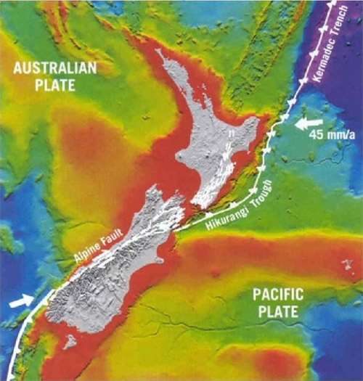
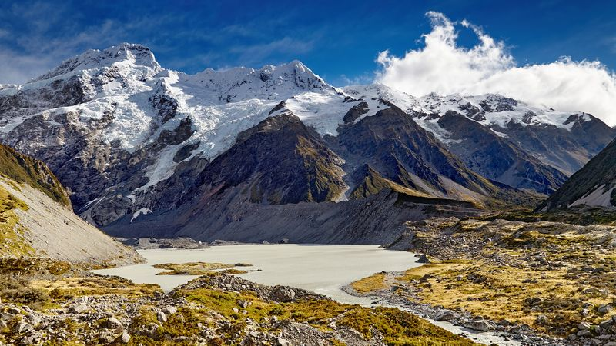
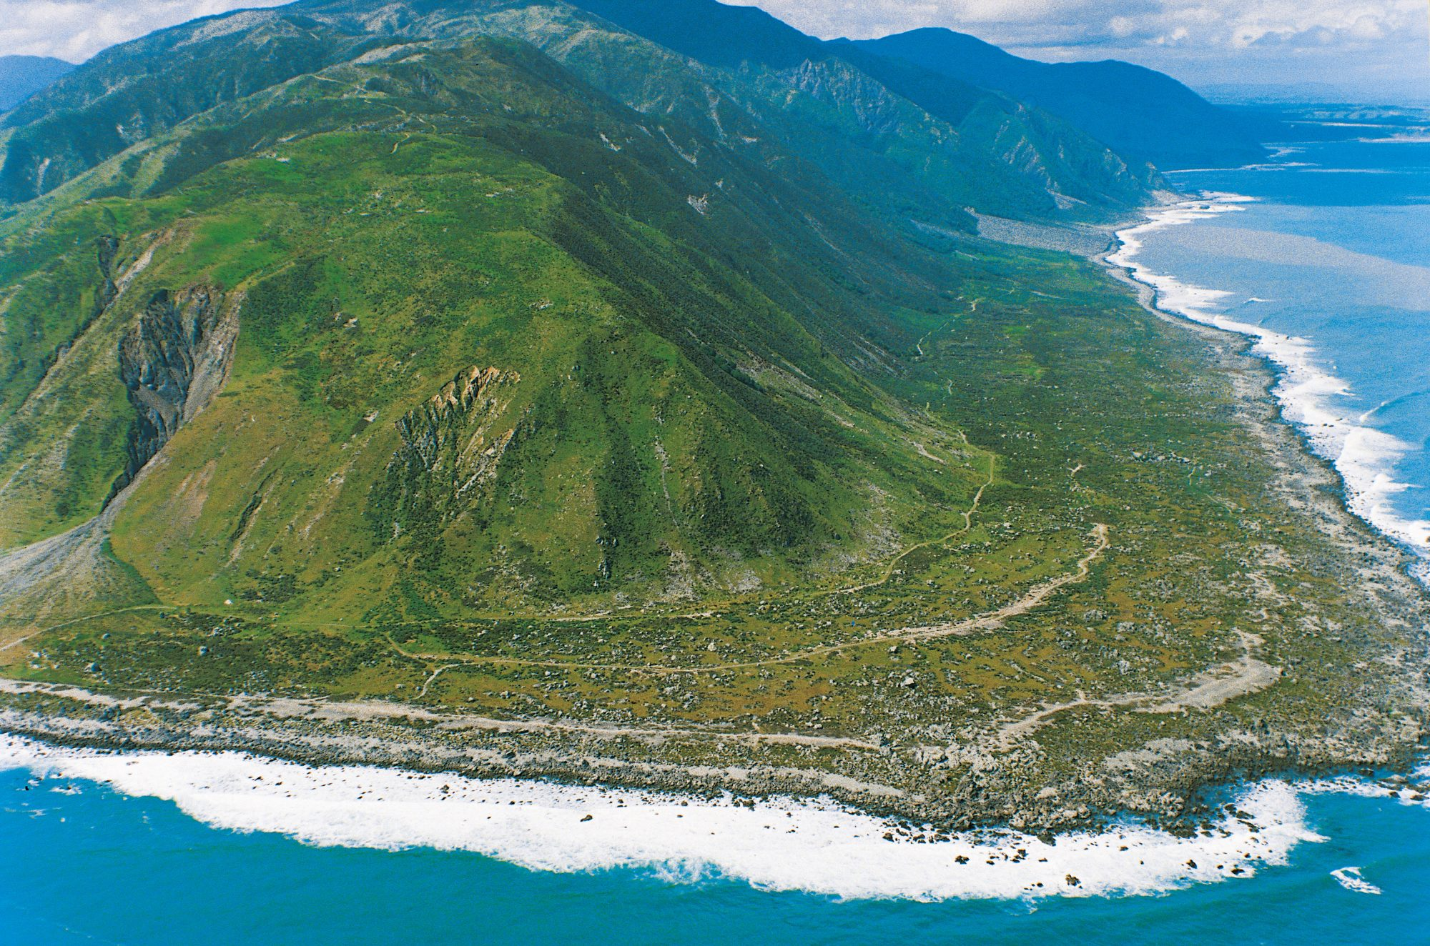
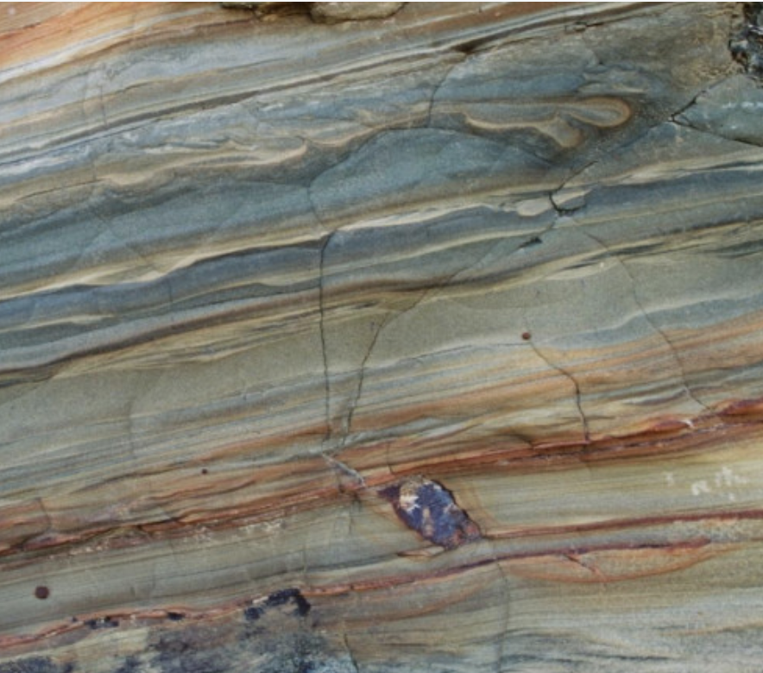
NZ’s Geological history
Notes:
Put together by Mike Stone
Italics in presenter notes = student questions
Could give students a blank Geol Time scale table for them to fill in main events as you go. Gives them an idea of sequence
NZ & plates: https://www.orc.govt.nz/managing-our-environment/natural-hazards/earthquakes/alpine-fault
S Alps scene https://www.britannica.com/place/New-Zealand/Relief
Strata: https://www.gns.cri.nz/our-science/land-and-marine-geoscience/our-past/
Shoreline: https://www.nzgeo.com/stories/the-day-the-earth-shifted/

Slide 2
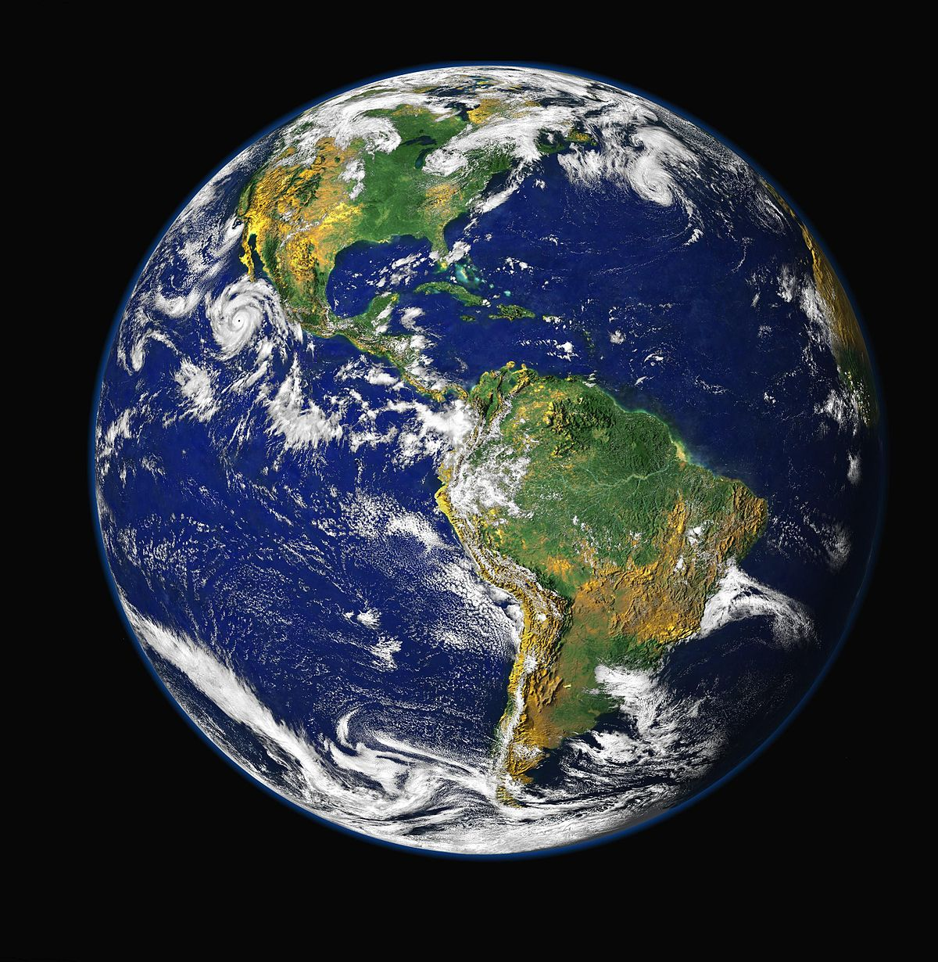
Ages
NZ not very old cf age of earth
Earth approx 4.6 billion years old
Oldest known rocks 4.1 billion years (10⁹)
Oldest rocks in NZ 680 million years (10⁶)
But permanent land dates back only 140 x million years …?
Notes:
Cf = compared to
Oldest rock in Flinders ranges, Australia
Why are old rocks hard to find? Once uplifted they are eroded and shaped by wind & water & melted again too.

Slide 3
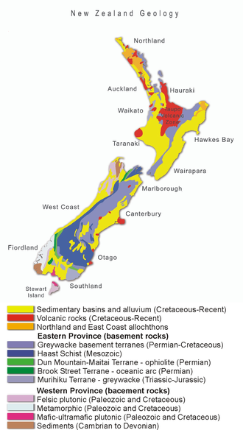
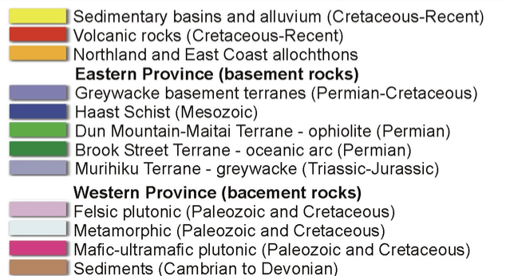
NZ rocks
Notes:
NZ today.
Remind me – what’s the difference between sedimentary, igneous, metamorphic rocks
so sedimentary rocks are evidence of erosion
igneous (including plutonic) are evidence of volcanic eruption
metamorphic are evidence of mountain building
What do you notice? Lots sedimentary near coast, metamorphic Sth Island, volcanic all over but bigger areas NI
Where are our oldest rocks? (brown) NW Nelson & SW Fiordland

Slide 4
Pre-Cambrian & Palaeozoic
Notes:
Once formed, the molten earth began to cool. The surface solidified and oceans formed.
All the land was originally one landmass – Pangaea, a supercontinent
250 million years ago Pangaea began to break into 2, Laurasia in the North, Gondwana in the south
What continents will form from Laurasia? N America, Asia the continents in the northern hemisphere

Slide 5
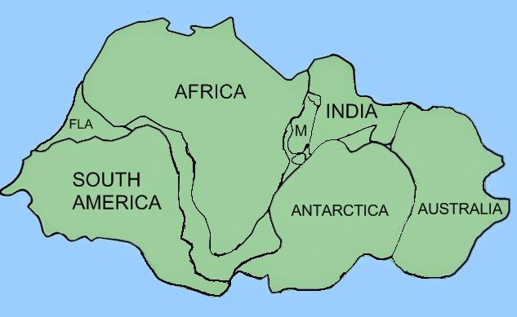
Major landmasses of Gondwanaland
Notes:
Gondwanaland was giant supercontinent, NZ wasn’t a landmass in its own right yet
Can you guess what the M & FLA mean? M = Madagascar, FLA = Florida (USA)

Slide 6
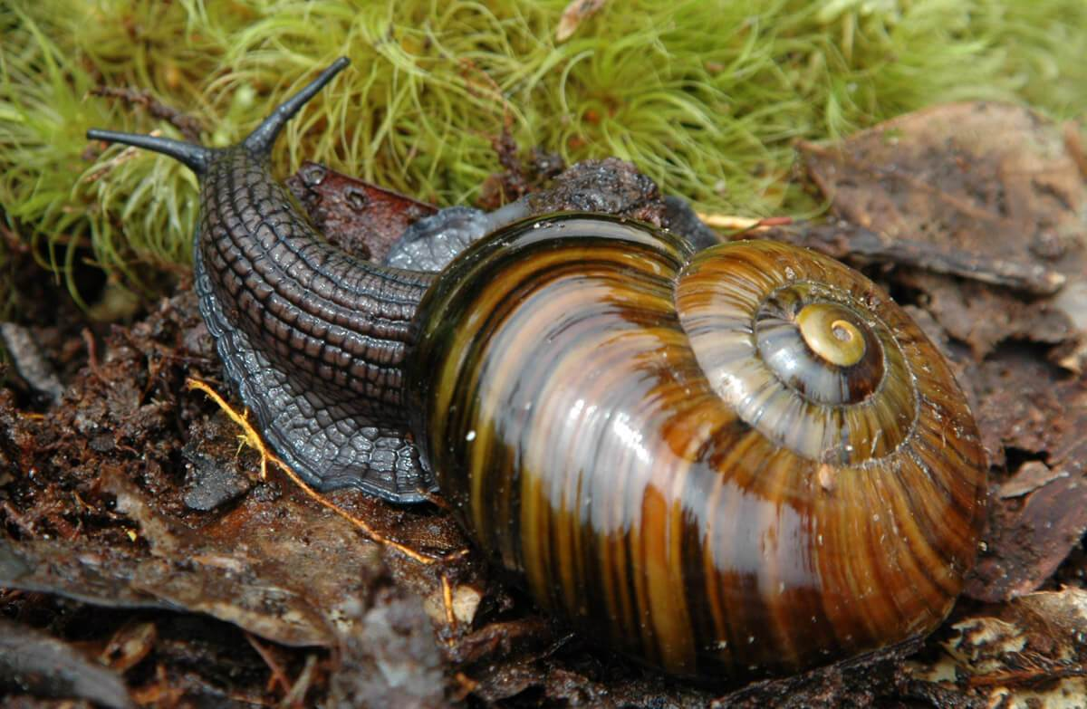
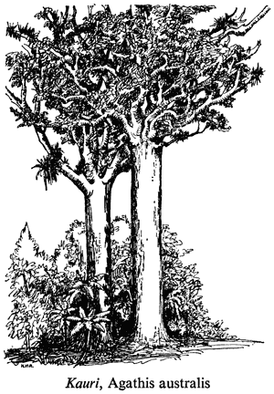
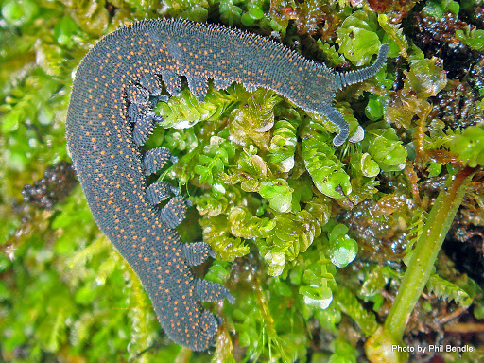
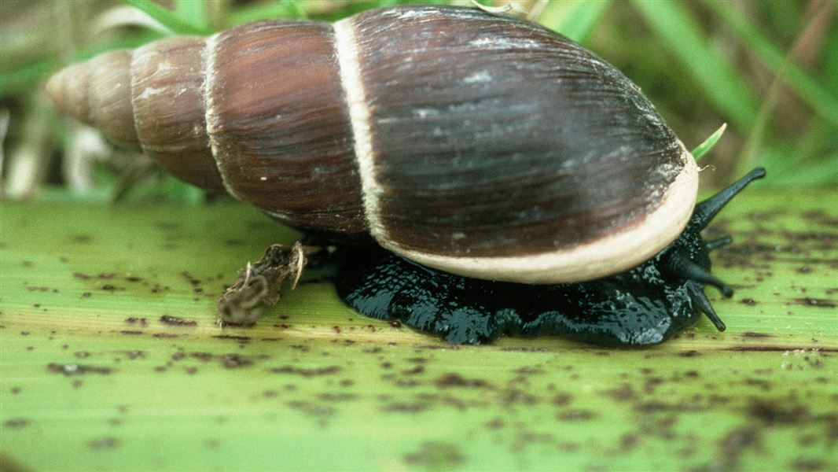
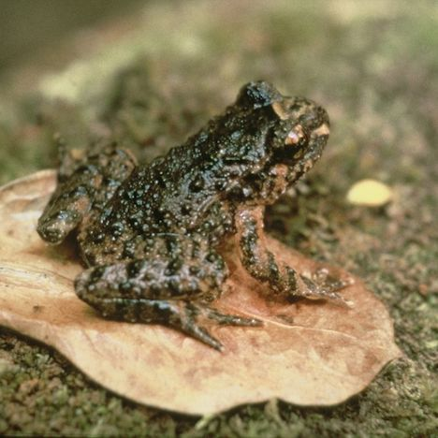
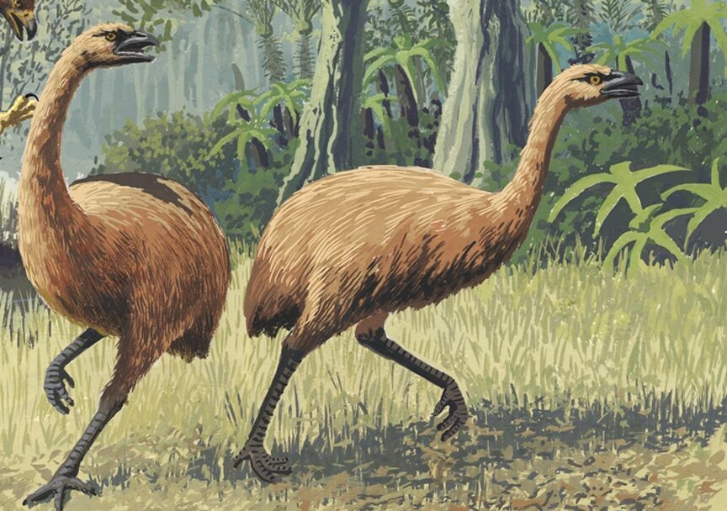
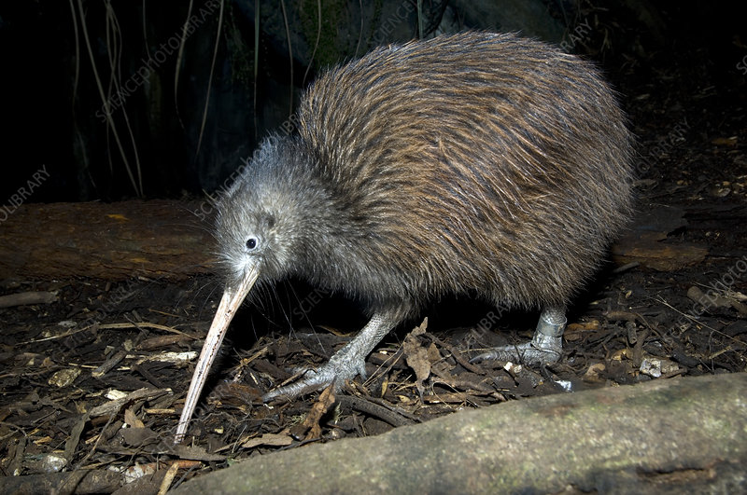
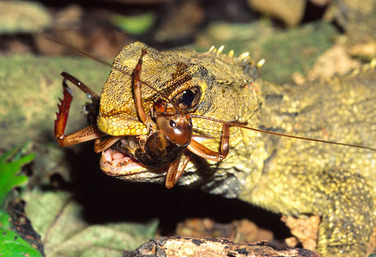
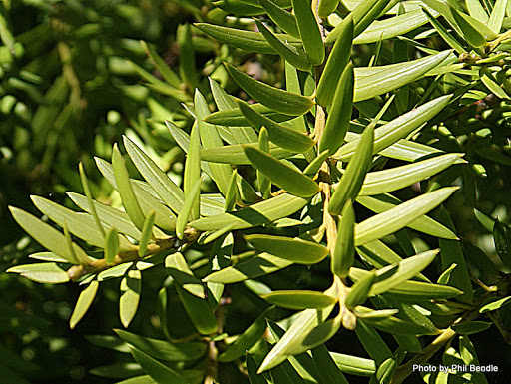
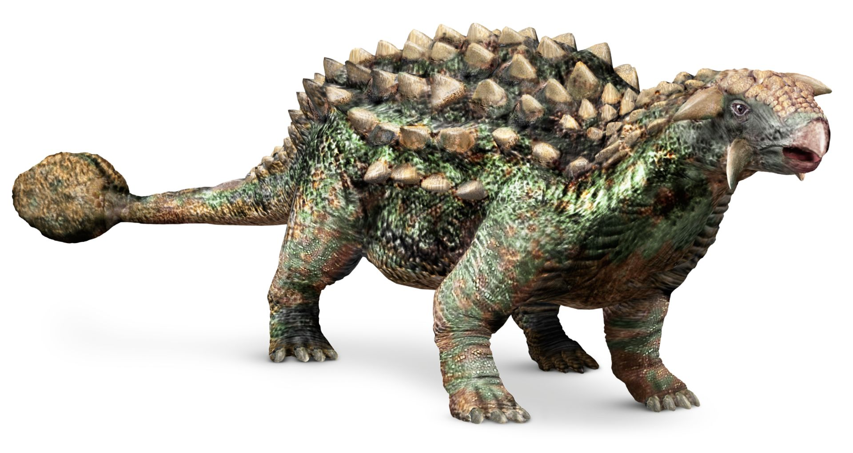
Notes:
Species found on Gondwanaland (in order of images)
Kauri Peripatus Paryphanta Placostylus
Moa Hochsttetters frog
Ankylosaur Tuatara & weta Totara & other podocarps NI brown kiwi
Also
Wren, endemic parrot family Strigopidae – kākāpō, kākā and kea
Nothofagus
Other Podocarps also miro, mataī
Dinosaurs – also had sauropods, therapods, pterosaurs. All our dinosaurs went extinct at the end of the cretaceous – paved ways for other phyla.
Who was Joan Wiffin?

Slide 7
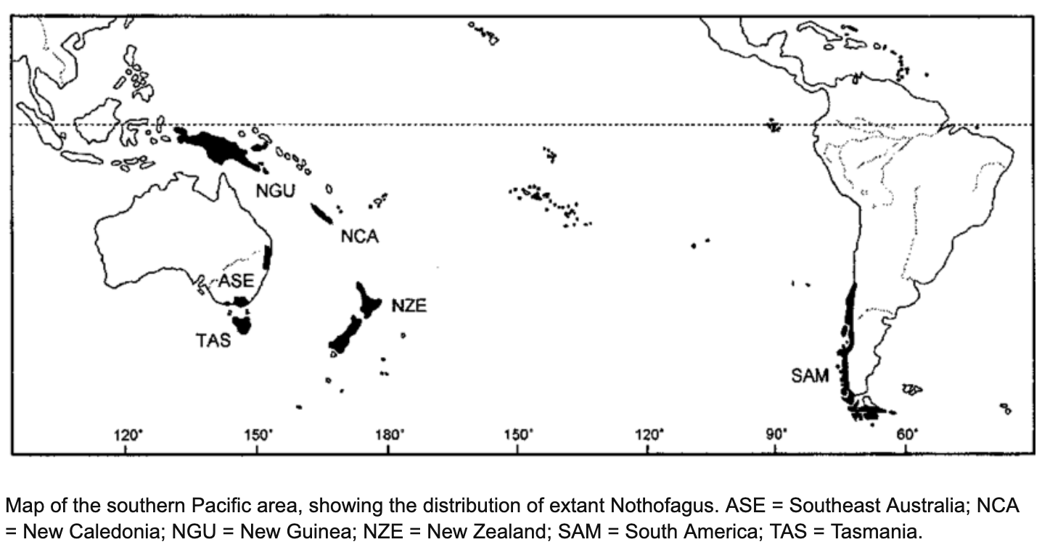
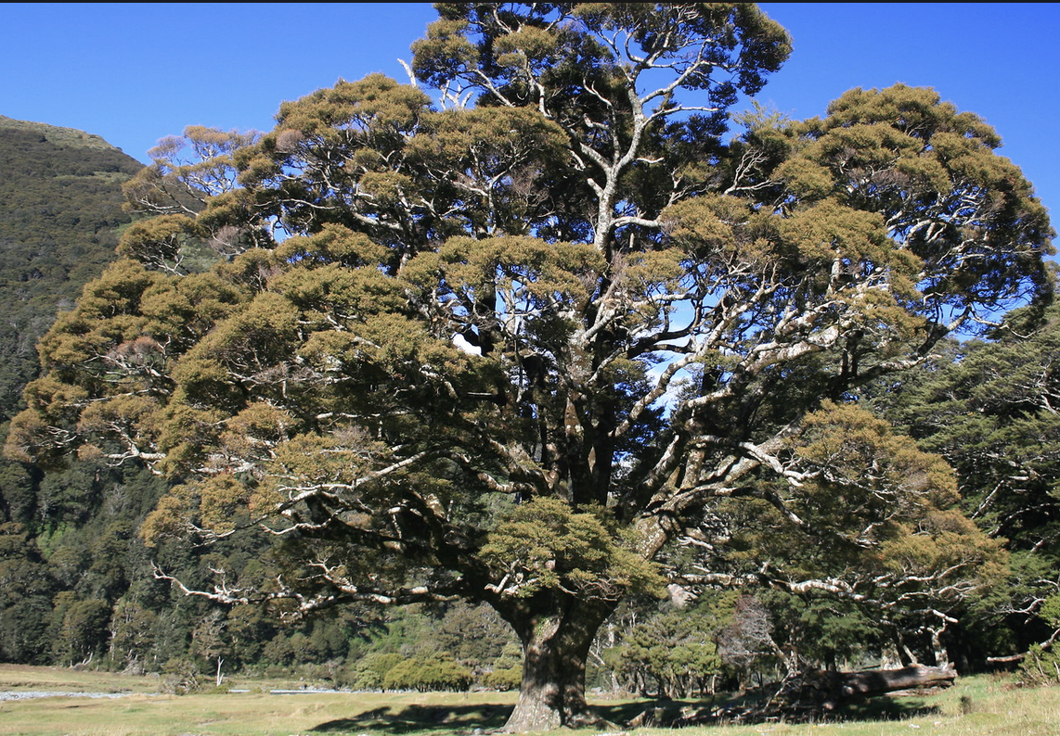
Nothofagus seeds:
Sink in fresh water
Die in salt water
Killed by freezing
Disliked by birds
Too heavy for wind dispersal
Notes:
If you’ve travelled in the south island what are the most common trees? Beeches.
Southern spp of beech Nothofagus (cf Northern spp of beech, Fagus)
Map: Swenson & Hill 2001 https://www.researchgate.net/figure/Map-of-the-southern-Pacific-area-showing-the-distribution-of-extant-Nothofagus-ASE_fig1_263029918
Photo: Silver beech (Nothofagus menziesii) at Mt Aspiring. [Steve Attwood]

Slide 8
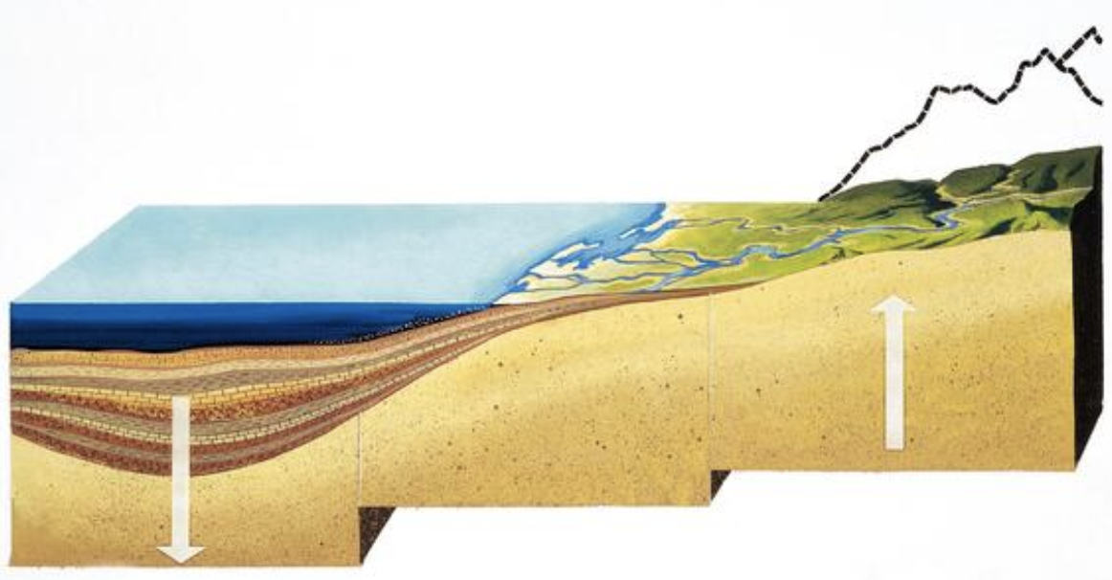
Geosyncline formation 280 – 120 mya
Trough offshore filled with sediments washed down from the part Of Gondwana that would eventually become Australia
Bed of geosyncline sinks due to weight of sediments
The deposited muddy sandstone sediments formed greywacke, the basement rock under most of NZ.
Notes:
NZ formation began in a ditch off the coast of Australian

Slide 9
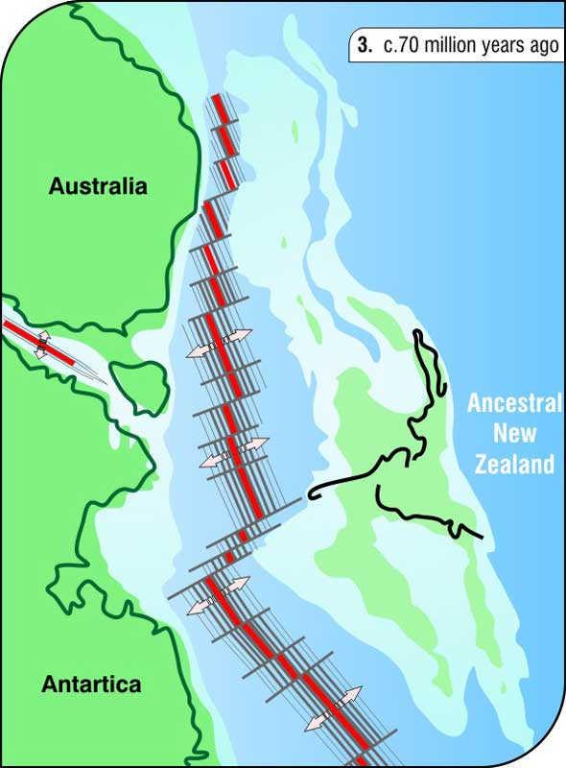
End of Cretaceous 100 – 83 mya
Upwelling magma led to a chain of volcanoes which began to erupt.
Tasman sea and Atlantic & Indian oceans widened → further isolating all major Gondwana landmasses
NZ broke away with Gondwana species, no mammals survive
At this time there was a mass extinction of many animals including dinosaurs, ammonites and phytoplankton. Other groups (mammals, birds) expanded.
Notes:
K/T boundary – between Cretaceous and Tertiary
By this time mammals had already started to evolve, they had reached Australia, Antarctica, NZ (evidence at St Bathans) but did not become established here
So once we separated from Gondwana 83mya how can other animals get here?
Isolated Land masses are a barrier to species dispersal, unless they can swim, fly or float organisms can’t cross the ocean between.
Mid ocean ridges in red

Slide 10
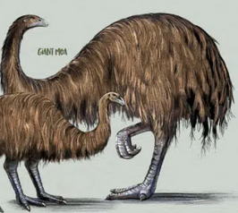
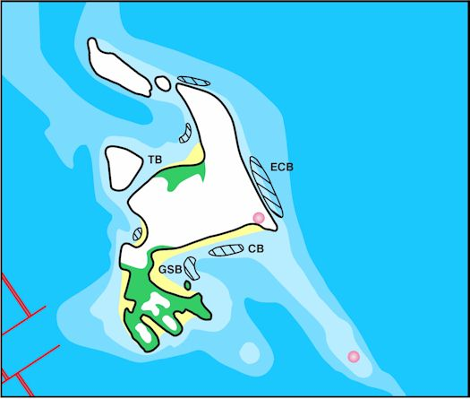
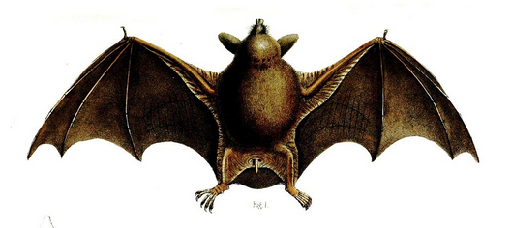
Palaeocene 65-54 Ma
Tasman sea fully formed, NZ isolated from Australia
The lack of land mammals allowed moa to diversify to fill role of mammals on other continents – grazers, browsers. 12 species
A variety of bird and mammal immigrants arrived – short-tailed bats, wattle bird ancestors
Notes:
What is the difference between a grazer and a browser?
Short tailed bats arrived 30mya
We originally thought that the fossils found represented 24 species, but ancient DNA shows only 12 spp moa, males smaller than females, i.e. sexually dimorphic
Discuss how Founder effect applies here
NZ drifting northwards from Antarctica.
Deposition of potential petroleum reservoir and source rocks including marine black shale (hatched areas).
Tropical climate but further south than now
This is the first on several similar diagrams. Worth going through the colours & symbols with students.
white = terrestrial non-deposition
green = terrestrial deposition
yellow = marine margins mostly sand
pale blue-grey = shelf; mid-blue = slope or submarine rise; dark blue = deep ocean. Red = Faults, subduction zones and seafloor spreading centres.
Pink circles = active volcanism.
Basins: Taranaki (TB), East Coast (ECB), Canterbury (CB), Great South (GSB), and Western Southland (WS).
https://www.gns.cri.nz/Home/Our-Science/Energy-Futures/Oil-and-Gas/NZs-Sedimentary-Basins/Paleogeographic-maps/Latest-Paleocene

Slide 11
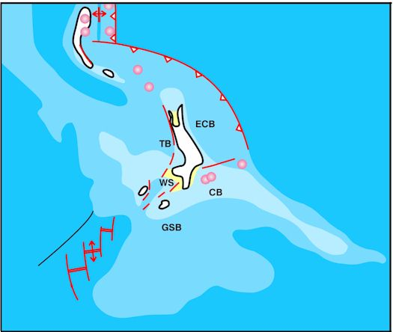
Oligocene 37-25 Ma
NZ heavily eroded and submerged - marine fossils abound
NZ completely submerged? No, as we still have Gondwana species that can’t tolerate salt water
Leiopelmid frogs
Nothofagus
Peripatus
Suggests there must have been islands present to act as refugia
Notes:
Explain how these species survived
How do small islands of survivors give opportunities for speciation?
Less than 1/3 of the area of modern New Zealand remained above sea level, as numerous islands.
On the land still above the sea the bulk of NZ’s coal deposits accumulated
Extensive shallow marine seas. Widespread deposition of limestone
major cracks develop (will eventually join to become Alpine Fault, splitting the continental mass in two)
Uplift → erosion → sediments deposited in basins off the coast
Colour coding:
white = terrestrial non-deposition;
yellow = marginal marine sand-dominated facies;
pale blue-grey = shelf; mid-blue = slope or submarine rise; dark blue = deep ocean. Red = Faults, subduction zones, and seafloor spreading centres.
Pink circles = active volcanism.
Basins: Taranaki (TB), East Coast (ECB), Canterbury (CB), Great South (GSB), and Western Southland (WS).
https://www.gns.cri.nz/Home/Our-Science/Energy-Futures/Oil-and-Gas/NZs-Sedimentary-Basins/Paleogeographic-maps/Late-Oligocene

Slide 12
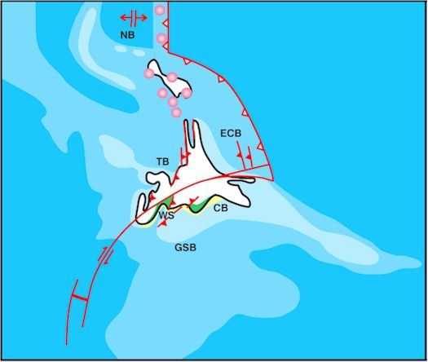
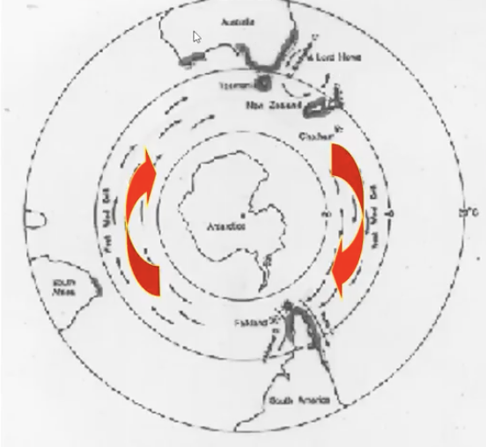
Early Miocene 20 Ma
West wind drift established
prevailing westerly winds
help distribute things blown along as rafts in water or birds flying in air.
brought species to us from Australia (& carried species from NZ to S. America)
Long-tailed bat
Pukeko (→ takahe)
Skinks on rafts of vegetation
Species geographically isolated on these islands; diff selection pressures, diff env conditions plus impact of genetic drift → allopatric speciation.
eg skinks & geckos
Notes:
Skinks not geckos, as geckos were Gondwana spp, already here
NZ still largely submerged
NZ sits across plate boundary now → Subduction zone & faults
More uplift, sediments eroded into basins
Other migrants from upwind – Australia - tūī and bellbird, weka, Fantail
Allopatric speciation?
Colour coding:
white = terrestrial non-deposition;
yellow = marginal marine sand-dominated facies;
pale blue-grey = shelf; mid-blue = slope or submarine rise; dark blue = deep ocean.
Red = Faults, subduction zones, and seafloor spreading centres.
Pink circles = active volcanism.
Basins: Taranaki (TB), East Coast (ECB), Canterbury (CB), Great South (GSB), and Western Southland (WS).
https://www.gns.cri.nz/Home/Our-Science/Energy-Futures/Oil-and-Gas/NZs-Sedimentary-Basins/Paleogeographic-maps/Early-Miocene

Slide 13
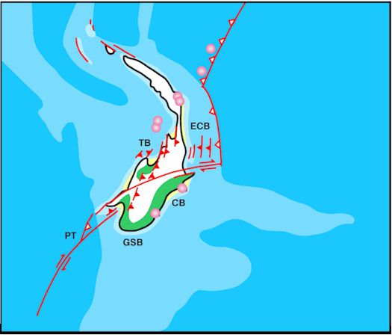
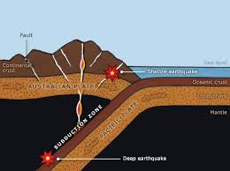
Late Miocene 10 Ma
NZ landmass rising due to –
Sea level rising in a warm phase
Subduction of Indo-Australian & Pacific plates. The one on top rises → mountain building
NI lots volcanic activity
SI alpine fault active – plates move past each other rather than subducting – transform fault (like San Andreas)
Notes:
NZ rising with more erosion, lots of volcanic activity in North Island. Alpine Fault is active, but no S Alps yet
Volcanic arc(s) active in north. Large V of Dunedin & Christchurch
Subduction south of NZ. Widespread compression, formation of petroleum trapping structures. Increasing tempo of uplift, erosion and sediment supply.
Colour coding:
white = terrestrial non-deposition;
green = terrestrial deposition;
yellow = marginal marine sand-dominated facies;
pale blue-grey = shelf; mid-blue = slope or submarine rise; dark blue = deep ocean.
Red = Faults, subduction zones, and seafloor spreading centres
Pink circles = active volcanism.
Basins: Taranaki (TB), East Coast (ECB), Canterbury (CB), Great South (GSB) . PT = Puysegur Trench
https://www.gns.cri.nz/Home/Our-Science/Energy-Futures/Oil-and-Gas/NZs-Sedimentary-Basins/Paleogeographic-maps/Late-Miocene

Slide 14
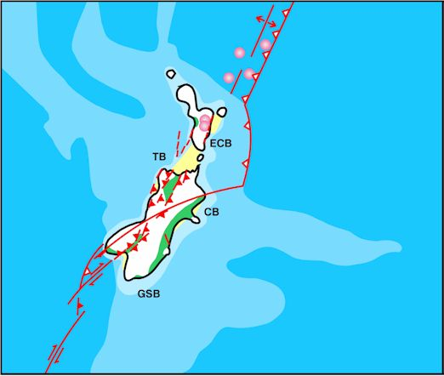
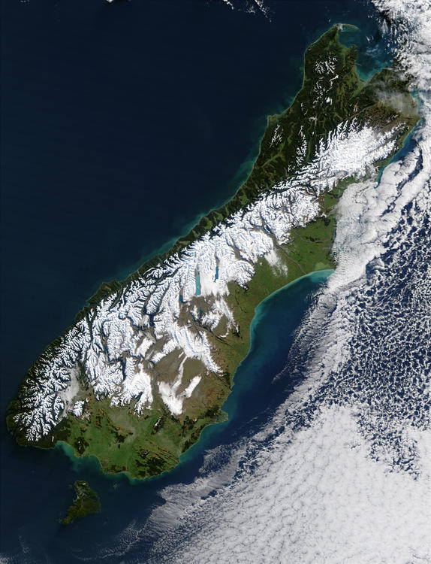
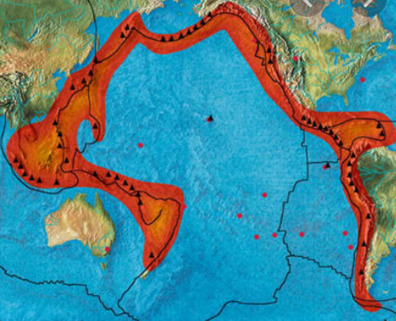
Pliocene 5 – 1.8 Ma
Geological activity continues – land rising due to subduction & sea level rise
NZ & Australia moving rapidly north → climate is changing
Cook & Foveaux Straits form
Kaikoura Orogeny → forms Southern Alps, Kaikoura ranges
Widespread volcanic activity – Pacific Ring of Fire developing
Notes:
Moving N at a few cm a year, land to east of AF rising at 1-2m/century
Species from the nearby landmass, Australia, continued to migrate to NZ – mānuka, rātā, pōhutukawa, saddleback, kōkako, and huia.
What is an orogeny?
Colour coding:
white = terrestrial non-deposition;
green = terrestrial deposition;
yellow = marginal marine sand-dominated facies;
pale blue-grey = shelf; mid-blue = slope or submarine rise; dark blue = deep ocean. Red = Faults, subduction zones, and seafloor spreading centres
Pink circles = active volcanism.
Basins: Taranaki (TB), East Coast (ECB), Canterbury (CB), Great South (GSB) .
https://www.gns.cri.nz/Home/Our-Science/Energy-Futures/Oil-and-Gas/NZs-Sedimentary-Basins/Paleogeographic-maps/Base-Pliocene

Slide 15
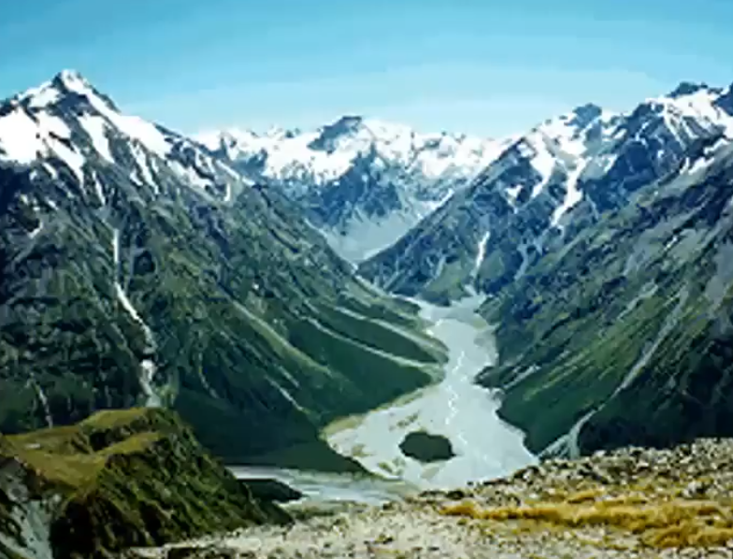
Consequences of Pliocene/Kaikoura orogeny
1st alpine habitats for 50 my → new set ecological niches available
NZ divided into warmer, wetter west & cooler, drier east.
Eucalypts grew in west with associated fauna (pollen in strata)
Mountains became physical barriers to species dispersal
When sea level rose, NZ again divided into a series of islands
species isolated → adaptive radiation
Eg land snails Paryphanta & Placostylus
Notes:
Adaptive radiation?
Image of the braided Rangitātā river in the Southern alps

Slide 16
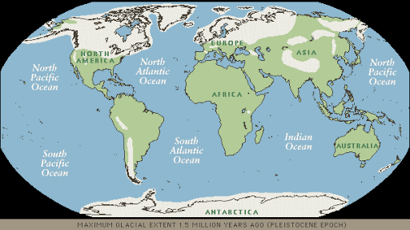
Notes:
What is this showing?
Top & bottom shaded white = ice. Ice age 2my long. Not constant but extensive in both NH & SH
This is Pleistocene, 2.4 mya to 10,000 ya
How did the ice age develop? From Late Pliocene, glaciers at poles, developing ice spreads → increases albedo → incr heat reflected away → earth cools
Combn hi albedo, changed oceanic & atm currents → Pleistocene ice age started 2ma

Slide 17
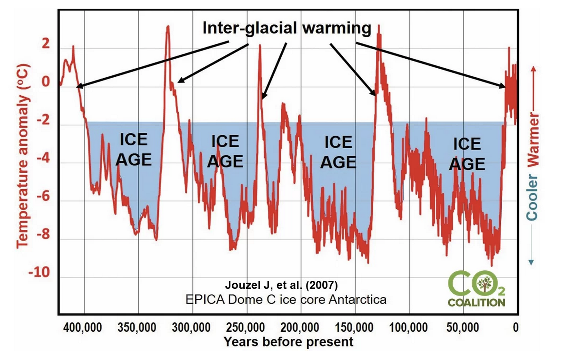
Pleistocene ice ages
Cold glacial period alternated with warmer interglacials
2.4 mya – 10,000 ya
Physical effects
mean annual temp dropped by 5ºC
ice covered 27% earth’s surface
sea level dropped by 105 – 135 m
Complex changes had a marked influence on the survival & distribution of plants & animals in NZ
Notes:
How might snow, ice affect plants and animals?
New Zealand vegetation cover at the height of the maximum of the last ice age reconstructed from pollen, macrofossil, beetle and geomorphic evidence. (From McGlone, Newnham & Moar, 2010) https://www.wgtn.ac.nz/sgees/research/research-groups/quatenary/research-projects

Slide 18
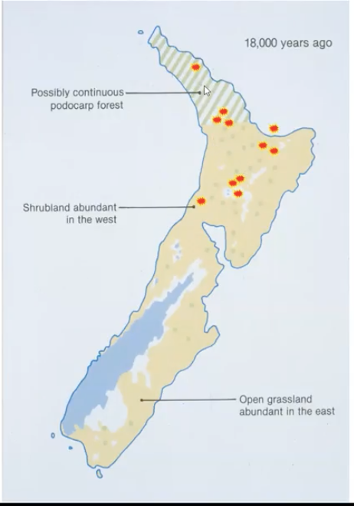
Last NZ glaciation 25-15,000 ya
Speleotherm data suggests glacial maximum was at 20,000 ya with a smaller cold event 12-13,000 ya
Mean annual temperature dropped 4.5ºC
Extensive glaciation along Southern Alps, down to sea level on West Coast (gouged sea floor), small glaciers on Tararuas & Volcanic Plateau
Sea level was so low NZ was 1 continuous land mass, no Foveaux or Cook Straits
Forests confined to sheltered sites & northern rufugia - pollen evidence and quick recovery
Notes:
Speleotherms – stalactites and stalagmites
Why did sea level drop during the ice ages?
What might be some effects of this glaciation and a continuous landmass? See next slide
Kiwi walked from SI to NI, land snails expanded range
Considerable erosion from higher slopes formed new more fertile lowland soils

Slide 19
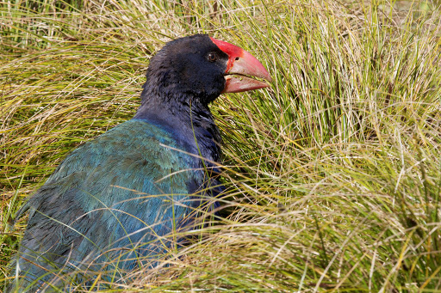
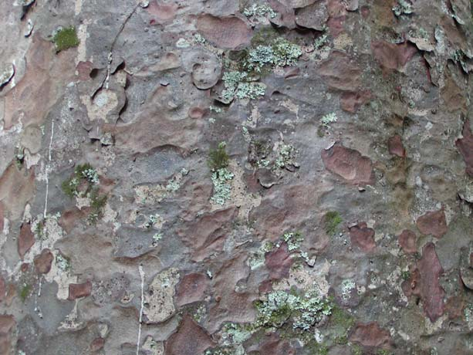
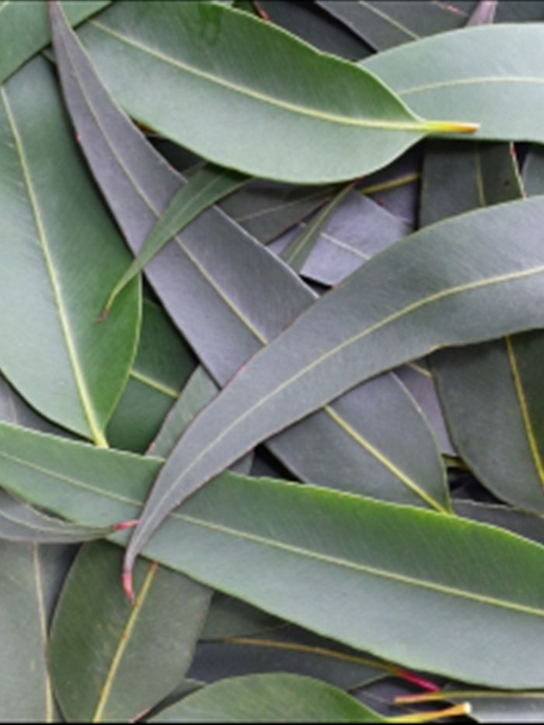
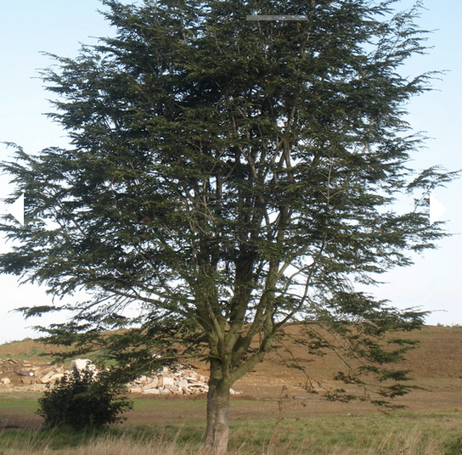
Biological effects
The range of Nothofagus was severely restricted during glacials – but it came back so quickly when glaciers retreated that the species must have survived in sheltered areas that didn’t get so cold.
Eucalypts died out
Kauri extended down to Wellington during warmer interglacials
Takahe evolved on newly extended subalpine grasslands
Notes:
Takahe. Kauri bark. Eucalypt leaves - nothofagus

Slide 20
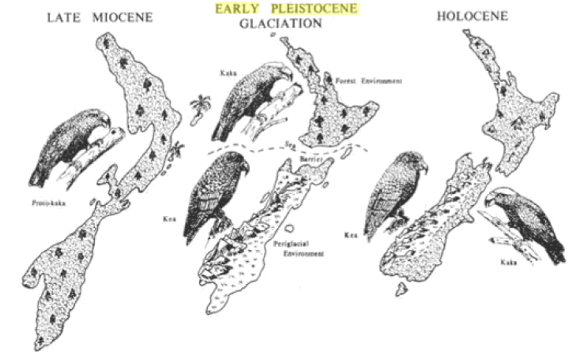
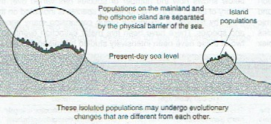
Disjunct taxa
Groups that are related but widely separated geographically
Causes?
dispersal over a wide area
suitable habitat once present in gaps
habitats separated by geological changes eg sea level rise
Examples
Castle Hill buttercup (relict pop survives at 600m on scree, rest are subalpine)
Placostylus and weta in what used to be Northland islands
Kaka (forests) and kea (alpine)
Paryphanta on either side Cook Strait
Notes:
Disjunct = widely geographically separated positions with no obvious way to move between. Taxa=?
Scree? Subalpine?
Northland populations of flax snail placostylus on islands, with low sealevel 2-3 spp become widespread. Sea level rose, islands isolated, adaptive radiation → evolution of several new spp
5 islands in northland each with own race of weta, now joined & spp interbreeding, old boundaries become hybrid zones
Paryphanta on either side of Cook Strait implies continuous land bridge. No further recent speciation suggests landbridge lost only recently or selective pressures relatively weak
Kaka: protokaka across NZ landmass when SL low. Sep. Kaka in N, kea in S. spp now sympatric in SI. Kaka has sub spp either side CS. Point out Manawatu Strait
Bottom image: Biozone
Top image:
Biogeography and Ecology in New Zealand edited by G. Kuschel
https://books.google.co.nz/books?id=8PrtCAAAQBAJ&pg=PA62&lpg=PA62&dq=early+pleistocene+kea+kaka+manawatu+strait&source=bl&ots=nUXcUxMxcj&sig=ACfU3U2z45-32ueSHh_rZpuApeVQP5vtfQ&hl=en&sa=X&ved=2ahUKEwjGhYOsjrfpAhWS8HMBHS_2BwAQ6AEwCnoECAkQAQ#v=onepage&q=early%20pleistocene%20kea%20kaka%20manawatu%20strait&f=false

Slide 21
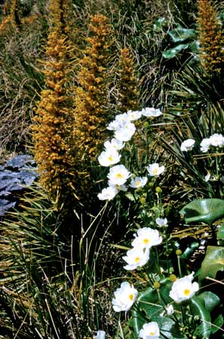
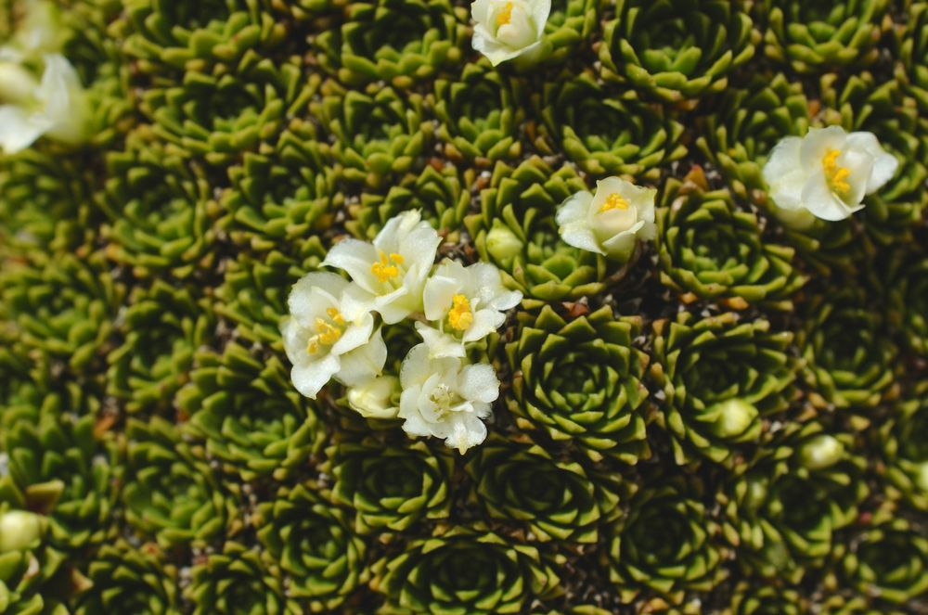
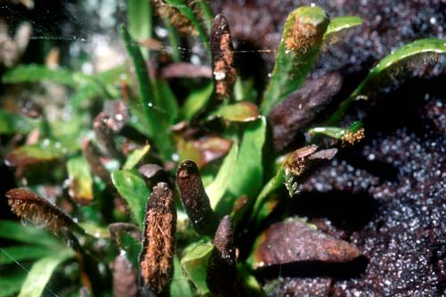
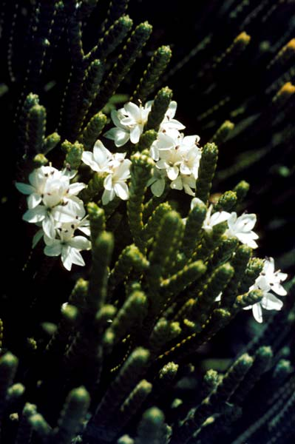
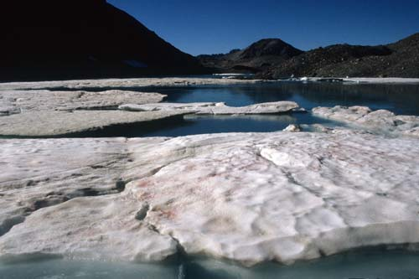
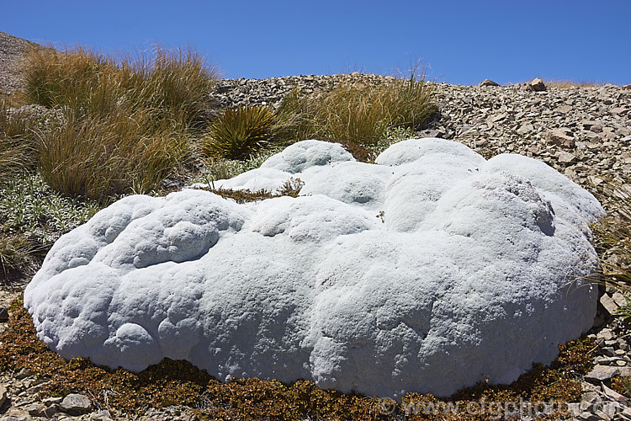
Notes:
Extreme & rapidly changing conditions → evoln of diverse alpine fauna & flora
Top L Giant Spaniard a speargrass & Mt Cook Lily – world’s largest buttercup
Top Mid Hectorella caespitosa, a high-altitude cushion plant
Top R Alpine fern
Bottom mid Whipcord hebe
Bottom L Vegetable sheep Raoulia eximia
Bottom R Red snow – red-pink patches on snow due to alga Chlainomonas
The origin of New Zealand’s high altitude plants is a mystery. The mountains are geologically young and geographically isolated. Most of the alpine species occur nowhere else, although related to plant life in Australia, New Guinea and South America. Before land rose a few mya, NZ low-lying & warm.
How did alpine-adapted plants survive?
Cretaceous mountain flora may have been able to adapt to warmth and low altitude, and then expand into the new mountain habitats of the Pleistocene period. Another possibility is that ancestral forms have reached New Zealand by long-distance dispersal across the sea, mostly from or via Australia.

Slide 22
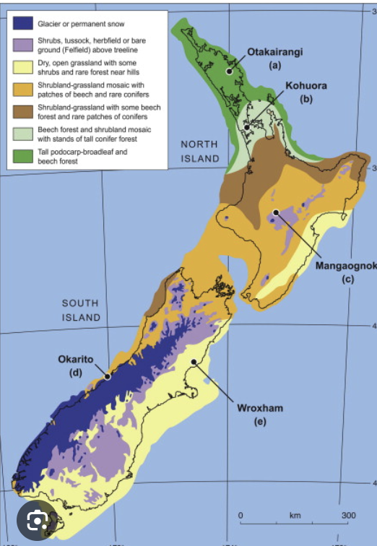
Post glacial vegetation changes
Forest patches in glacial areas were refuges for wide range of species
Vegetation spread rapidly with increases in temperature & rainfall.
Shrublands and grasslands were replaced by complex forests in <500 years at most locations. Very quick – argues strongly for forest remnants in South Island even though it was very cold & covered in glaciers.
Rapid spread only possible if
Many small pockets of surviving bush
Animals (especially birds) survived in sufficient numbers to disperse seeds
Notes:
Forest patches in glacial areas were refuges for wide range of Animals. Often able to use surrounding scrub or shrublands
Vegetation spread rapidly with increases in temp & rainfall. Shrublands and grass lands replaced by complex forests <500 years at most locations. V quick – argues strongly for forest remnants in SI even though v cold & covered in glaciers
Could do a slide on volcanism in the last 2my next??
super-volcanoes – Taupō, Rotorua, and Okataina calderas
Ignimbrite plateaus
Active andesitic volcanoes – Taranaki, Tongariro, Ngāuruhoe, Ruapehu and White Island.
Auckland volcanic field
https://teara.govt.nz/en/geology-overview/page-10

Slide 23
Holocene – time of human arrival
Forests in 80 % of country except for alpine zones & grasslands in Canterbury & Otago
NZ had a rich fauna – with a few large predators:
eagle, harrier, falcon, raven in air
tuatara & lizards on ground
Big predators being birds, who hunt by sight, favoured evolution of large, flightless, cryptically coloured & nocturnal prey
Misconception – no predators until humans brought mammals! NZ did have predators, just not terrestrial mammalian predators
Notes:
Morepork only nocturnal predatory bird, Haast’s eagle hunted by day

Slide 24
Dating human arrival in NZ
How do we know when humans arrived?
Pollen samples – changes in forest cover due to fires, subsequent spread of bracken fern (a good food source) & grasslands.
Human remains found above the ash from Kaharoa eruption sequence & not below – volcanic ash is easily dated.
Presence of rat-gnawed seeds – humans introduced rats, seeds can be dated
Accumulated eggshells – evidence of moa hunter culture, can be dated
→ NZ was 1st settled by humans about 1280 AD.
Notes:
Kaharoa ash came from the Tarawera eruption in 1314
Image: www.landcareresearch.co.nz/research/biodiversity/forest/past_env/detection.asp
How might humans have affected the plants and animals living here? See next slide

Slide 25
Human-influenced changes
NZ had many large flightless birds eg takahe, ground-dwelling insects eg weta, weevils as well as frogs, lizards.
Human – influenced changes
Habitat destruction
Introduction of terrestrial mammalian predators
These changes were catastrophic for native biota because
They happened so rapidly, over a few hundred years, that evolutionary adaptation was not possible
Cryptic, nocturnal prey who froze on sight of predators were easy targets for mammals who hunt by scent
Many native species were K selected while the exotics were r selected
Notes:
Human influenced changes catastrophic for native biota because
So fast evol adaptation not poss
Intro mam predators
Do you remember K and r selection? See next slide

Slide 26
Patterns of Population growth
K selected
r selected
Sigmoid growth, plateau oscillates around k, the carrying capacity of the environment
Large animals
Few young
Prolonged parental care
Mature slowly, long life span
Many native species
Grow rapidly, exceed carrying capacity of environment then numbers drop quickly
Smaller animals
Lots of young
Short period of dependency
Mature quickly, short life span
Many introduced (exotic) species
Notes:
K – grow slowly, good parental care but few offspring so when killed by predators slow to replace loss
R – grow to maturity quickly, lots offspring. Drive predators to extinction
What is the implication of this for our natives and their predators?

Slide 27
NZ Landcover 1200 NZ Landcover 1840 NZ Landcover 1990
Notes:
Forest 1000AD – before humans
1840 M used fires to clear land & hunt. (Moa disappeared within 1st 200 yrs of settlement, the pattern with megafauna worldwide)
https://www.researchgate.net/figure/Land-cover-in-New-Zealand-from-pre-human-Maori-settlement-c-800-years-ago-left_fig2_235725288

Slide 28
Human effects on extinction rates in NZ
Of the biota breeding in NZ prior to human arrival
Avifauna – 31% locally or globally extinct.
Endemic species – 41% extinct
Offshore islands act as refuges. Islands on continental shelf were part of mainland during ice ages - their flora and sometimes fauna, give us an idea of how NZ looked prior to human arrival
Notes:
Name some offshore islands on continental shelf
subantarctic – chathams - on continental shelf?

Slide 29
Zealandia
Greater NZ landmass – pink border
Extends from New Caledonia to the Campbell Plateau & from Lord Howe Island to the Chatham Islands
In contact with Gondwanaland New Guinea, Indonesia (land bridges, island chains)
Notes:
Appeared in late Jurassic
Once above water and joined to other landmasses it received a lot of their biota
As sea floor spreading rafted NZ away from GWL those P & A were shipwrecked here and in some cases survived here only
Currently New Zealand is at latitude 60°S, longitude 180°,
Deep gash going NE from NZ?

Slide 30
Sources
Ideas and some images from Alison Campbell’s scholarship webinars
The 100-million-year evolution of Zealandia https://www.youtube.com/watch?v=YsSMhjb0dsM&t=6s
https://teara.govt.nz/en/geology-overview
https://www.gns.cri.nz/our-science/land-and-marine-geoscience/our-past/our-geological-origins/
https://en.wikipedia.org/wiki/Geology_of_New_Zealand
https://www.geotrips.org.nz/downloads/Ballance_NZ_Geology-V2.pdf especially diagrams and summary p27 – 33
https://www.britannica.com/place/New-Zealand/Relief ???
https://issuu.com/biozone/docs/2022_ncea_lvl_3_ext_colourised_/s/17256483
https://www.biologyonline.com/tutorials/new-zealands-unique-geographical-history

