Slide 1
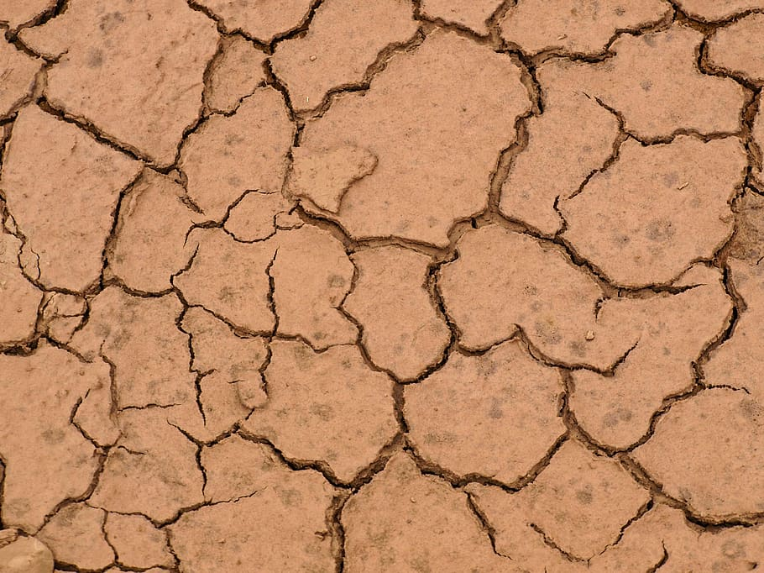
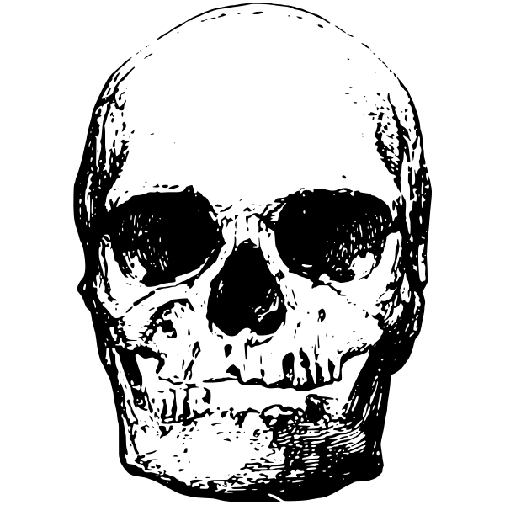
Skull
Game designed by @MissDtheTeacher - www.missdtheteacher.blogspot.com
Notes:
TEACHER NOTES: This game works really well when used with the Google Add On Pear Deck. It allows students to have the image of each skull on their own screen without being able to go on to the next slide.

Slide 2
Skull Rules
All players/teams place their markers on the start square.
To start the game, the skullmaster will display a skull (on the screen or on paper).
Players/teams can do research to help them identify the animal that the skull belongs to.
Once a player/team is confident with their answer, they say SKULL. All teams then get 20 counts to write down their best guess. The skullmaster will count to 20 and then say pens down.
Each player/team passes their answer to the next player/team to check whether their neighbouring team’s answer matches the correct answer provided by the skull master.
If a team has correctly identified (including spelling) the common name and species, that team may move their marker to the next space on the game board.
The winning player/team is the first to make it to the finish square.

Slide 3
finish
start

Slide 4
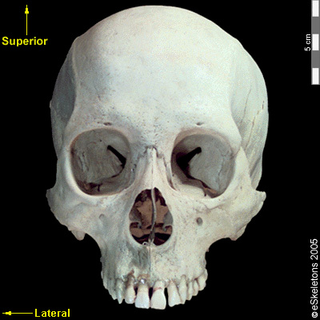
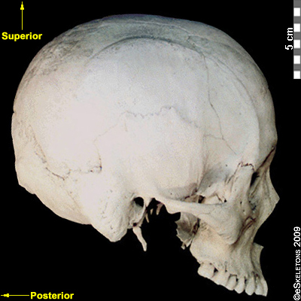
1

Slide 5
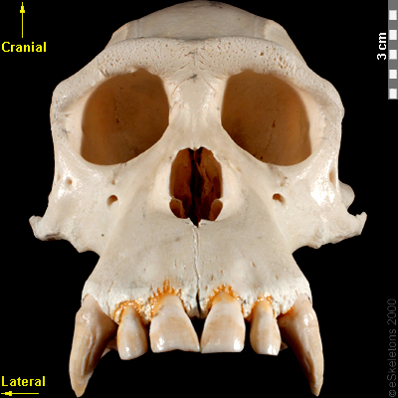
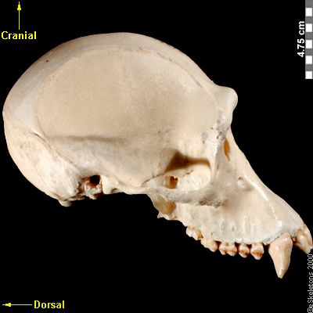
2

Slide 6
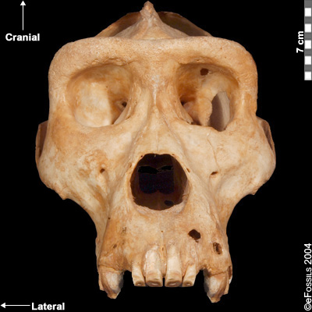
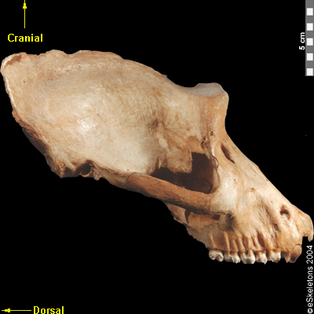
3

Slide 7
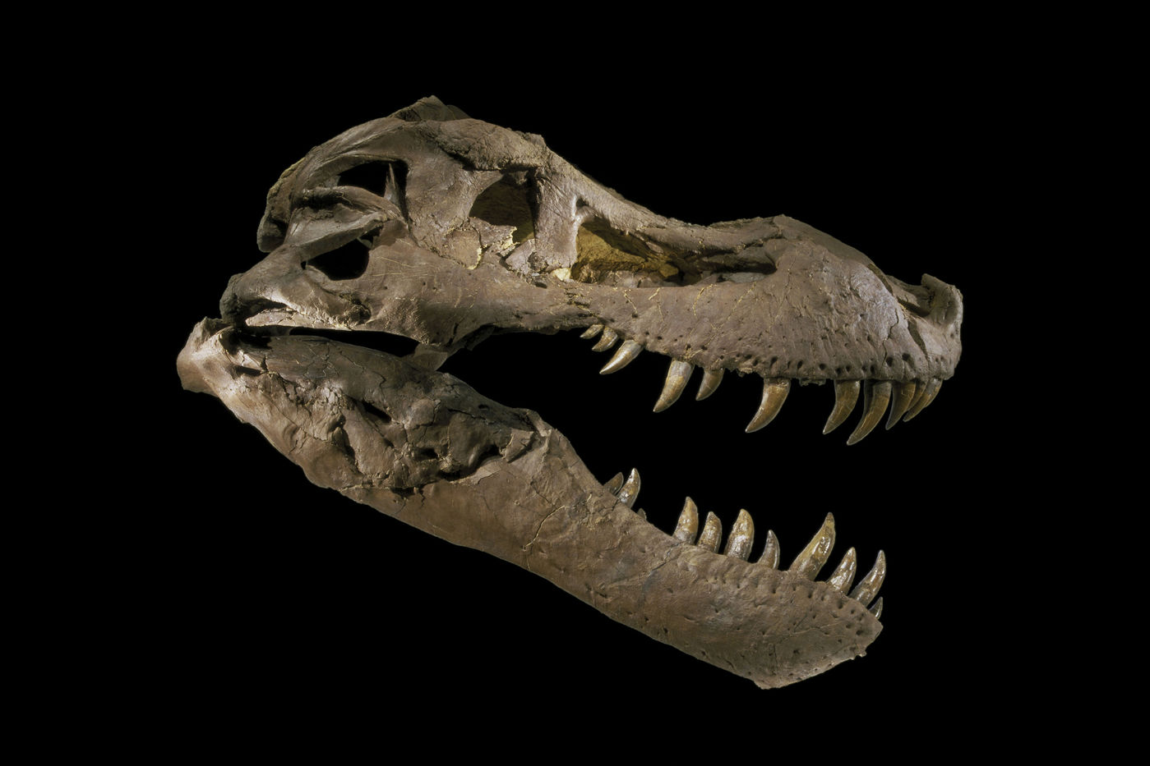
4

Slide 8
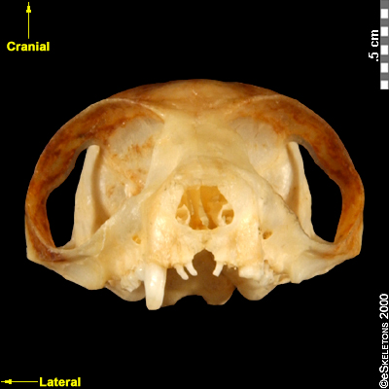
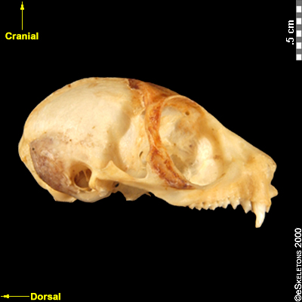
5

Slide 9
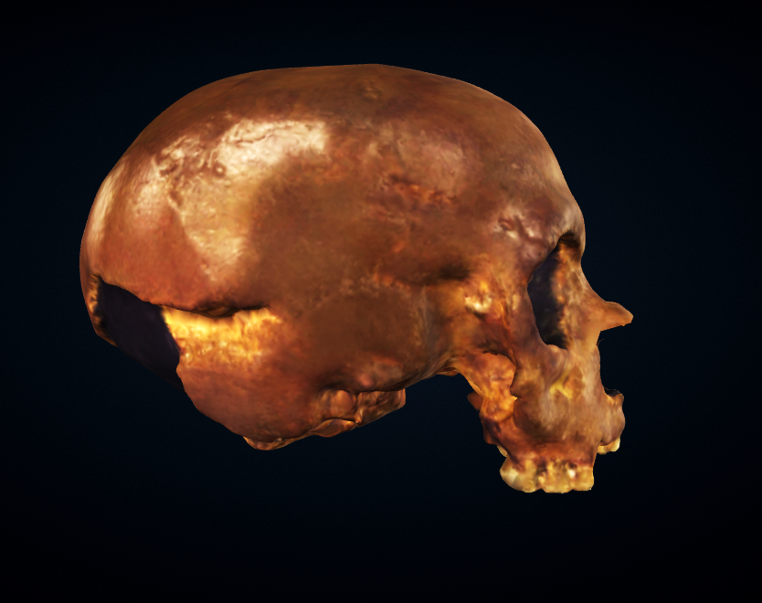
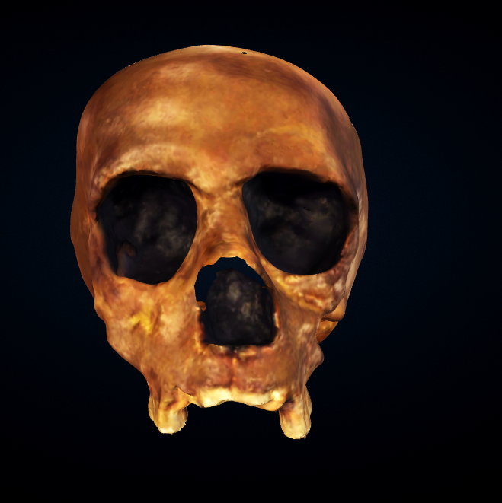
6

Slide 10
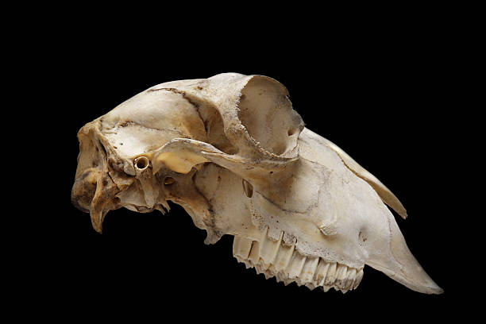
7

Slide 11
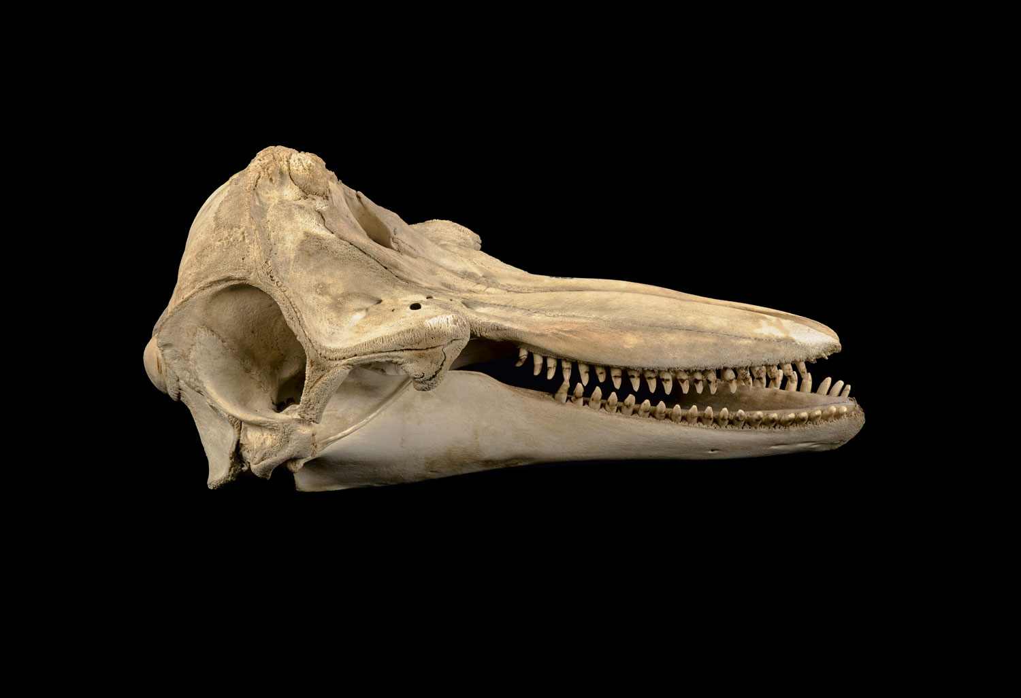
8

Slide 12
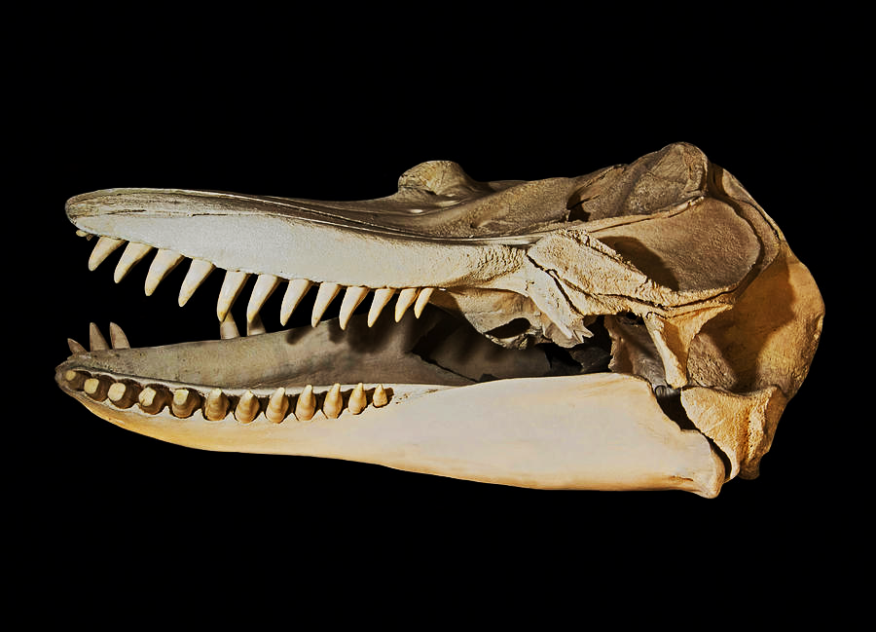
9

Slide 13
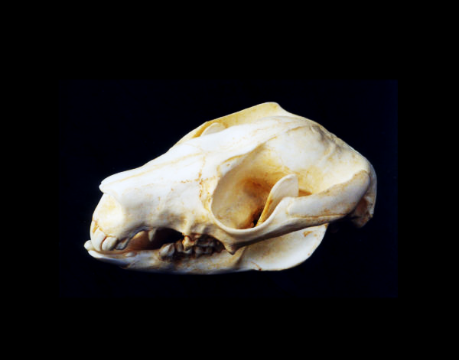
10

Slide 14
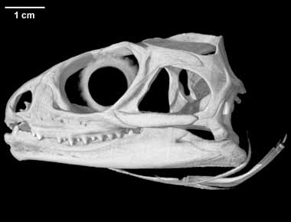
11

Slide 15
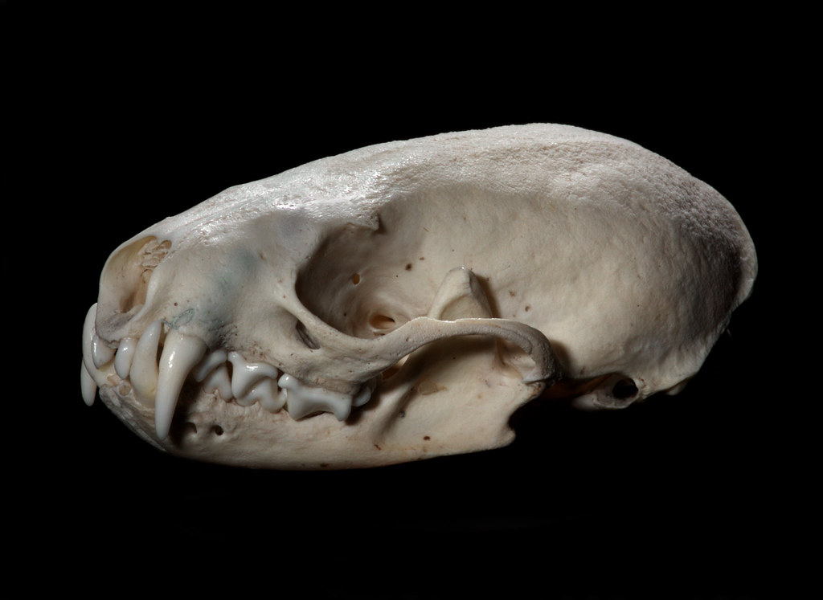
12

Slide 16
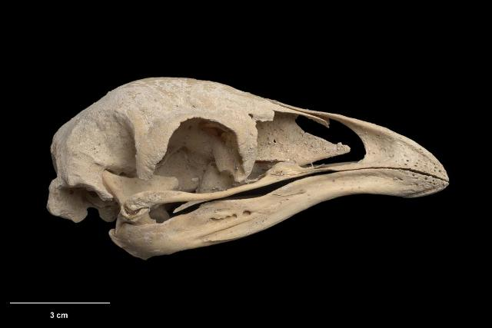
13

Slide 17
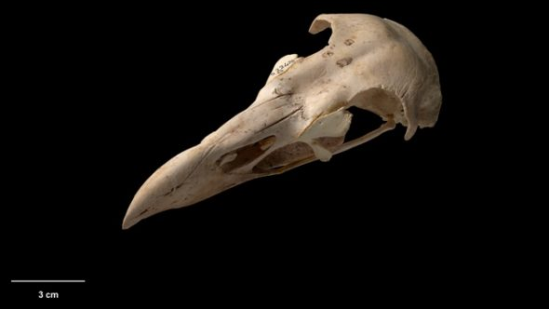
14

Slide 18
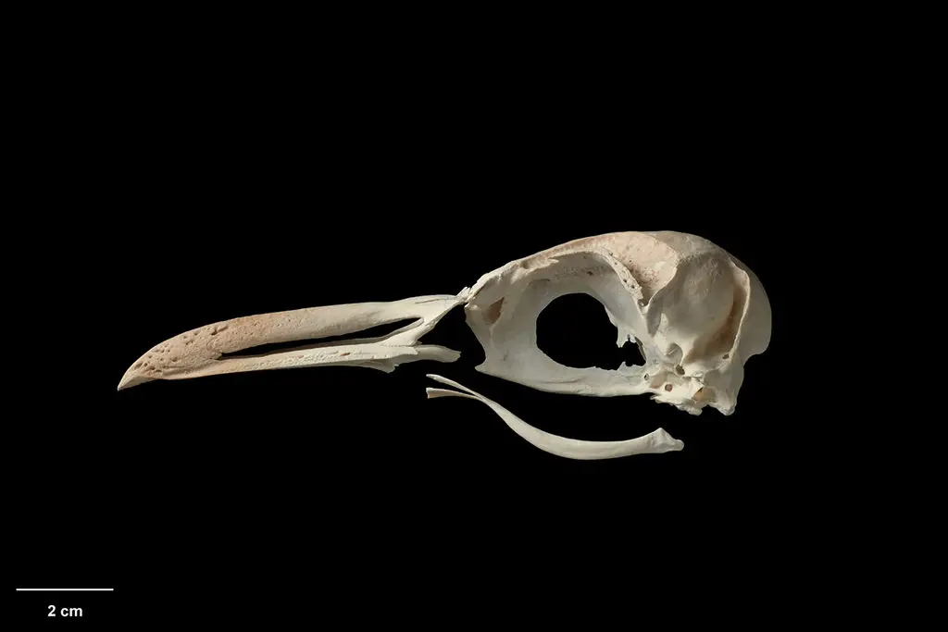
15

Slide 19
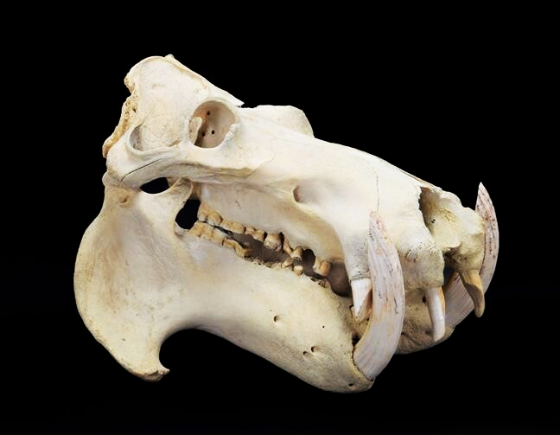
16

Slide 20
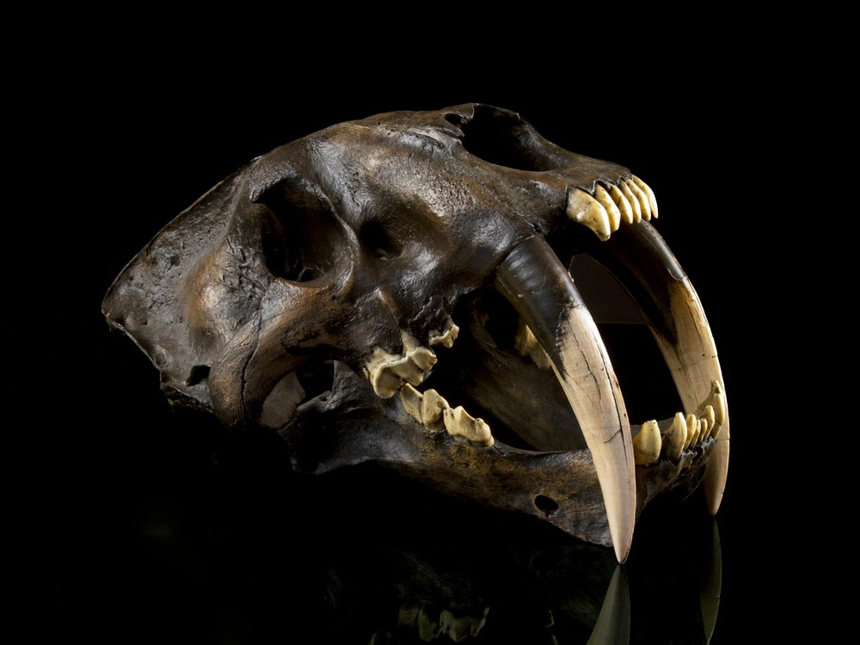
17

Slide 21
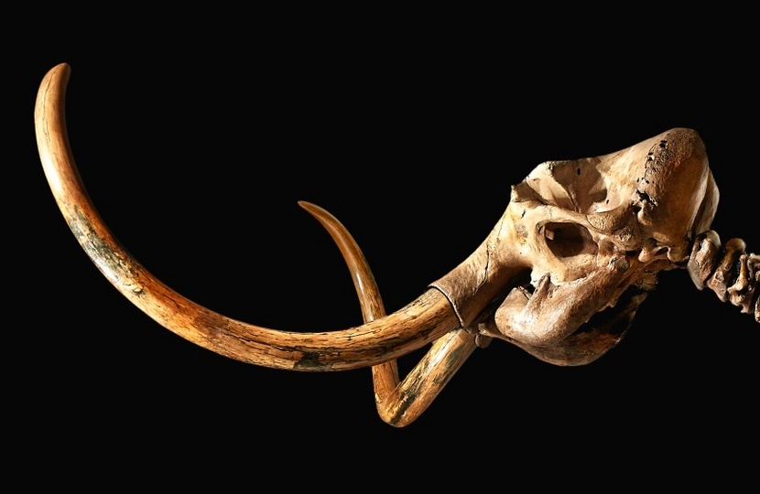
18

Slide 22
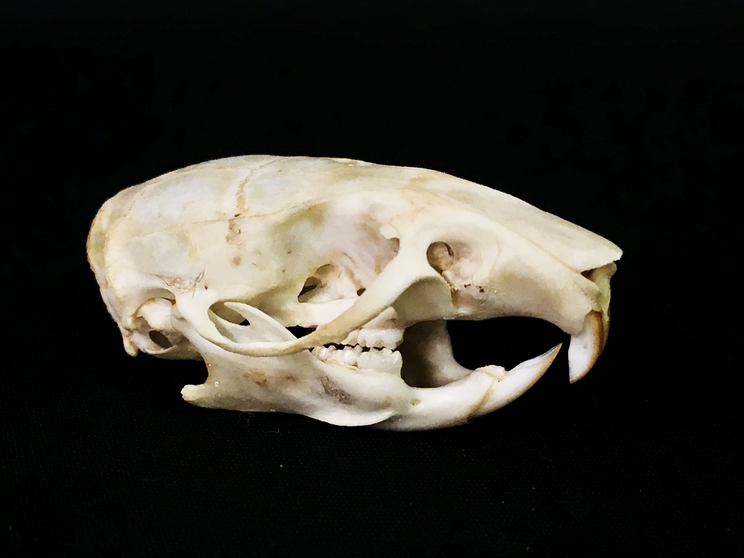
19

Slide 23
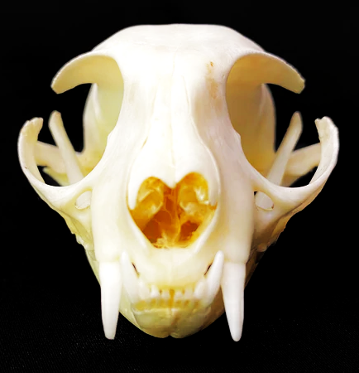
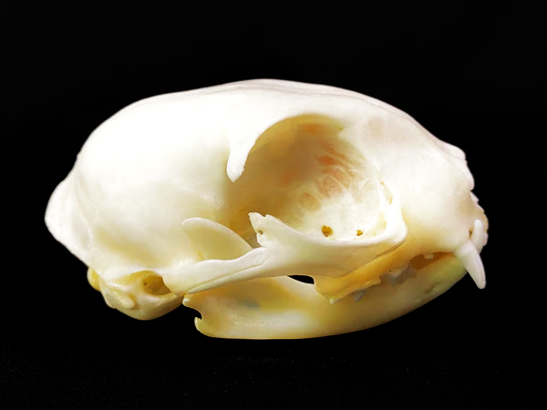
20

Slide 24
ANSWERS
Human - Homo sapiens
Chimpanzee - Pan troglodytes
Gorilla - Gorilla beringei
T Rex - Tyrannosaurus rex
Bushbaby - Galago senegalensis braccatus
Neanderthal - Homo neanderthalensis
Sheep - Ovis aries
Bottlenose dolphin - Tursiops truncatus
Orca - Orcinus orca
Possum - Trichosurus vulpecula
Tuatara - Sphenodon punctatus
Stoat - Mustela erminea
Moa - Dinornis robustus
Haast eagle - Hieraaetus moorei
Penguin - Eudyptes warhami
Hippopotamus - Hippopotamus amphibius
Saber toothed cat/tiger - Smilodon
Wooly mammoth - Mammuthus primigenius
Rat - Rattus norvegicus
Cat - Felis catus

Slide 25
Reflection Questions
Which was the most interesting / surprising skull? Why?
Other than human, which was the most recognisable skull? Why?
What were the most obvious features of the skull that helped you to identify the species? How did they help?
What other features of the skull did you use to help you identify the species? How did they help?
Each of the organisms in this game share some common anatomical features in their bones. What might they be?
Why do some organisms have skulls that appear very similar (eg. gorilla and chimpanzee, human & neanderthal), while others look very different (eg. mammoth and rat)?

