Slide 1
Gause’s Principle
Notes:
Mike Stone 2024
Source of some ideas: paradox of the plankton https://www.facebook.com/reel/567365035761167
I have not included Paramecium or flax caterpillars here to allow some examples to do activities with

Slide 2
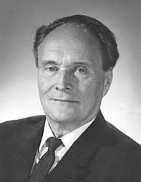
Gause’s Principle
“Two species with identical niches (and competing for a single resource) cannot coexist together indefinitely.”
Also called the competitive exclusion principle
Attributed to Georgii Frantsevitch Gause (1934)
Notes:
A Soviet and Russian biologist and evolutionist, 1910-1986
based on experimental work done with mixed cultures of both yeast and Paramecium. Because of the war his work was1st published in America and only published in Russia in 1984
Later worked on antibiotics
Image https://www.timetoast.com/timelines/precursores-de-la-ecologia

Slide 3
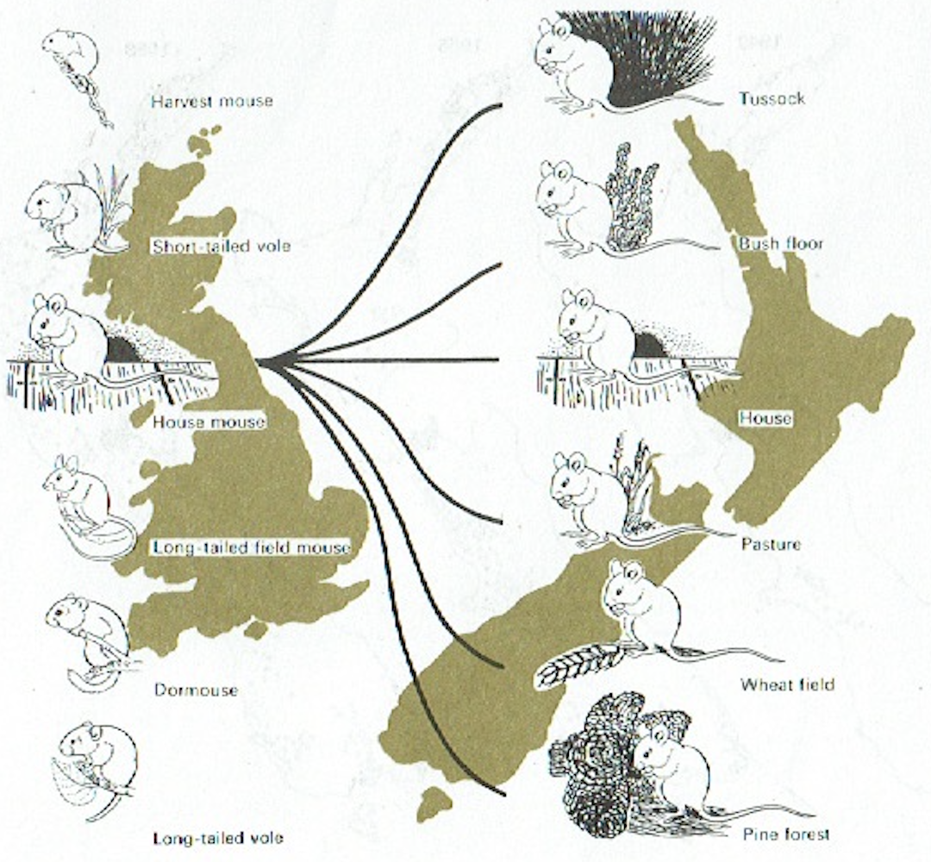
Implications of Gause’s Principle
Co-existing species have differences in their niche
When several species co-exist their niches may be narrower than when they live alone
Notes:
We only have 1 type of mouse here? Why is it found in so many more niches in NZ?
In the absence of competing species, the house mouse is found in a broader range of ecological niches here than it occupied in its homeland
Image from text Biological Patterns & Processes

Slide 4
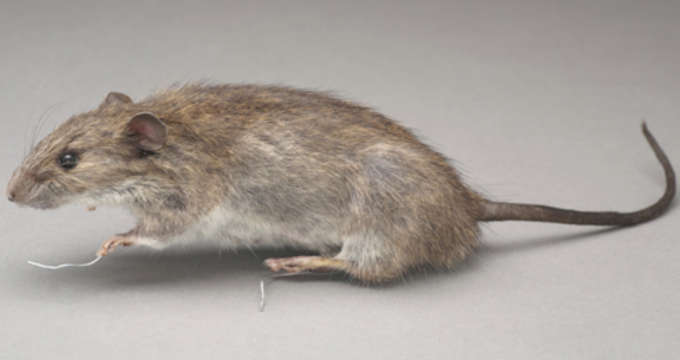
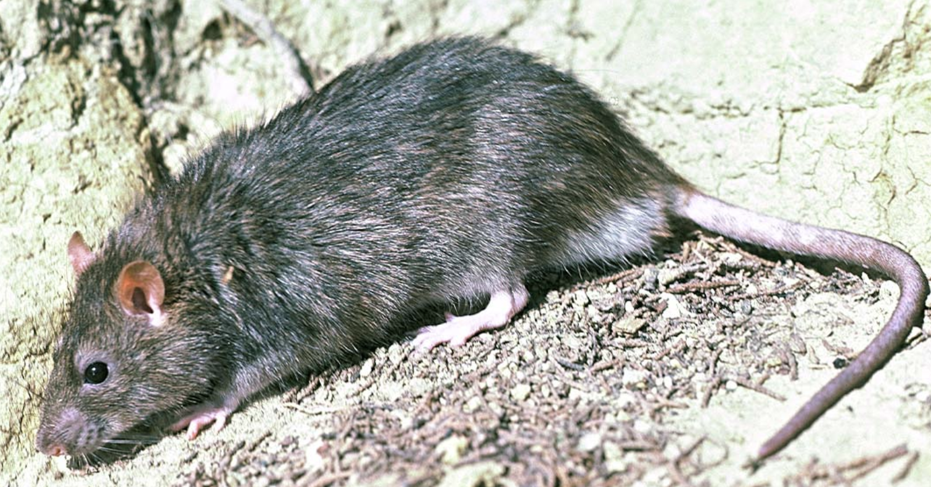
NZ rats
Kiore, Rattus exulans | Norway rat, R. norvegicus | English rat, R. rattus
Smallest Good climber Omnivore Lives in the bush Now extinct on mainland. | Largest Poor climber, digs holes Scavenger Lives in urban areas especially near water | Slim Good climbers Omnivore Found in the bush Most common
Notes:
Why did kiore die out on the mainland? Why did the other 2 not?
Kiore and English rat had the same niche and so competed and kiore died out on mainland
Norway rat and English rat had different niches so could co-exist
Norway/brown rat (Rattus norvegicus) is the largest. Its tail is thick and shorter than the body & pale underneath. Small ear, hairy on the rim. Brown fur on their back and pale grey fur on their belly.
English/Ship/black rat (Rattus rattus) is more common. Slim. Large hairless ears. Tail longer than its body and dark all round. Either black all over or grey-brown fur on their back with a creamish-white belly.
Kiore/Pacific rat (Rattus exulans) – smallest. Thin tail shorter than body. Brown fur with white-tipped grey fur on their belly, and pale feet with dark markings on the outer edge of their back feet. Ear small, slightly hairy. Omnivorous diet, feed on the ground and in trees and are good climbers. Introduced by early Maori voyagers, prey on rare weta, snails, frogs, lizards, tuatara, birds and bats, as well as other insects and the flowers, fruits and seeds of plants.
Kiore image https://web.archive.org/web/20220123194643/http://pestdetective.org.nz/culprits/kiore/
Norway rat https://www.doc.govt.nz/nature/pests-and-threats/animal-pests-and-threats/rats/
Black rat https://tekorowaiowaiheke.org/latest-news/species-of-rats

Slide 5
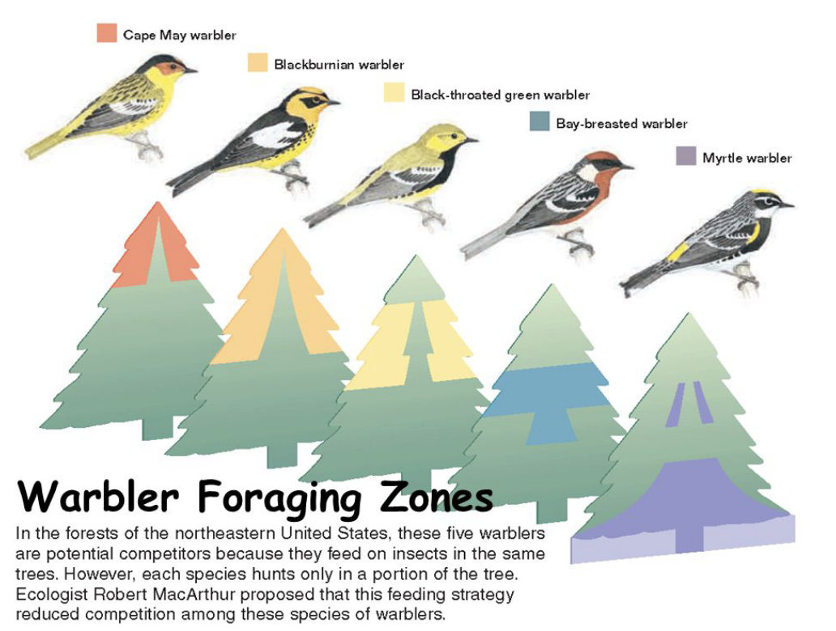
American warblers
These warblers avoid competition by occupying a unique portion of the spruce tree
Notes:
How does this exemplify Gause’s Principle?
Image source: http://www.tomwbell.net/uploads/5/6/9/7/56976837/lecture_10.pdf
Referring to this paper: MacArthur, R. H. (1958). Population ecology of some warblers of northeastern coniferous forests. Ecology, 39(4), 599-619. http://www.tomwbell.net/uploads/5/6/9/7/56976837/1931600.pdf

Slide 6
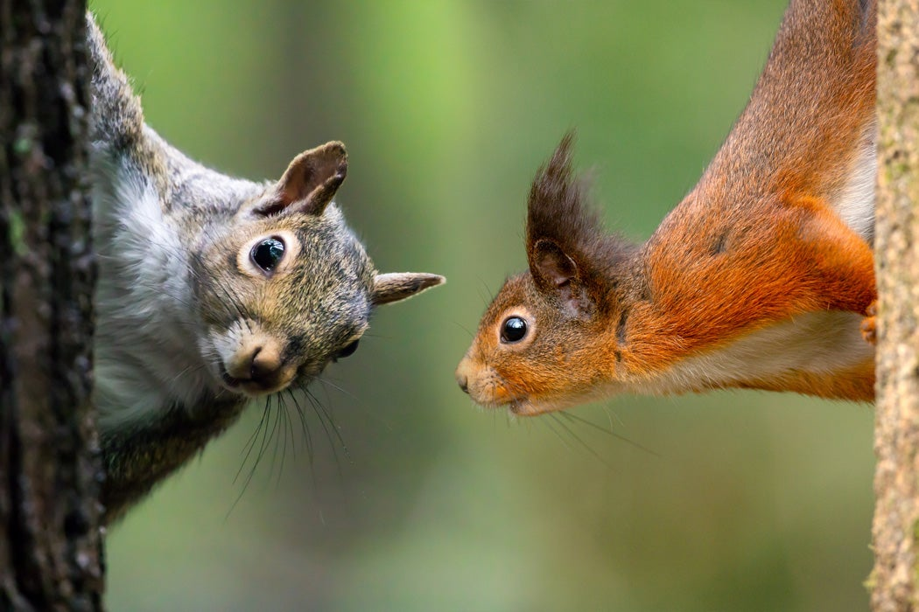
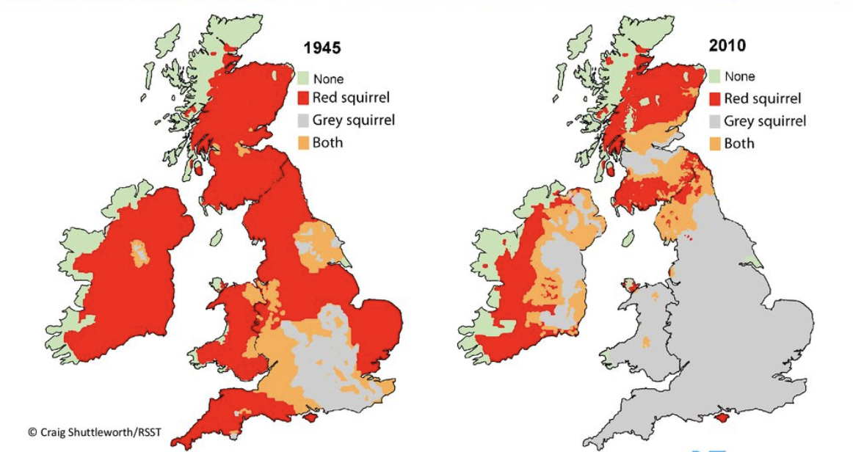
British Squirrels
The native red squirrel population in the UK has been decimated by the introduction of its American cousin, the eastern grey squirrel. The grey is considered an invasive species as they carry squirrel pox, lethal for the reds.
Notes:
How does this exemplify Gause’s principle?
The red is dying out because they have the same niche and it is being out-competed
Eurasian red Sciurus vulgaris; the eastern gray squirrel Sciurus carolinensis
The grey weas introduced in the late 1800’s.
In the 1870s the red squirrel pop was estimated at 3.5 million, these days about 150,000
Image squirrel: https://fantasticfacts.net/13246/
Map: https://redsquirrelsunited.org.uk/about/background/squirrel-distribution-map-c-craig-shuttleworth-and-rsst/

Slide 7
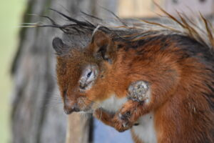
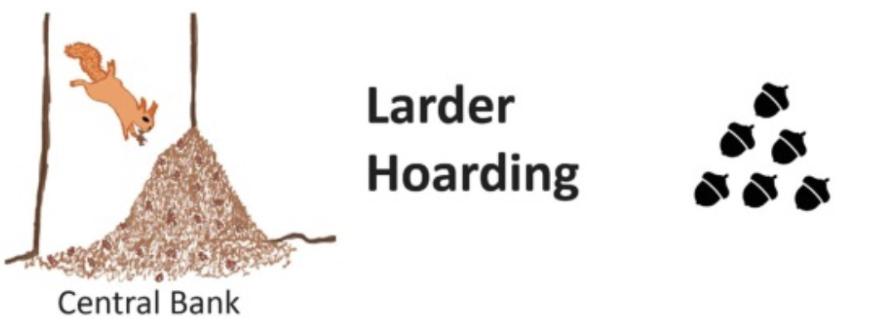
Why has the grey squirrel out-competed the red?
Squirrel pox virus causes skin ulcers, lesions, and scabs near the eyes, feet, mouth and genitals.
The red squirrel stores its nuts in one place and this larder is regularly raided by grey squirrels
Notes:
SPV image: https://www.northernredsquirrels.org.uk/squirrels/squirrel-pox-virus/
Hoarding images: https://www.sciencedirect.com/science/article/pii/S2352154622000456

Slide 8
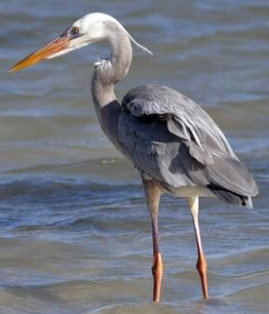
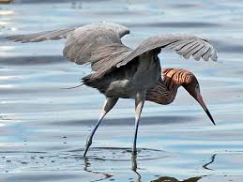
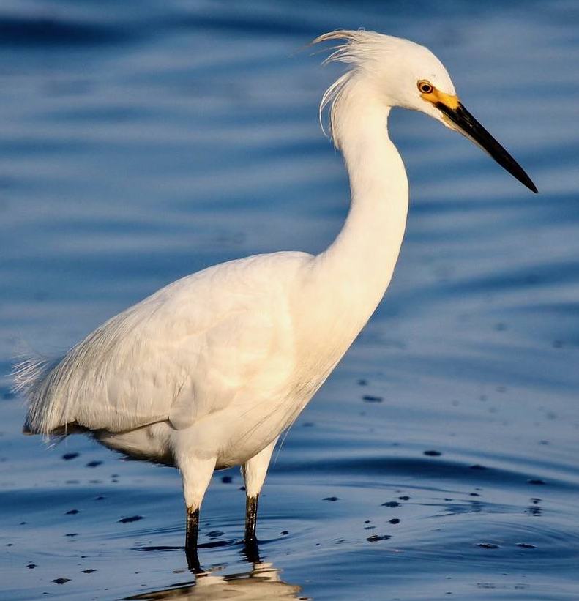
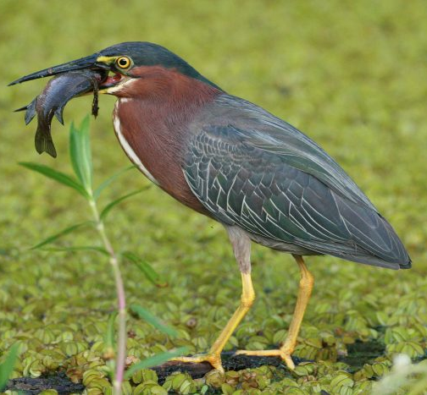
Wetland birds in Florida
Great Blue Heron | Red Egret | Snowy Egret | Green Heron
Feeds in deepest water | Feet stir up prey, outspread wings cast shadow in which prey hide & are then caught | Uses feet to stir up mud to chase out prey at edges of the water | Feeds in shallowest water amongst the reeds
Notes:
How does this exemplify Gause’s principle?
feed on fish, but catch them in different ways
GBH: https://www.allaboutbirds.org/guide/Great_Blue_Heron/id
RE: https://www.birdandhike.com/Wildlife/Birds/11-Pele/02-Arde/Reeg/_Reeg.htm
SE: https://www.saltergrove.org/snowy-egret/
GH: https://www.chesapeakebay.net/discover/field-guide/entry/green-heron

Slide 9
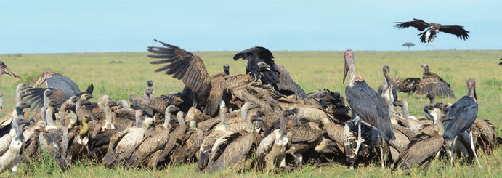
African vultures
Cinereous vulture Aegypius monachus - rips carcass open
Griffon Gyps fulvus - feeds on muscles and guts with long far-reaching beaks and horny teeth that help grip soft meat
Lappet-faced vulture Torgos tracheliotus - eats skin, sinews and meat adhering to bones, use their feet to grip while tearing with the beak
Bearded vulture Gypaetus barbatus - takes only bones
Egyptian vulture Neophron percnopterus - feeds on small bits left on bones or on the ground
Notes:
How does this exemplify Gause’s principle?
Many species of vultures feed together with little competition, because they do not feed on the same kind of meat within the carcass.
Image: https://www.researchgate.net/figure/Ecosystem-services-in-action-vultures-feeding-at-a-carcass-on-the-African-savannah_fig3_326086717

