Slide 1
ONE FOOT IN THE CLOUDS
Who are we and what is our objective?

Slide 2
We are loosely organised collective of like-minded educators that support Aviation themed practical and theoretical skills acquisition by high school students

Slide 3
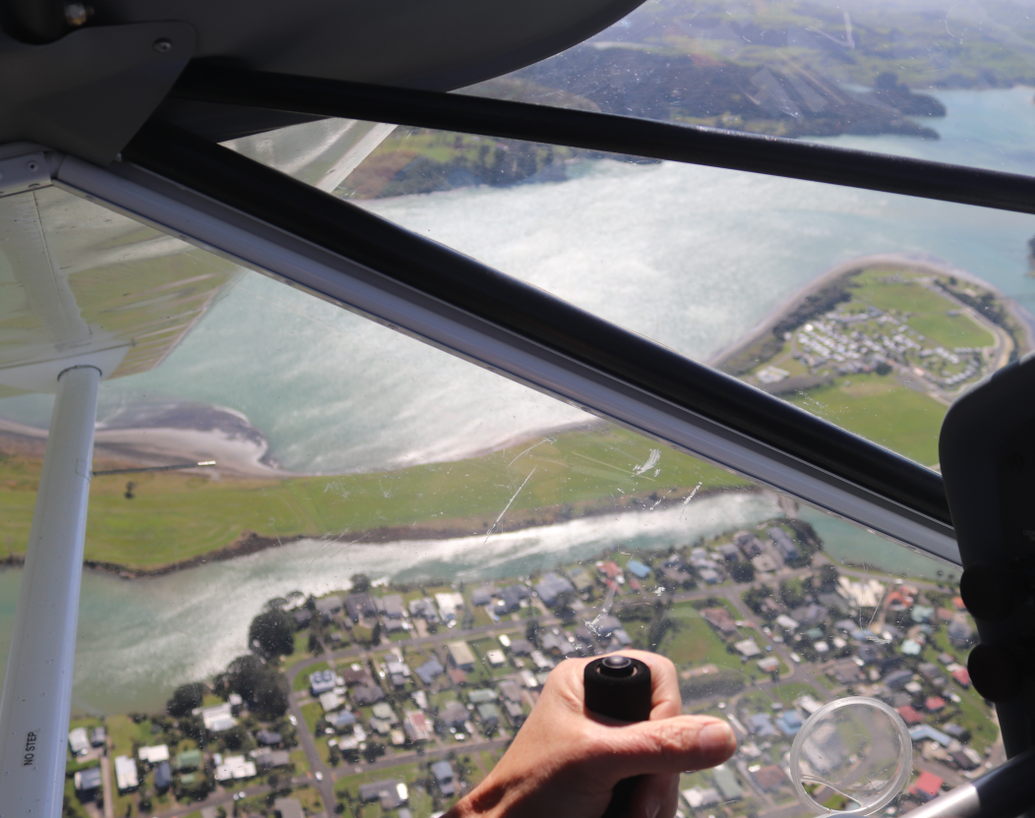
Because aviation is technical, mathematical, demanding and fun!

Slide 4
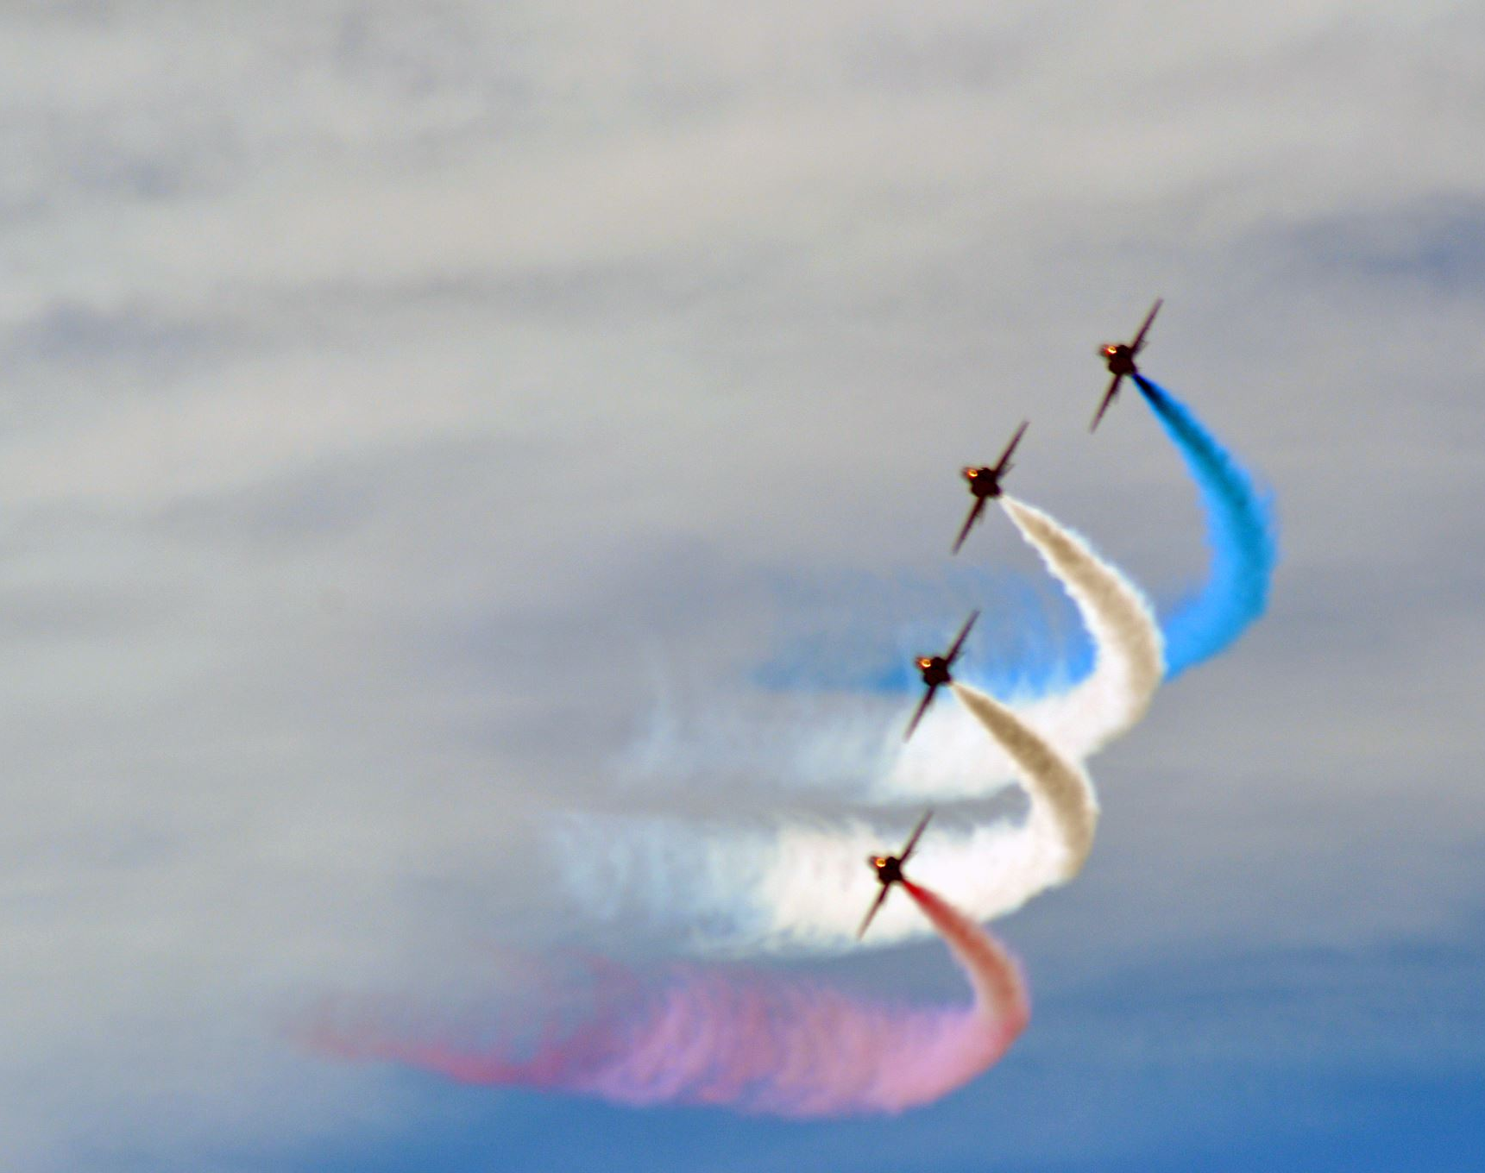
The Royal Aeronautical Society and ONE FOOT IN THE CLOUDS
Presents Project Frankenplane

Slide 5
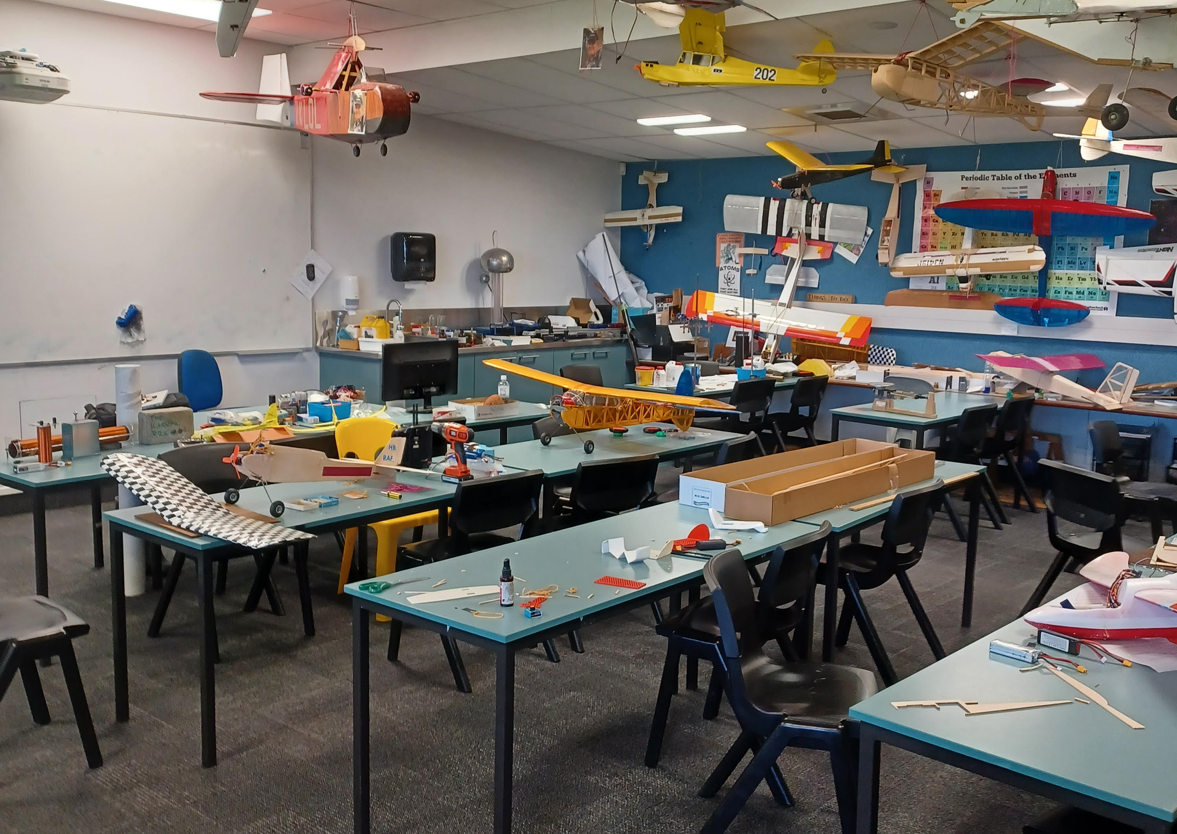
OUR MOTTO…..
“BEG,
BORROW,
INVENT
“AQUIRE”
And if all else fails, then….
BUY.”

Slide 6
What is a Frakenplane?
An aircraft made from free parts from other (dead) planes.

Slide 7
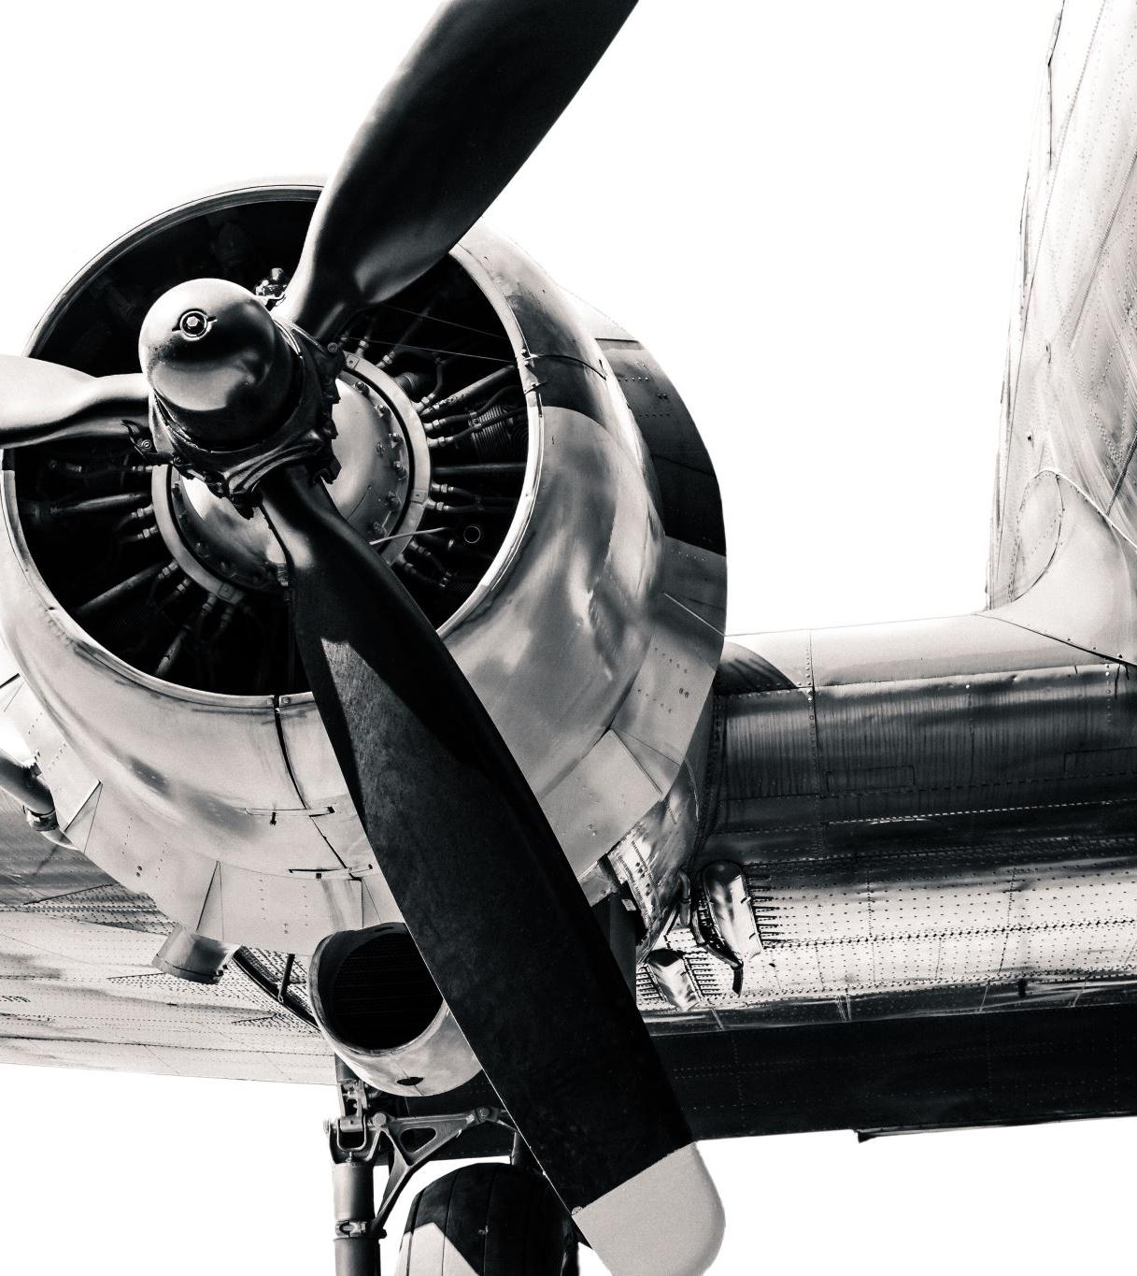
Our plan. Encourage schools to compete in practical AVIATION based challenge
Teachers will lead a group of students in designing and building a radio-controlled aircraft to perform a set of tasks.
Students will work with volunteers from universities and the aeromodelling, aviation communities to develop an airplane with 4 standard components.
The students will learn by designing, building, and flying RC aircraft with the support of a community that they must gather around them.
There will be a competition where students will test their designs against each other for prizes.
Students are encouraged to use as many “cheats” as they can.

Slide 8
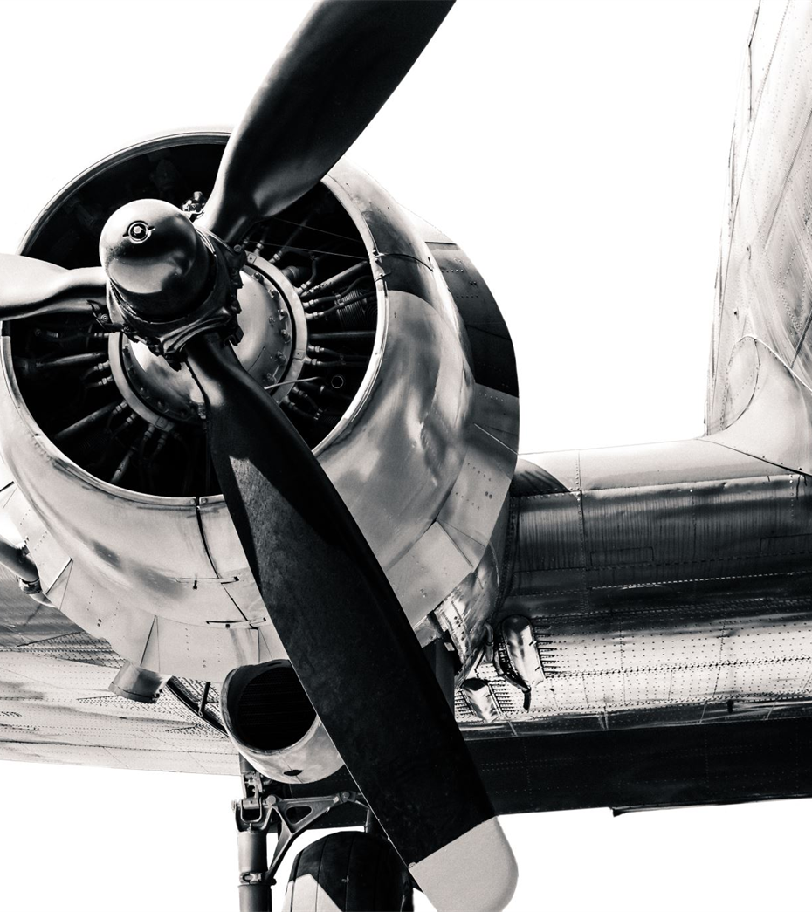
How it starts.
You fill out link to express their interest. (posting on Facebook)
Teachers (you) build a carbon tube for your team.
Teachers assemble a team.
You take your tube back to your students along with the provided motor, speed controller and battery. All these Items must be used unmodified.
Start the design and build (beg, borrow, build, steal cheat or buy).

Slide 9
Support
Local model clubs
Aspeq
CAA
Massey school Aviation
Local flying clubs
University students
Royal Aeronautical Society
One Foot in the Clouds training.

Slide 10
Key timings
Expressions of Interest
Via Facebook (Saturday)
Term 1, 2025
Carbon tube building.
Teams supplied with power train
Contact with MFNZ for each school
Full set of Rules
Term 2, 2025
Build
Learn to fly (MFNZ Wings qualification)
Term 3, 2025
Competition (held in Auckland)
Flight exams
Awards

Slide 11
Key points
Supplied standard components to be used unaltered.
Carbon tube
One rubber ball
One electric motor 400w
One speed controller
One 5s battery LIPO
Mission
Fly a pattern involving 3 take off and landings
Drop the ball as close as possible to the target while in flight.
Sit and aviation-based exam
Costs
Hopefully free but potentially $300 depending on sponsorship.
Prizes
Between $3000 and $5000.
Award from Royal Aeronautical Society.

