Slide 1
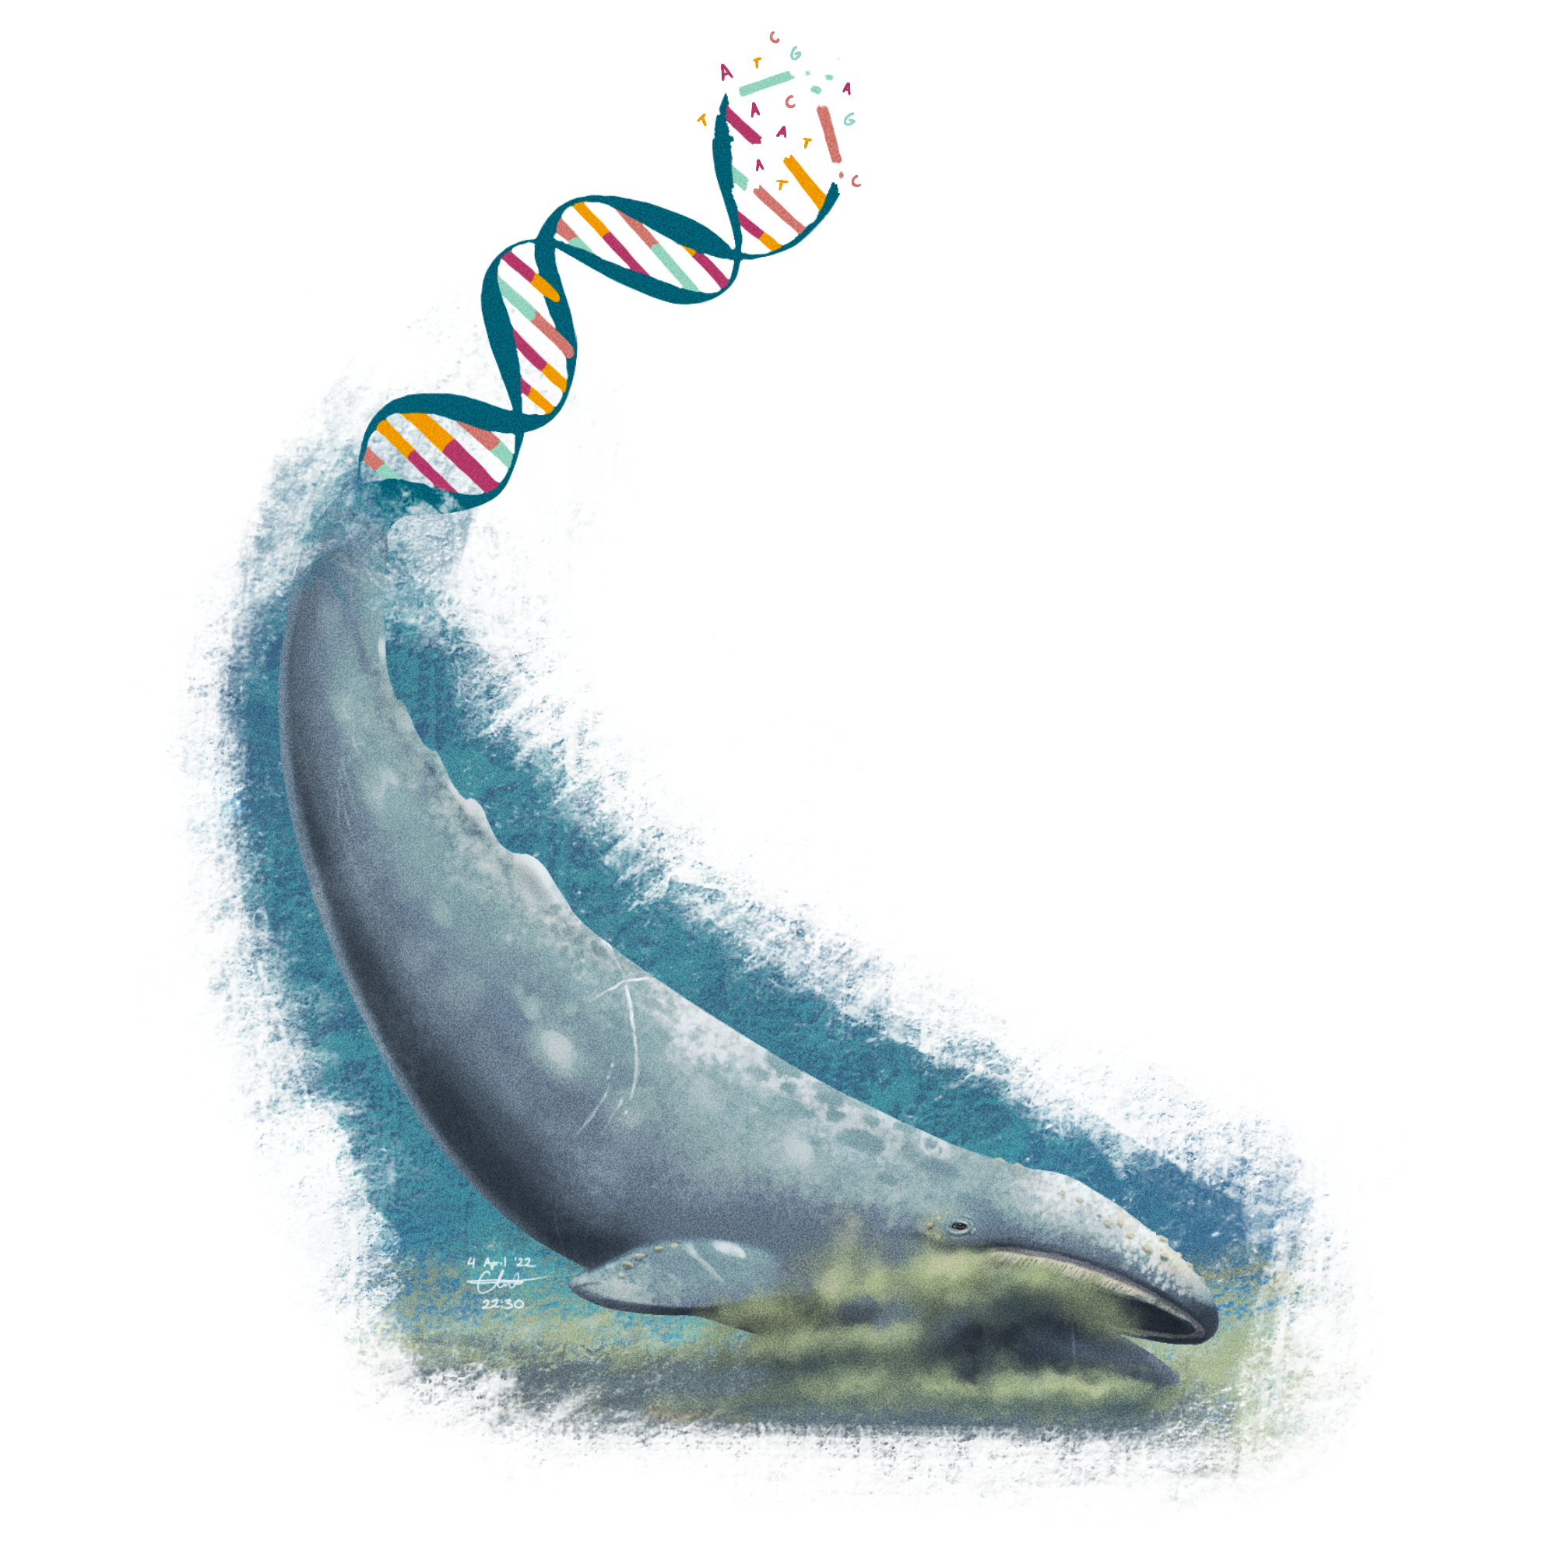
A Whale of a Change
Tails of connecting concepts through mutation, protein synthesis and evolution

Slide 2
NGSS Standards
NGSS LS3.A1:
Standard: Develop and use a model to describe why structural changes to genes (mutations) located on chromosomes may affect proteins and may result in harmful, beneficial, or neutral effects to the structure and function of the organism.
NGSS LS2.C1: Standard: Use mathematical representations to support explanations of how natural selection may lead to increases and decreases of specific traits in populations over time.
NGSS LS4.C2: Standard: Apply concepts of statistics and probability to explain the variation and distribution of expressed traits in a population.

Slide 3
Learning Goals:
SWBAT:
discuss the relationships among DNA, mRNA, Mutations, and protein synthesis
Define and be able to identify point mutation, missense mutation, nonsense mutation, silent mutation, frameshift mutations (insertion and deletion)
“Translate” amino acid sequences
Infer the general affect particular point mutations might have on synthesis of a polypeptide chain
Model ( through use of origami whale) and discuss possible implications of mutation with regard to point mutations

Slide 4
Grouping
You and your partner will be assigned one of the following group types: Type 2, Type 3, Type 4, or Type 5
Enter the group type you were assigned below
Group Type:

Slide 5
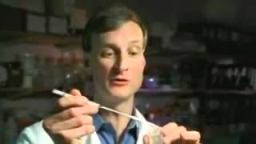
Watch Video Clip 1

Slide 6
Answer Video Clip 1 Notes:
After watching Video Clip 1 answer :
Define Mutation:
What does “ we are related to them not descended from them” mean?
What do you think is meant by “spelling changes”

Slide 7
DNA Mutations
Point Mutation
Single DNA Base (Letter:A,T,C,G) Switched
3 Types Point mutation
1.Silent
2.Missense
3. Nonsense
Frameshift Mutations
base is added or deleted, shifting the reading frame
Notes:
Other resources can be used for research of mutations like this site, and this video

Slide 8
3 Types of Point DNA Mutations- silent, missense, nonsense
1:Silent Mutation – No Change
Normal DNA:GAA -> Glu
Mutated DNA: GAG-> Glu
both amino acid = glutamic acid, so no change!

Slide 9
3 Types of Point DNA Mutations- silent, missense, nonsense
2: Missense Mutation – changes 1 amino acid.
Normal DNA:GAA -> Glu
Mutated DNA:GTA -> Val
amino acid changed from Glutamic acid to Valine

Slide 10
3 Types of Point DNA Mutations
3. Nonsense Mutation – change makes stop signal
Normal DNA: GAA -> Glu
Mutated DNA: TAA-> STOP
Stop signal stops protein too early.

Slide 11
Frameshift DNA Mutations
-A DNA base is added or deleted,
shifting all bases after making MANY changes.
Insertion Example (Inserted A)
Original DNA : ATG-CGT-ACA-GTT → Met - Arg - Thr - Val
Mutated DNA : ATA-GCG-TAC-AGT-T →Tyr – Arg – Met – Ser
Deletion Example (deletion of T)
Original DNA : ATG-CGT-ACA-GTT→ Met - Arg - Thr - Val
Mutated DNA : AGC-GTA-CAG-TT → Ser – His – Val – Lys

Slide 12
Answer Video Clip 1 Notes:
Read the following Text Link Answer 1 and 2 after a small group discussion, name the peers you worked with in your answer
Define point mutation and discuss the 3 general types of point mutation and how each affects protein synthesis
Describe what is meant by frameshift mutations and how insertions and deletions affect protein synthesis
Notes:
Individual version shared on skipped slides

Slide 13
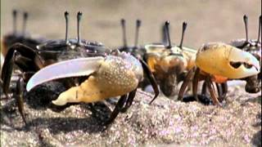
Watch the following Video clip

Slide 14
Record your groups answer
Discuss the meaning of the statement, “If one of the genes turned on in the wrong place, striking changes to the body could take place,” and relate the quote to point mutations.
(you can use an audio recording here or type your discussion points)

Slide 15
Under each type number (2-5) indicate the type of mutation exhibited.
OriginalDNA:AUG AUC UUU UUU CGU GGU ACG UGC UAU AUG AGG GGU GAG UAG
mRNA:
Amino Acids:
Mutation Type:
Type 2 DNA : AUG AUC UUC UUU CGU GGU ACG UGC UAU AUG AGG GGU GAG UAG
mRNA:
Amino Acids:
Mutation Type:
Type 3 DNA : AUG AUC UUU UUU CGU GGU ACG UGC UAA AUG AGG GGU GAG UAG
mRNA:
Amino Acids:
Mutation Type:
Type 4 DNA : AUG AUC UUU UUU _GU GGU ACG UGC UAA AUG AGG GGU GAG UAG
mRNA:
Amino Acids:
Mutation Type:
Type 5 DNA : AUG AAUC UUU UUU CGU GGU ACG UGC UAA AUG AGG GGU GAG UAG
mRNA:
Amino Acids:
Mutation Type:
Notes:
Students will need a codon chart

Slide 16
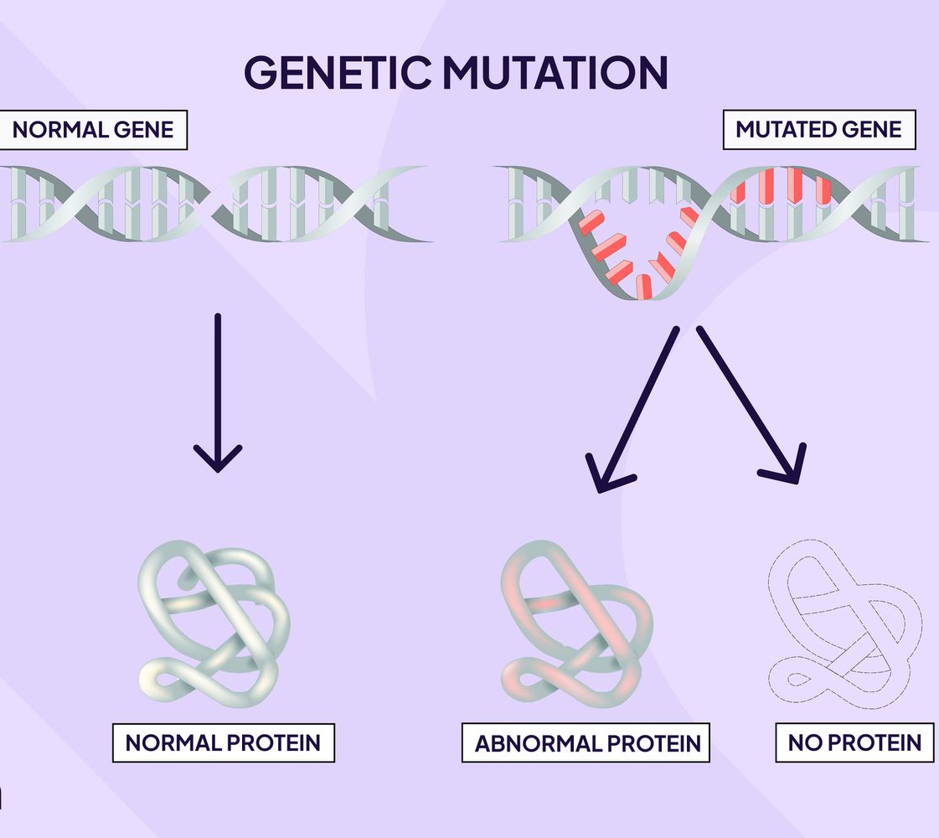
Make a prediction:
Can a change(mutation) in DNA cause a change in gene expression (a trait)?
Gene
Gene expression

Slide 17
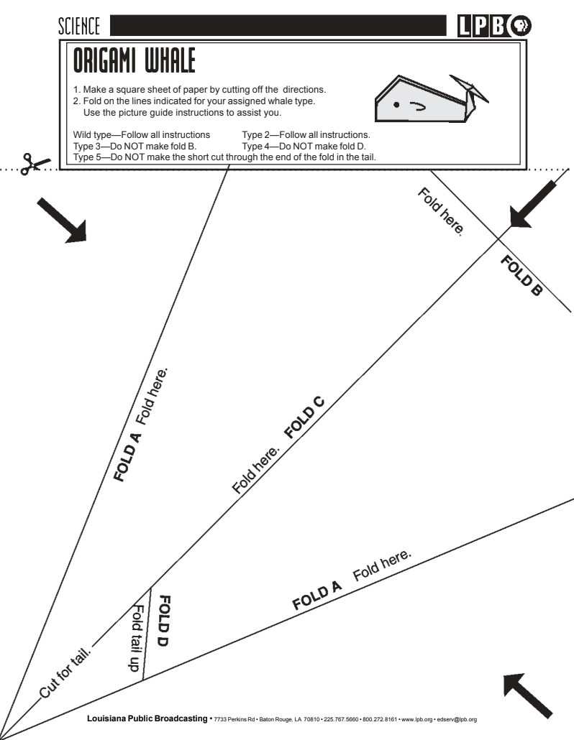
After Having Your Previous Work Checked Get Your Whale of a Tail Origami Paper
Your Origami PRINTED PAPER should look like this
Notes:
Teachers can find a link to print the origami paper here , group students into wild type, type 2, type 3, type 4, or type 5.
There are digital folding instructions linked under each group but you may want to print some folding instructions as well to help support students.

Slide 18
Click on your group only to find your instructions
OriginalDNA:AUG AUC UUU UUU CGU GGU ACG UGC UAU AUG AGG GGU GAG UAG
Type 2 DNA : AUG AUC UUC UUU CGU GGU ACG UGC UAU AUG AGG GGU GAG UAG
Type 3 DNA : AUG AUC UUU UUU CGU GGU ACG UGC UAA AUG AGG GGU GAG UAG
Type 4 DNA : AUG AUC UUU UUU _GU GGU ACG UGC UAA AUG AGG GGU GAG UAG
Type 5 DNA : AUG AAUC UUU UUU CGU GGU ACG UGC UAA AUG AGG GGU GAG UAG
Notes:
Students will need a codon chart

Slide 19
Wild Type Whale instructions
Follow all instructions

Slide 20
Type 2 instructions
Follow all instructions

Slide 21
Type 3 instructions
Do NOT make fold B

Slide 22
Type 4 instructions
Type 4- Do NOT make fold D

Slide 23
Type 5 instructions
Do NOT make the short cut through the tail

Slide 24
BONUS
Insert a photo of your whale here!

Slide 25
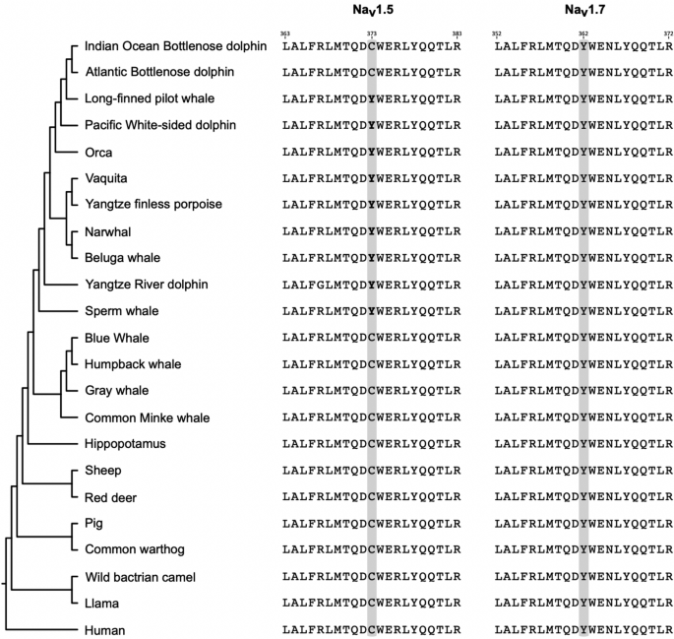
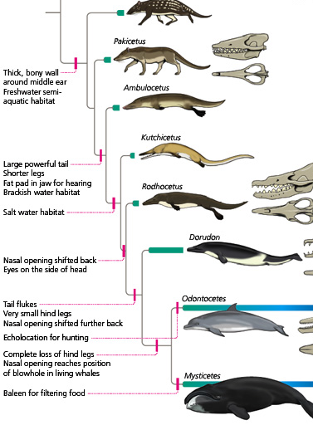
Mini Evolution Extension:
Watch this video on Whale Evolution and answer the following question:
What are whales closest living relative?
What did scientists test to come up with these findings?
Claim: What could have caused the prehistoric ancestor of the whale to develop new traits over time, leading to the modern whale's body structure?

Slide 26
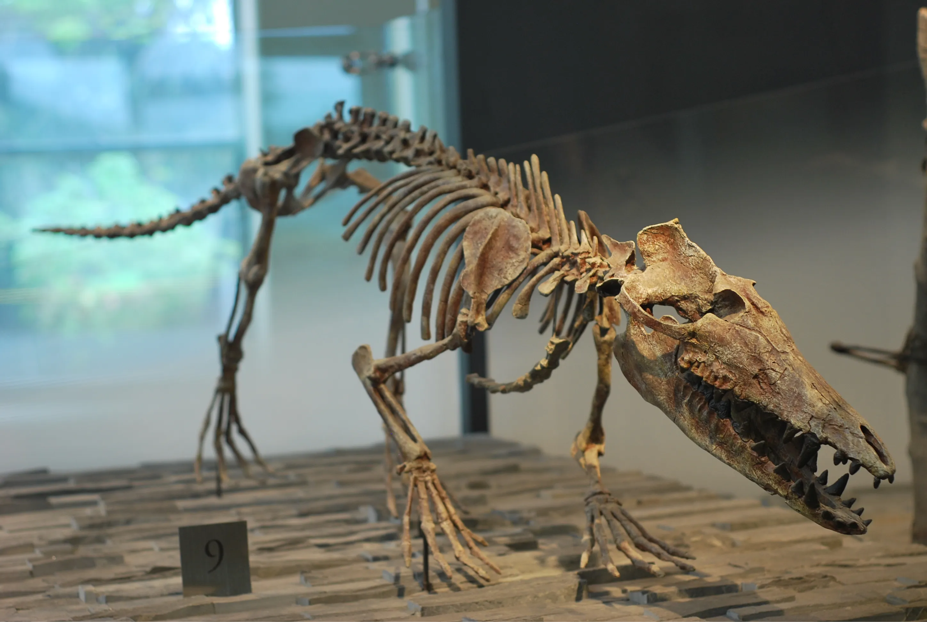
Extended Evolution Activity :
Use the Following Fish or Mammal Case study
To a Organizer Evidence and submit.

Slide 27
Discuss, with your classmates/group the possible implications of each of the mutations on the previous slide. First problem and hypothesis then after activity collect data and conclusion
Lab Notes (include yours and your partners name)
Problem:
Hypothesis (justification of getting to this hypothesis):
Collect Data:
Conclusion:
Notes:
Used for lab format

Slide 28
Class discussion and circle back
Look at your RNA and mutation type, find groups with different types of RNA and their mutation types
Gather data
Circle back to your lab notes and complete your notes
Notes:
Used for lab format

Slide 29
Submit what you have done so far in “A Whale of a Tale” on canvas to get your materials for your next step
Notes:
Used for lab format

Slide 30
Answer the following questions
1. Define point mutation. Discuss the 3 general types of point mutation and how each affects protein synthesis.
2. Describe what is meant by frameshift mutations? How do insertions and deletions affect protein synthesis?
Notes:
You can add this supplemental video for students if necessary watch this video and

Slide 31
TEACHER PRINT RESOURCE LINK:
LPB “What a Whale of a Change!”
Notes:
Used for lab format

