Slide 1
Science during Matariki
Ian McHale
NZASE
Notes:
Some ideas of an astronomy unit you could build around Matariki
If you discuss this with your department you will come up with other things you could do too.
These ideas could be used at both primary and secondary levels, integrated into other subjects slide 10

Slide 2
NoS focus?
What aspects of NoS or Science Capabilities might be useful here?
Investigating in Science | Understanding about Science | Communicating in Science | Participating & Contributing
Where the focus is on student investigations | Where the focus is on scientists’ work | Making meaning of scientific representations | Is about taking action
Gather and Interpreting Data Using Evidence Critiquing Evidence | Gather and Interpreting Data Using Evidence Critiquing Evidence | Interpreting Representations | Engaging with Science
Notes:
Green = Nature of Science, NZC; Blue = Science capabilities. Image from Sabina Cleary

Slide 3
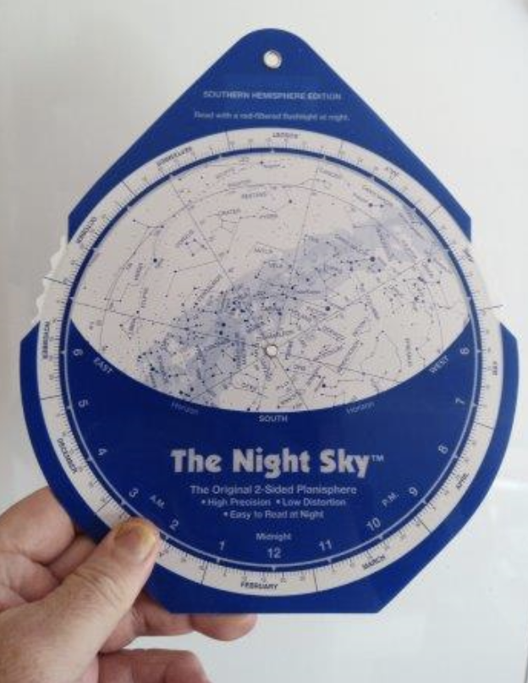
Start with observable astronomical patterns
What can students see?
Focus on
Observation and inference
Systematic recording
Drawing and labelling
Interpreting data
Check students understand the points of the compass
… of the sun, moon, constellations and how their movement changes thru the day/night/month/year
What activities, readings might be useful here?
Notes:
What astronomical cycles can we observe everyday that allow us to gather and interpret data. Because this is how scientists work and this is how Māori astronomy works. We can see the moon, sun and stars everyday (depending on the weather).

Slide 4
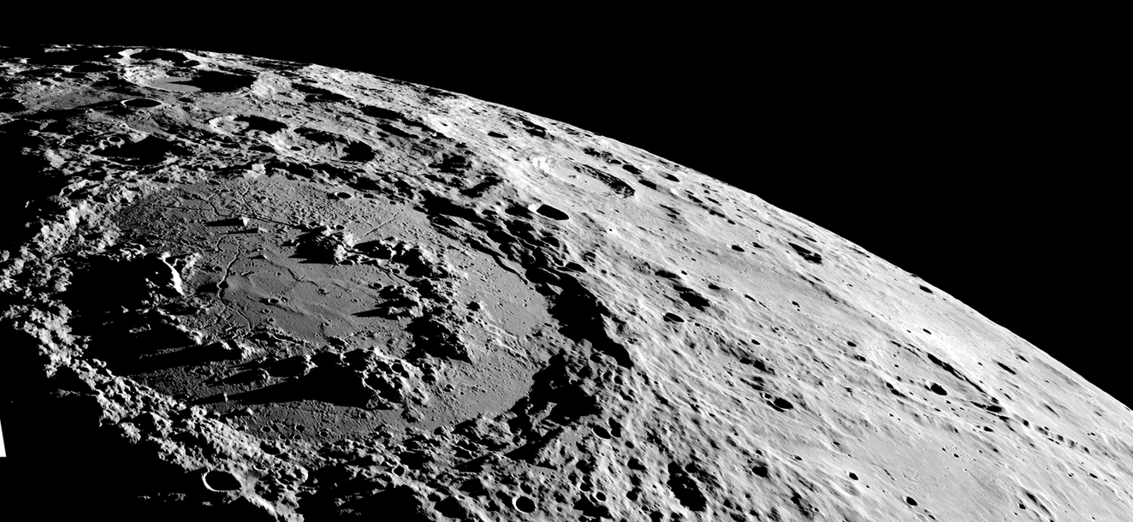
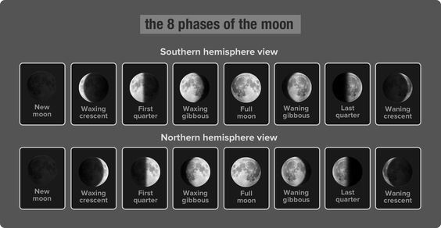
Moon
Sequence of the phases we see in NZ
What we can see through a telescope
Why is the Moon Upside Down? Reading from Connected L3 2013
Other activities?
Notes:
Lunar diary?
Model with globe and light source
Connected https://instructionalseries.tki.org.nz/Instructional-Series/Connected/Connected-2013-level-3-Food-for-Thought/Why-Is-the-Moon-Upside-Down

Slide 5
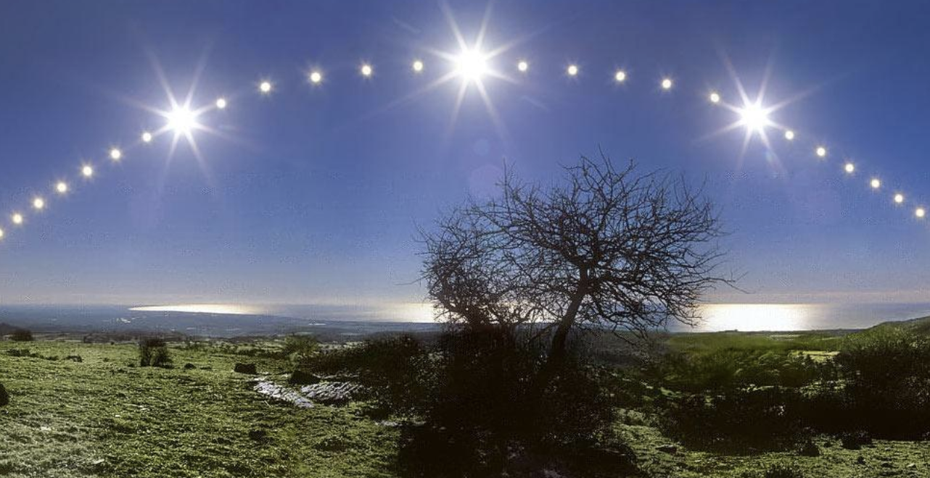
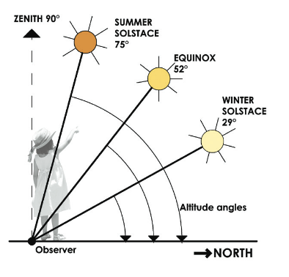
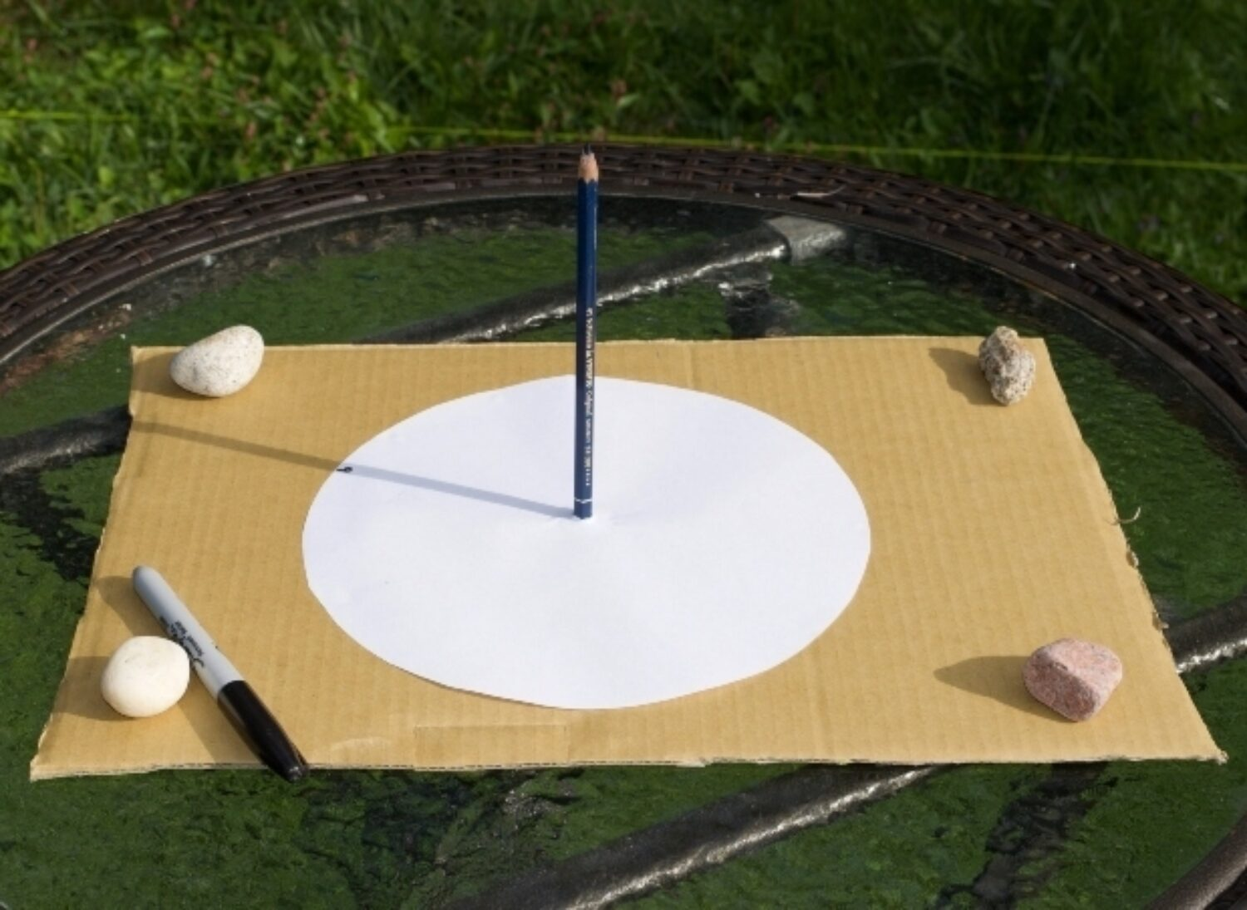
Sun
What changes to the sun do we see
During the day?
Over the year?
Observation & inference - Eg observe the sun at midday every day for a month Can students explain when it is night?
School Journal article
Other activities?
Notes:
Cool Facts about a hot place : https://instructionalseries.tki.org.nz/Instructional-Series/School-Journal/School-Journal-Level-2-October-2015/Cool-Facts-about-a-Hot-Place
During day: https://www.pbslearningmedia.org/resource/buac18-k2-sci-ess-sunposition/changing-position-of-the-sun-in-the-sky/
Over year (highest pt, Melbourne) https://www.mrsc.vic.gov.au/files/assets/public/live-amp-work/environment/environmentally-sustainable-design-factsheets-2018_1.pdf

Slide 6
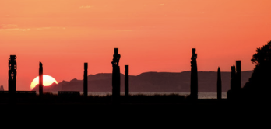
Pūrakau
Māui catches the sun
Tamanuiterā and his 2 wives
Others?
We can explore mātauranga Māori and we can explore science but it is best not to compare the two
Notes:
The pūrākau about Tamanuitera the sun and his two wives has codified knowledge around the yearly movement of the sun, maybe we can connect this to our own observations of the sun. https://thespinoff.co.nz/atea/22-12-2017/tamanuitera-the-sun-and-his-two-wives
Tamanuiterā, the sun, makes his journey rising in the North-Eastern sky in the winter, through to the South-Eastern sky in the summer, and back again. Tamanuiterā splits part of each year between his beautiful wives Hine Takurua, the Winter Maid, and Hine Raumati, the Summer Maid. Hine Takurua and Hine Raumati live in two very different domains on Earth. Hine Takurua dwells out on the ocean and is connected to the foods of the sea, while Hine Raumati resides on land and supports all the various food that grows on Papatūānuku. The story of Tamanuiterā and his two wives is Māori understand the path that the sun takes in the sky and the resulting changing seasons.
Maui and the sun: You Tube video https://www.youtube.com/watch?v=jbM3PwcGi0g
Journal article https://instructionalseries.tki.org.nz/content/download/42166/468143/file/RTR-Maui%2520and%2520the%2520Sun-Online.pdf
Science Learning Hub resource https://www.sciencelearn.org.nz/resources/1752-maui-and-the-sun
Images
Andrew Caldwell Good morning, Tamanuitera. Sunrise over Cape Kidnappers & Atea a Rangi, Napier, Hawke's Bay, New Zealand

Slide 7
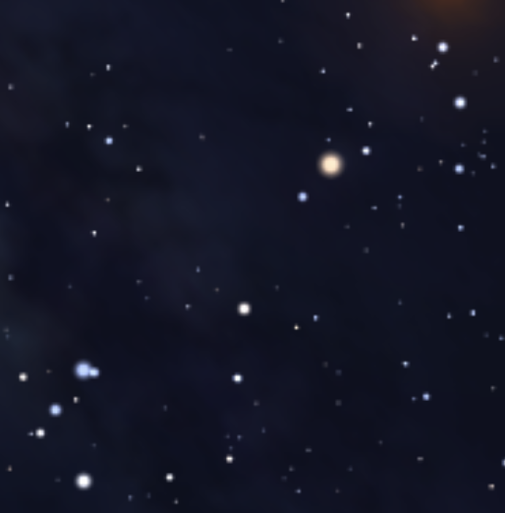
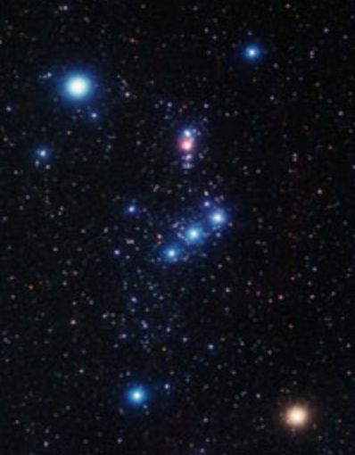
Constellations
Te Mangoroa | Milky Way
Te Kakau | Orion's Belt
Te Taura o te Punga | Pointers
Taki-o-Autahi or Te Pūtea Iti a Tama Rereti | Southern Cross
Te Waka-o-Tama-rereti | Tail of Scorpion
Te Waka-o-Maire-rangi | Part of Scorpio
Which ones do we focus on?
What activities are useful?
Notes:
Scorpius: Stellarium
Orion: https://www.mistermoose.org/nz/arriving.html
Science Capabilities

Slide 8
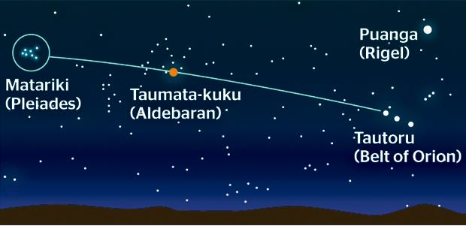
Matariki
How to find?
Significance of Puanga
What do we know about the star cluster?
Notes:
Matariki is low on the horizon in the NE sky, look between 5.30 a.m. and 6.30 a.m.
Face NE → Find Tautoru (3 stars of Orion’s belt) → find bright orange star to the left, Taumata-kuku (Alderbaran), follow line til hit Mtaraiki cluster.
Also here: Puanga/Puaka (Rigel in Orion), Takurua (Sirius)
Matariki is a star cluster, a smaller closer group of stars, rather than a larger recognisable pattern (the constellation)

Slide 9
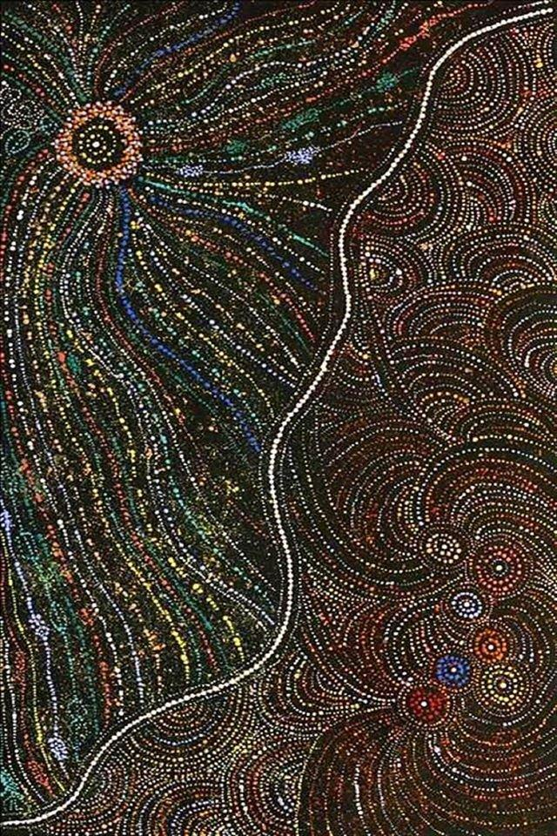
In other cultures
Australia – various, e.g. Star dreaming: 7 Napaljarri women
Hawaii – Makali’i
Japan – Subaru
India – Krittika
Europe – Pleiades
In many of these, 6 or 7 women are being chased by a hunter (Orion)
Notes:
Painting by Wendy Nungarrayi Brown titled Star (Seven Sisters) Dreaming
https://theconversation.com/the-worlds-oldest-story-astronomers-say-global-myths-about-seven-sisters-stars-may-reach-back-100-000-years-151568

Slide 10
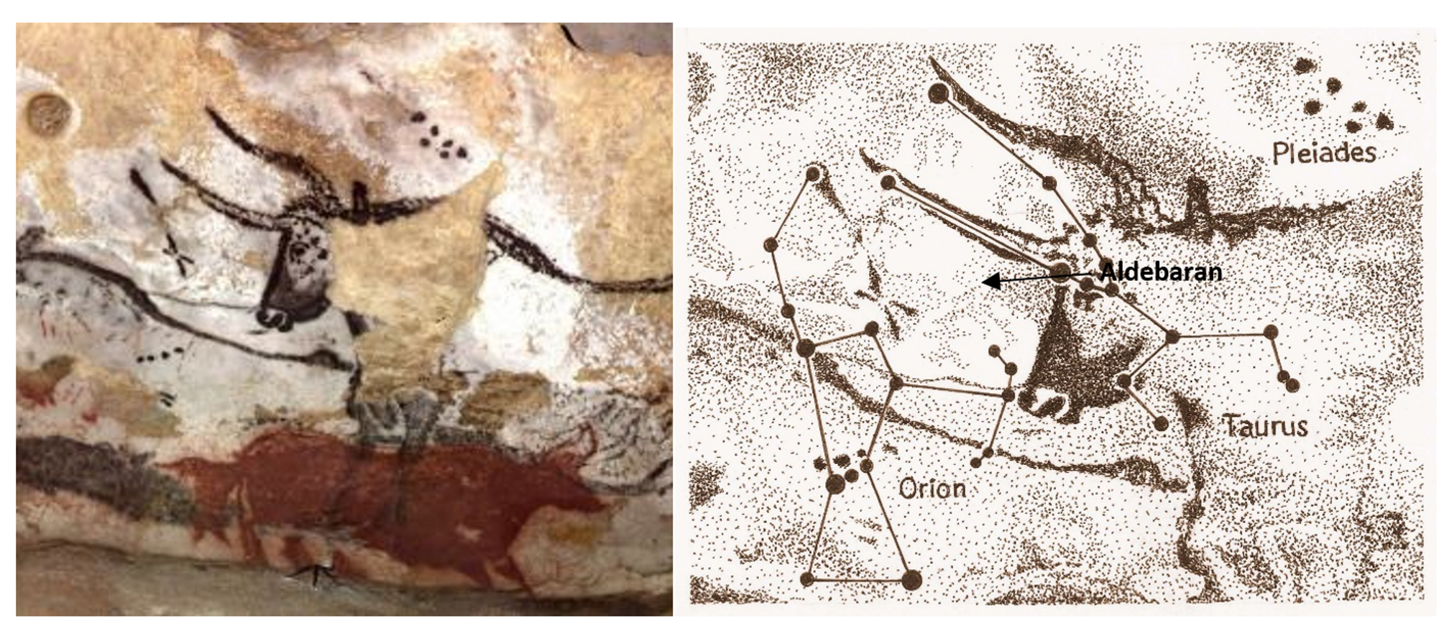
30,000 years ago people saw patterns in the stars
A cave painting in Chauvet is believed to show 3 star groups.
What do you notice?
Notes:
A cave painting in Chauvet is believed to show 3 star groups – Orion, Taurus and Pleiades
Different order in the northern hemisphere – Pleiades to the right of Aldebran

Slide 11
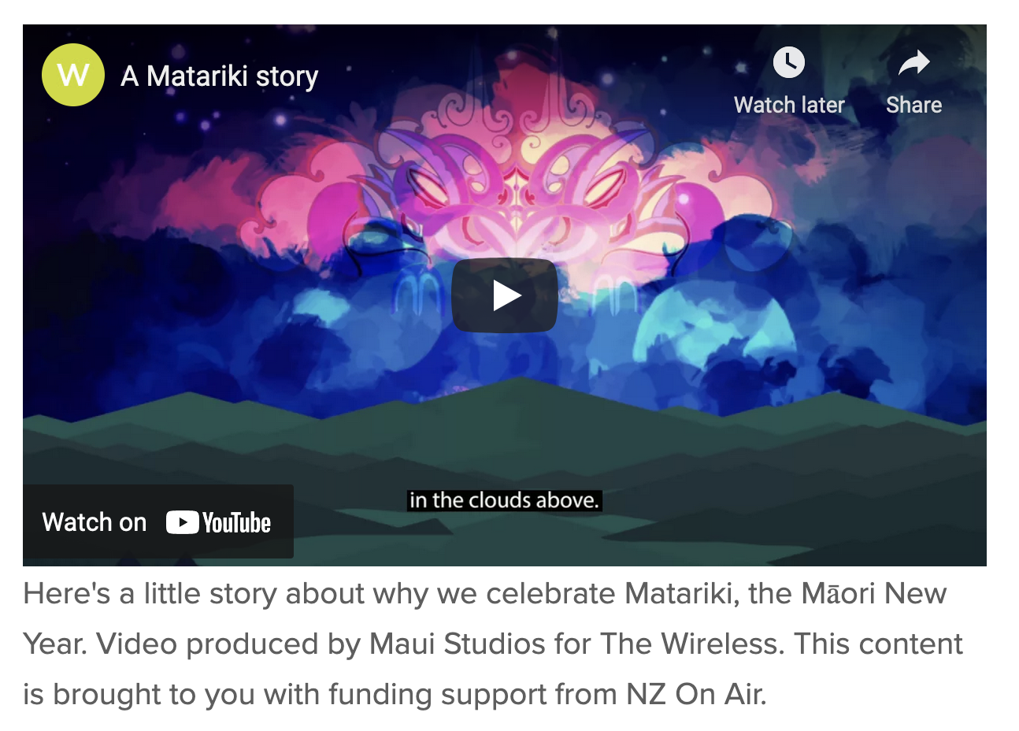
A useful site: inmotion
Goes through each star with some information and an activity
Make kawakawa balm
Enlarge a child’s artwork
Plan a garden
Sing a waiata
Create with playdough
Make rain sounds
Make a flax flower
Rewena bread
Make a kite
Explore Celestron SkyPortal app
Notes:
https://www.inmotion.org.nz/matariki-the-star
App: https://www.celestron.com/pages/skyportal-mobile-app

Slide 12
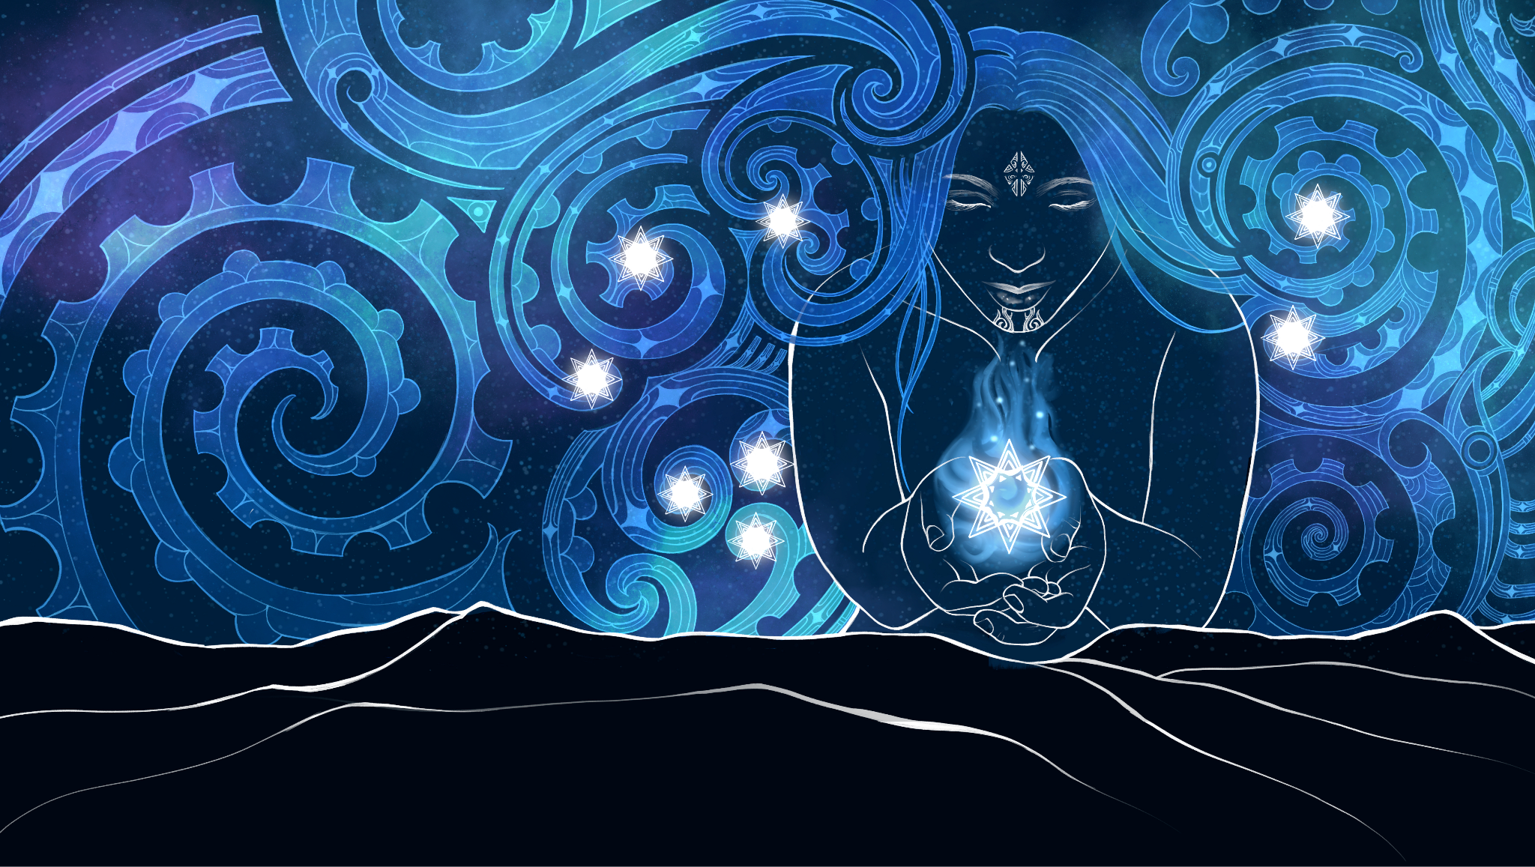
Cross-curricular links
How can we incorporate Matariki into
maths/numeracy?
english/literacy - reading? writing?
Miriama Kamo reading her book The stolen stars of Matariki.
social studies ?
technology?
the arts? visual arts ?
1st waiata or 2nd waiata?
??
Notes:
Ask students to bring a photo of an ancestor or someone who had passed on and share stories of what we remember about them.
Lay down a hangi and feed the whole school of 600. Students learned how prep ground, prep food, set a table and serve their parents.
maths https://nzmaths.co.nz/search?keys=matariki
technology https://technology.tki.org.nz/Technology-in-the-NZC/Planning-programmes-and-units-of-work/Technology-unit-planning/Celebrating-Matariki
Social studies https://instructionalseries.tki.org.nz/Instructional-Series/Ready-to-Read-Colour-Wheel/Matariki
english https://instructionalseries.tki.org.nz/Instructional-Series/School-Journal/School-Journal-Level-2-November-2017/Celebrating-Puanga-at-Ramanui
song https://docs.google.com/presentation/d/1QxBsuzIjlGUJxR30HTBvUnaNCIa5JuEiGx_1ByLu45k/edit#slide=id.g22f22ee6d7_0_0
2nd waiata https://www.youtube.com/watch?v=tLoDXwHpX6o
visual arts https://topteachingtasks.com/5-ways-to-introduce-matariki/
miriama Kamo

Slide 13
Other ideas?
Notes:
Ask students to bring a photo of an ancestor or someone who had passed on and share stories of what we remember about them.
Lay down a hangi and feed the whole school of 600. Students learn how prep ground, prep food, set a table and serve their parents.
Make an instrument
Make flax stars, baskets
Tikanga when gathering plants
Gift giving
What about behaviours? Being reflective, being thankful, remembering those who have died
Image: https://www.whakatane.com/events/matariki-2021

Slide 14
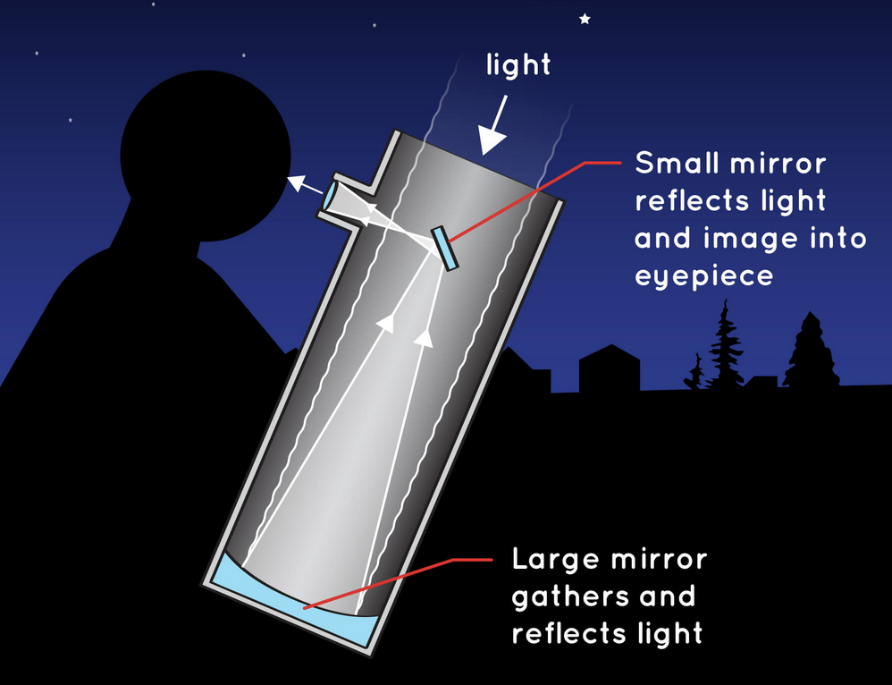
Reflection
What have I learnt?
What do I take away?
What are my next steps?
Notes:
Reflection time. Pause. Consider:-
What you take away?
What have I learnt?
What are my next steps
Image: https://spaceplace.nasa.gov/telescopes/en/

