Slide 1

Eclipse 8 Sep 2025
With Teacher Notes
Notes:
From Mike Stone (with thanks to Ross Stephen, Avondale College, who checked I had it right and gave us the wonderful activity on slide 16)
I have purposely not identified the type of eclipse – students can do that as part of the lesson
Each slide has teacher notes, many include questions you might ask students
For the activity at the end it will help if you have downloaded a light meter onto your phone first and tried it out. There are different Light meter apps for Android and for Apple. Or get the kids to find one for homework.
Image: Alma Thomas, The Eclipse, 1970, acrylic on canvas, 157.5 × 126.4 cm, Smithsonian American Art Museum, Gift of the artist, 1978.40.3

Slide 2
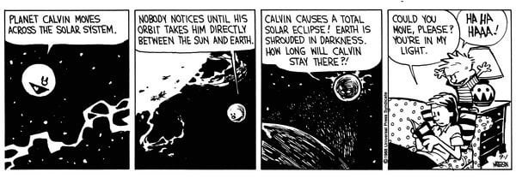
What do we know about eclipses?
In pairs share what we know about eclipses and one or two questions we might have.
Share an idea from each pair in a class brainstorm or on a digital platform. Eg this padlet https://padlet.com/mikhal/my-smart-padlet-dcxeewlhx5y10h0c
Notes:
https://padlet.com/mikhal/my-smart-padlet-dcxeewlhx5y10h0c

Slide 3
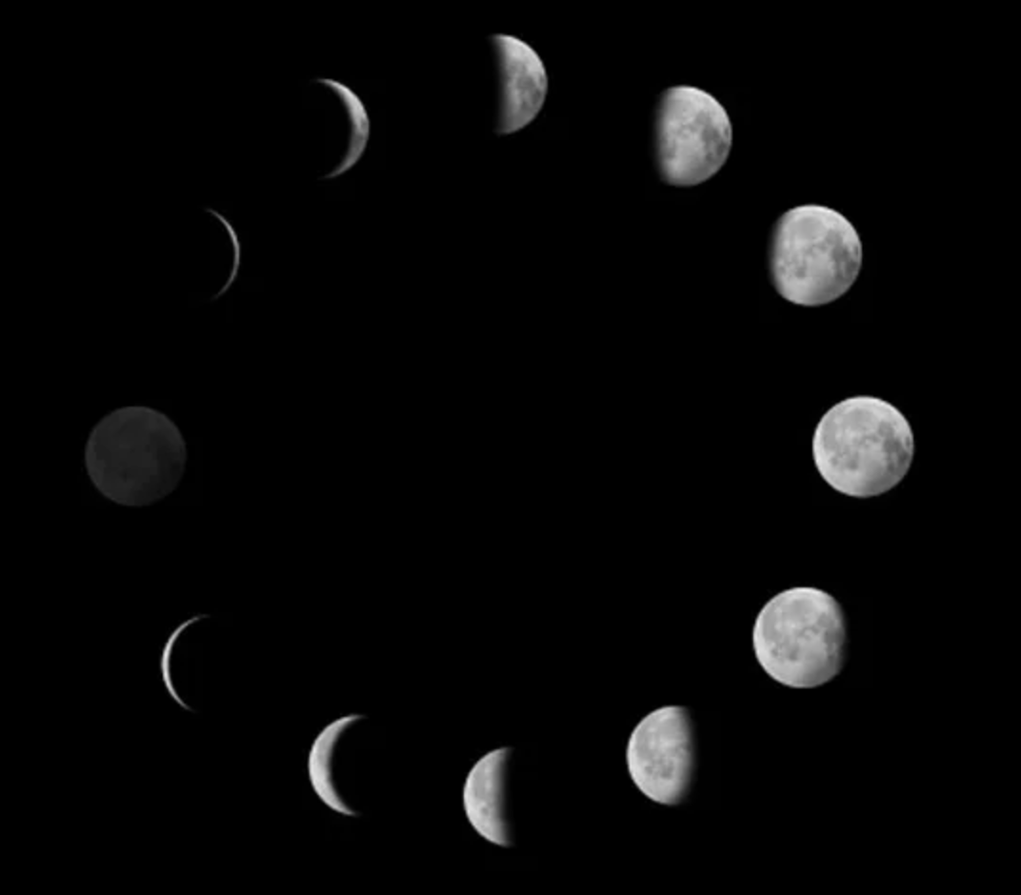
Reviewing moon phases
Last Quarter
Half of the Moon’s surface is always illuminated by sunlight. As the Moon orbits Earth, it changes how much of the lit-up side we can see.
New moon
Full moon
First quarter
Notes:
Where would the Earth be in this image?
Where is the light from the sun coming from in this image? From the left (behind the NM)
What direction is the sequence in? anticlockwise
How does it differ in the Northern Hemisphere – same sequence NM → 1Q → FM → 3Q but the opposite side of the moon is lit. SH: C O D NH: D O C

Slide 4
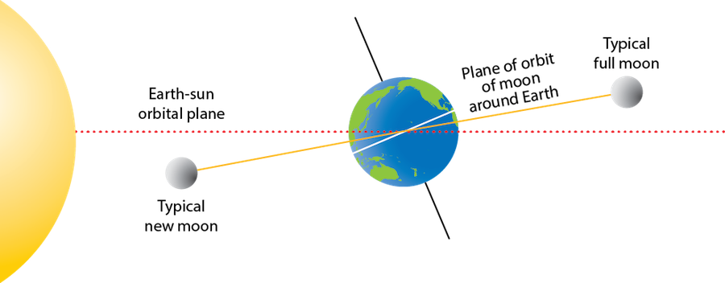
Reviewing orbits
The Earth’s and moon’s orbits only line up in the same plane for a short part of their cycle. This happens for about 34 days every 6 months or so.
The moon's distance from Earth can vary from about 363,300 km to about 405,500 km.
Notes:
How long – for the Earth to orbit the sun? 365.25 days
- for the moon to orbit the Earth? 28 days
Image: https://manoa.hawaii.edu/exploringourfluidEarth/physical/tides/tidal-movements/weird-science-eclipses

Slide 5

An eclipse is a shadow
There are times when the sun moon and Earth line up exactly. When that happens the light from the sun can cause a shadow.
Notes:
https://www.wikihow.com/Make-Shadow-Puppets
What do we need to make a shadow? Light source and something blocking it, and something for the shadow to fall on

Slide 6
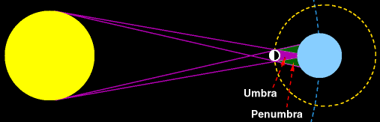
Solar Eclipse
A solar eclipse occurs when we are looking at the sun and the moon passes in front and causes a shadow on Earth
This can only occur during the day and only at a New Moon where the sun Earth & moon exactly line up
Notes:
Why can a solar eclipse only occur at new moon?
What’s the difference between the umbra and the penumbra?

Slide 7
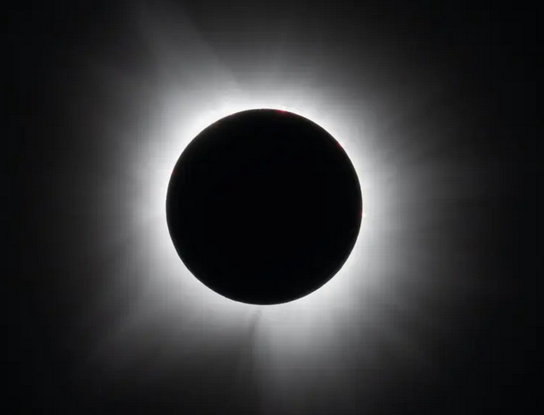
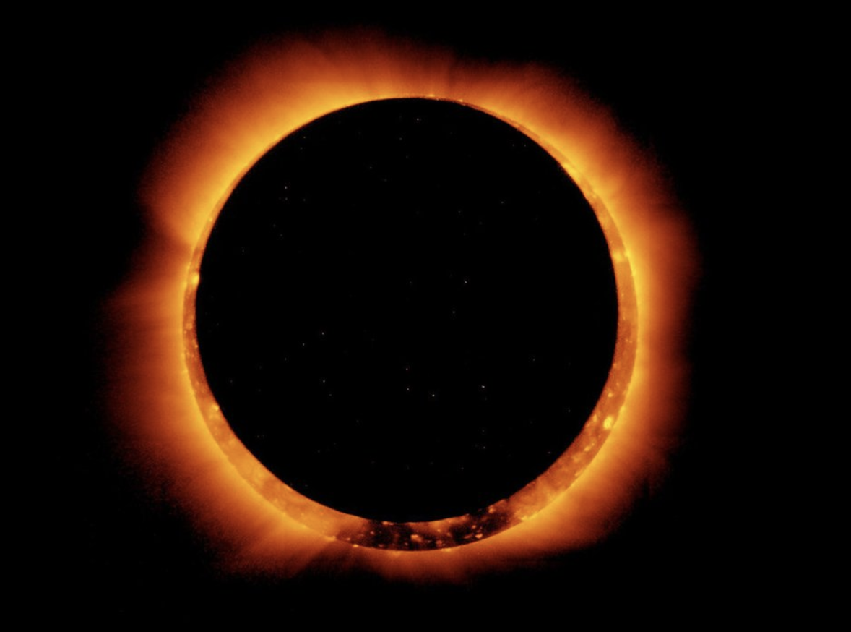
Solar eclipse in the umbra
The Umbra is the area where the sun is completely obscured by the moon.
If the moon is at its furthest distance from Earth, a person standing on the Earth in the umbral shadow would see a total eclipse. This can last from a few seconds up to 5 or 6 minutes.
If the moon is further away in its orbit then we see an annular eclipse.
Notes:
Which diagram shows the total eclipse and which the annular eclipse? Top right = total, bottom right = annular
What can we see of the sun? the sun’s corona (its outer atmosphere, which looks like a halo) & solar flares (spectacular arcs of glowing red gas).
So what would happen to the day? The day becomes dark, though not as dark as night
Images of moon https://www.jpl.nasa.gov/edu/resources/teachable-moment/the-science-of-solar-eclipses-and-how-to-watch-with-nasa/

Slide 8
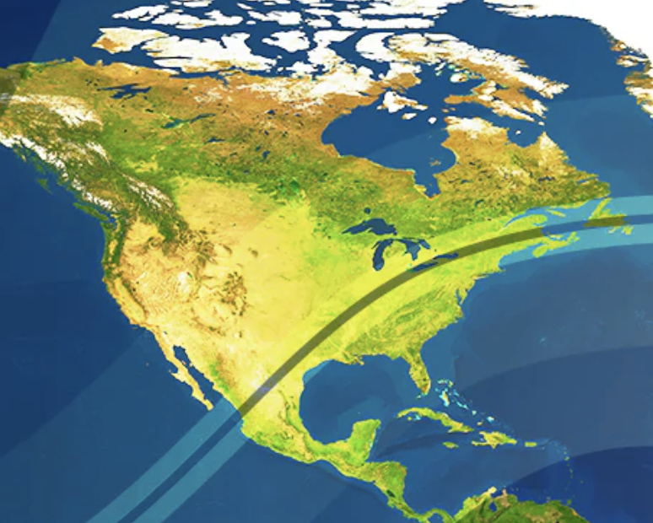
Path of totality (for the 2024 solar eclipse)
What would you say the path of totality is then, can you give a definition?
Notes:
What would you say the path of totality is then, give a definition?
https://www.celestron.com/blogs/news/how-to-view-the-april-2024-total-solar-eclipse?

Slide 9
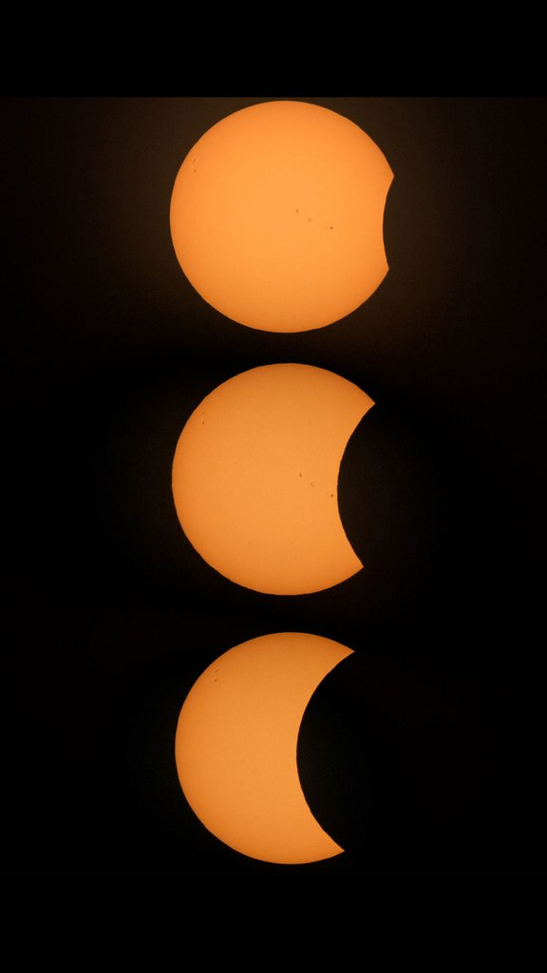
Solar eclipse in the penumbra
Here we can see a partial eclipses, but for two reasons:
  Viewers are outside the path of totality during a total solar eclipse (or the path of annularity during an annular eclipse) will see only part of the Sun’s surface covered by the Moon.
  When the Moon is nearly above or below Earth in its orbit so only part of the Moon’s shadow falls on Earth. In this case, only part of the Sun’s surface will appear covered by the Moon.
Notes:
https://www.jpl.nasa.gov/edu/resources/teachable-moment/the-science-of-solar-eclipses-and-how-to-watch-with-nasa/

Slide 10
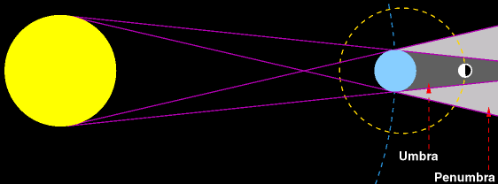
Lunar Eclipse
A lunar eclipse occurs when we are looking at the moon & the Earth passes in front of the sun & causes a shadow on the moon
This can only occur during the night and only at a Full Moon where the sun Earth and moon exactly line up
Notes:
Why can lunar eclipses only occur at full moon?

Slide 11
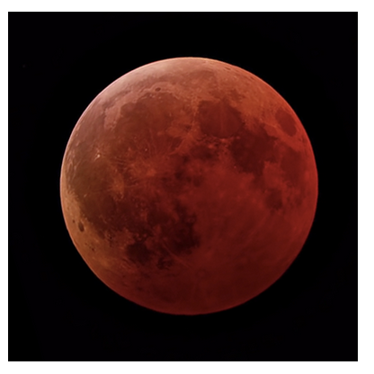
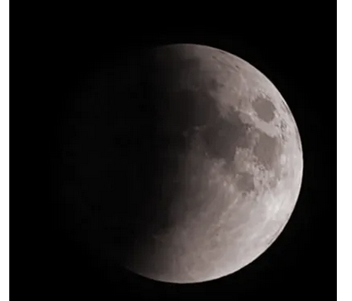
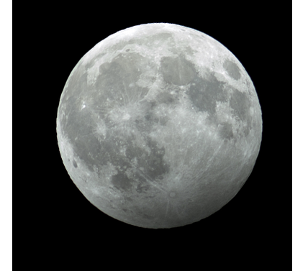
Lunar eclipse in the shadows
Total lunar eclipse: In the umbra the moon appears red (because the longer red wavelengths make it through Earth’s atmosphere, and the shorter blue wavelengths have scattered away).
Partial lunar eclipse: The moon passes through only part of the umbra if the Sun, Earth and Moon do not perfectly line up.
Penumbral eclipse: The moon will dim slightly as it travels through the penumbra (so slightly that it can be difficult to notice).
Notes:
https://science.nasa.gov/moon/eclipses/

Slide 12
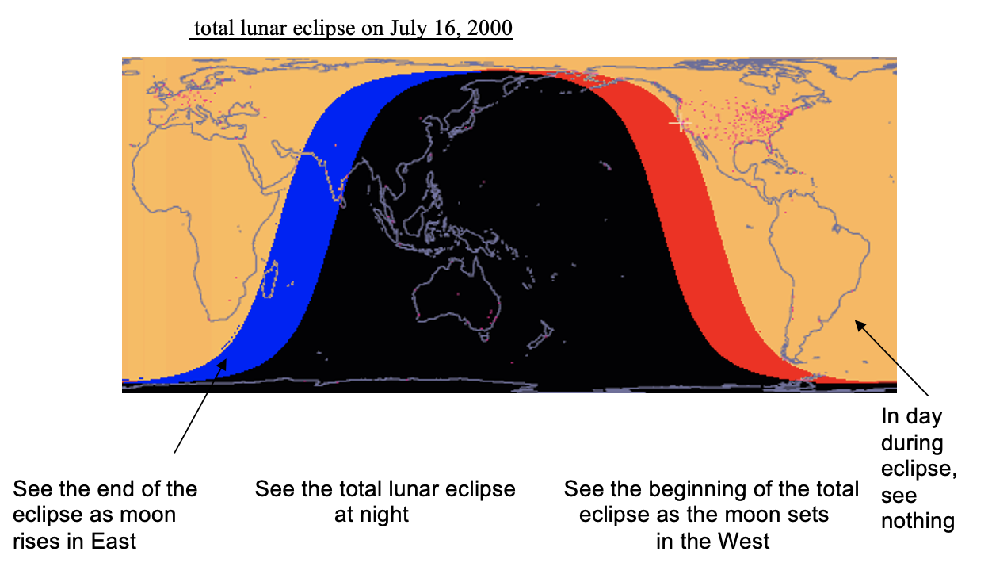

Slide 13
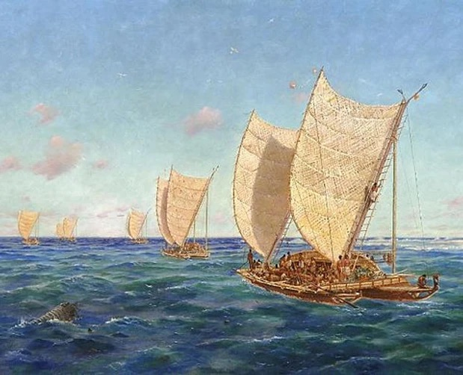
Māori and eclipses
Ockie Simmonds (Raukawa, Ngapuhi) claims the arrival of Te Arawa & Tainui waka coincided with a solar eclipse.
From the Te Arawa waka Hatupatu & his brother Tia led one party to explore inland and Ngātoroirangi led another.
Hatupatu took shelter in a hole in the rock now known as Te Kōwhatu ō Hatupatu, the Rock of Hatupatu.
Lake Taupō is known traditionally as Taupō-nui-ā-Tia, meaning ‘a great darkness settled over Tia’.
Rangipō, meaning, ‘darkening sky, or dark sky’, was named by Ngātoroirangi.
Notes:
Which sort of eclipse was this likely to have been?
The Coming of the Māori – Identifying a Specific Arrival Date of the Māori to Aotearoa-New Zealand
Ockie Simmonds[1] and Kiyotaka Tanikawa[2]
Video and text https://voyagingwananga.nz/ockie-simmonds/
Image: https://www.runa-yachtingnz.org.nz/how-korinorino-works

Slide 14
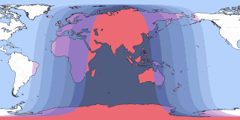
8 Sep eclipse from NZ
Penumbral eclipse begins 3:28 am
Totality 5:30 – 6:39 am
Penumbral eclipse ends 8:55 am, (but not visible after sunrise)
Notes:
What sort of eclipse must this be? Lunar
https://www.timeanddate.com/eclipse/in/new-zealand/auckland-region?iso=20250907

Slide 15
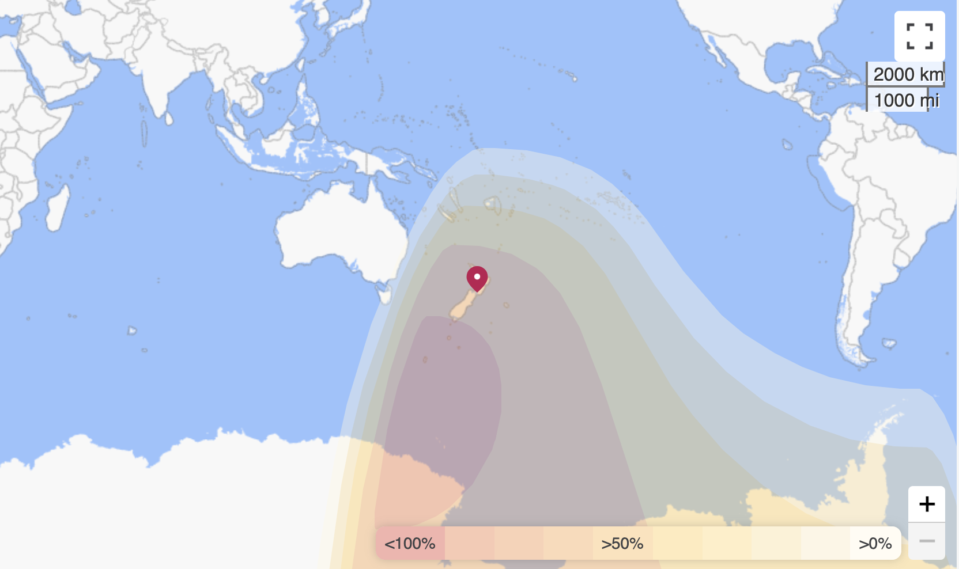
22 Sep eclipse from NZ
Partial eclipse begins 5:41 am and ends at 8:36 am.
Times will vary a bit for each city eg
Auckland 6:07 – 8:05
Dunedin 6:25 – 8:23
Notes:
What sort of eclipse must this be? solar eclipse

Slide 16
Stellarium Web Online Star Map
This site is designed to explore the night sky from any location at any date
To explore the 2024 solar eclipse, set the date to 8 April 2024, go to locations within the path of totality and explore what it was like during the solar eclipse
You’ll need to use Google to find specific locations
Notes:
an online planetarium running in your web browser, https://stellarium-web.org/
More able kids will be able to find specific locations. If not, this link may help
https://www.scientificamerican.com/article/here-are-the-best-places-to-view-the-2024-total-solar-eclipse/ or https://eclipsewise.com/2024/images/Atlas2024-Table01.pdf or https://eclipsewise.com/2024/images/Atlas2024-Table03.pdf

Slide 17
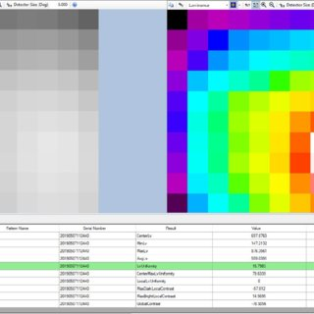
Measuring brightness of eclipses
Solar eclipse: Students find the Sun’s location in the sky at different times during an eclipse. They will then use mobile devices to measure lux before and during the eclipse to examine the impact a solar eclipse has on the energy received at Earth’s surface.
Total Lunar Eclipse: The Danjon Scale of Lunar Eclipse Brightness illustrates the range of colours and brightness the Moon can take on during a total lunar eclipse and is a useful tool to observers in characterizing the appearance of an eclipse. Students use the scale to assign an “L” value at three points during the eclipse. After the eclipse, students compare and justify their evaluations of the eclipse.
Notes:
Measuring brightness during a solar eclipse https://www.jpl.nasa.gov/edu/resources/lesson-plan/measuring-solar-energy-during-an-eclipse/
Science technician or art department may have lux meters (to augment mobiles)
To use a cellphone, download a light meter or lux meter app from the app store, then locate the ambient light sensor on your phone to take measurements in units like lux or footcandles
Measure the brightness of a total lunar eclipse https://www.jpl.nasa.gov/edu/resources/lesson-plan/watch-and-measure-a-lunar-eclipse/

Slide 18

Have we answered all student questions?
Go back to the brainstorm or padlet
What do we know now?
Have we answered all student questions?
If not, what’s the best way to find these answers?
Notes:
Some questions they will be able to find out by research.
But some questions may need an expert. Contact RASNZ or an observatory and see if you can get an expert to help, if needed. FTF or on zoom with students. Or phone & have a chat yourself and pass on the answers, if no other option is available.

Slide 19

Safely viewing solar eclipses
The bright sun can be focused by the eye’s lens onto a small part of the retina and cause severe damage (think magnifying glass burning a hole in paper). So we need to protect our eyes:
Binoculars and telescopes need a special solar filter
You can get solar viewers for eyes (try the nearest museum or observatory)
View using a pinhole camera
View a livestream (try NASA)
Notes:
https://www.jpl.nasa.gov/edu/resources/project/how-to-make-a-pinhole-camera/

