Slide 1


KŌTUI AKO VLN
TE WIKI O TE REO MĀORI
RESOURCES
2025
KIA KAHA
TE REO MĀORI
Notes:
Add opening message about using resources

Slide 2
Nau mai, haere mai koutou katoa
Please use these resources to support you, your ākonga, kura, whānau and wider community.
Content:
Kōrero - Speak: Karakia & Pepeha
Ako - Learn: Phrases about Auronga/ Emotions
Pānui - Read: Whakataukī/ proverbs and kīwaha/ sayings
Waiata - Sing: A waiata to learn, practice and sing
“Ko te reo kia tika, ko te reo kia rere, ko te reo kia Māori”.
NAU MAI
WELCOME

Slide 3

Toitū te kupu, toitū te reo!
Celebrate the 50th anniversary of Te Wiki o te Reo Māori (Māori Language Week).
‘Born of activism, the week grew from a single ‘Māori Language Day’ set up in 1972. The seeds of a full week dedicated to te reo Māori were planted in 1974. By 1975 Te Wiki had found its footing and was off! Its growth and gains are what we celebrate 50 years on.’
Kōtui Ako VLN want to do our part in ensuring our language thrives in our communities.
We hope these resources support your reo Māori journey
“Poipoia tō tātou reo, kia puawai ai”..

Slide 4
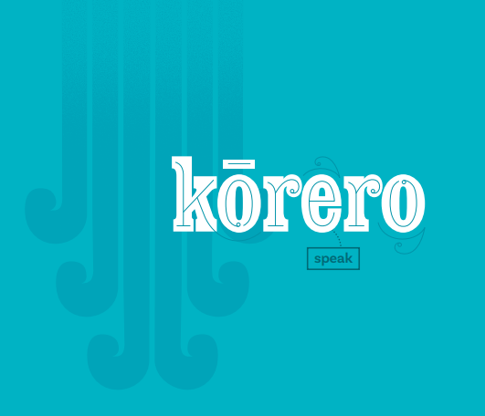
KŌRERO
SPEAK
Kōrero
The next three slides will cover karakia and mihimihi.
Slide 1: Karakia tīmatanga, opening prayer
Slide 2: Karakia whakamutunga, closing prayer
Slide 3: A mihimihi template to help guide your reo Māori journey
“Tukuna te reo kia rere”.
Tip: Set an hour or space where you only speak te reo Māori. It could be a reading corner or lunch time

Slide 5

KARAKIA TIMATANGA
Kia hora te marino
Kia hora te marino,
kia whakapapa pounamu
te moana,
Hei huarahi mā tātou
i te rangi nei,
Aroha atu,
Aroha mai.
Tātou i a tātou katoa
May peace be widespread,
may the sea be smooth like greenstone,
A pathway for us all this day,
Give love, receive love.
Let us show respect for each other
KŌRERO
SPEAK
KARAKIA
Repeat each line or follow our actions during Zoom

Slide 6
KARAKIA WHAKAMUTUNGA
Ka wehe atu tātou
Ka wehe atu tātou,
Ki raro i te rangimārie
te harikoa,
Me te manawa nui,
Haumi e, hui e, tāiki e!
KŌRERO
SPEAK
We are departing
Peacefully, Joyfully
And resolute
We are united, progressing forward!
KARAKIA
Repeat each line or follow our actions during Zoom

Slide 7
MIHIMIHI PEPEHA
A pepeha helps make a connection with people and places important to you.
What will you include in your pepeha?
Ko _______ taku māunga
Ko _______ taku awa
Ko _______ taku roto
Ko _______ taku moana
Ko _______ taku iwi
Ko _______ taku hapu
Ko _______ taku marae
Ko _______ taku kura
Nō _______ ahau
Ko _______ taku whānau
Ko _______ taku ingoa
_____ is my mountain
_____ is my river
_____ is my lake
_____ is my sea
_____ is my iwi
_____ is my hapu
_____ is my marae
_____ is my school
I am from _____
_____ is my family name
_____ is my name
KŌRERO
SPEAK
Mihimihi Pepeha
What will you include?

Slide 8

KŌRERO
SPEAK
Ako
The next three slides will cover phrases.
Slide 1: Practice the phrase alongside the video’s.
Slide 2: Practice and learn kupu aurongo or words to express different emotions
Slide 3: Try out different phrase that help with past, present and future tense.
“Tamaiti ākona ki te kāinga”.
Tip: start with simple sentence and keep adding to your kete. E.g learn a mihimihi, a new kīwaha or whakataukī
Notes:
Add intro description for how to use slides

Slide 9
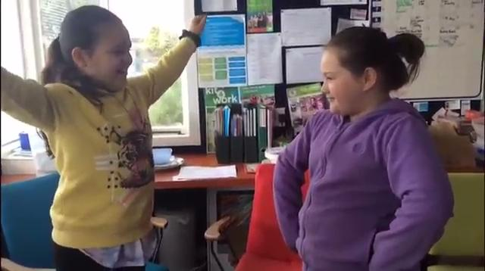
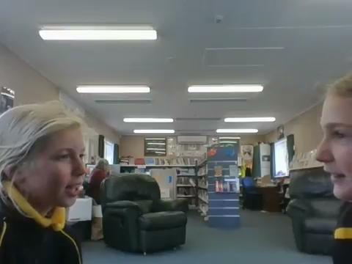
Kei te pēhea koe?
Kei te EMOTION ahau.
Kei te pēhea koe?
Kei te EMOTION ahau.
AKO
LEARN
Te Poi (Waikato)
How are you feeling?
I am EMOTION.
How are you feeling?
I am EMOTION.
WHAKARONGO
Can you work out what’s being said?
Wairakei (Waikato)

Slide 10
Rika impatient
Ngenge tired
Māuiui sick
Mamae sore
Kiriweti grumpy
Pōuri sad
Riri angry
Hōhā annoyed
Whakamā embarrassed
Āmaimai nervous
Rangirua confused
Mataku afraid
Wera hot
Makariri cold
Hāneanea comfortable
Tūmanako hopeful
Ohorere surprised
Pai good
Tino pai very good
Harikoa thrilled
Koa happy
Māia confident
Ohorere surprised
Hiamo excited
Āio calm
Ora healthy
Hīanga cheeky
AKO
LEARN
Learn and practice these Māori word about emotions

Slide 11
Kei te pēhea koe i tēnei rā?
Kei te EMOTION ahau.
How are you feeling today?
I am EMOTION.
AKO
LEARN
I pēhea koe inanahi?
I EMOTION ahau.
How were you feeling yesterday?
I was EMOTION.
KORERO
Practice saying these phrases talking about the present, the past, and the future.
Ka pēhea koe apōpō?
Ka EMOTION ahau.
How will you feel tomorrow?
I will be EMOTION.

Slide 12

KŌRERO
SPEAK
Pānui
The next slides will cover reading material to add understanding and knowledge to your kete
Part 1: A whakataukī or proverb
Part 2: A phrase for our everyday heroes
Part 3: A praise to celebrate the people in our lives
“Iti te kupu, nui te kōrero”.
Tip: make it intentional, something you can read and use everyday. A phrase, a children’s book or article.

Slide 13
“Hōkia ki ō maunga kia pūrea koe e ngā hau o Tāwhirimātea”.
Return to your mountain and be cleansed by the winds of Tāwhirimātea.
This whakatauākī tells us to return home during times of hardship and seek the support of whānau, learn about our tūpuna, iwi, marae, hapū to elevate our mauri and deepen our tuākiritanga or sense of self. Overall understanding who we are and where we come from.
WHAKATAUKĪ
Proverb
PĀNUI
READ
“Ko koe a tuahangata”.
You’re my hero
This phrase is used to celebrate a hero and let them know how important they are. This could be a friend, teacher or dad.
“Kei tawhiti koe”.
You’re number one!
This phrase can be used to praise someone that has done a great job. Also, good for celebrating achievements and thanking our everyday wins.
WHAKATAUKĪ and KĪWAHA
Read these phrases to deepen your understand and them to your kete mātauranga.
KĪWAHA
SAYINGS

Slide 14

KŌRERO
SPEAK
Waiata
The next three slides will cover a waiata that celebrates te reo Māori
Slide 1: The words to the waiata
Slide 2: A video to learn the actions
Slide 3: Sing along with Taoroa school who participated in our Language Moment in 2020
“Me he korokoro Tūī”.
Tip: Start with one waiata, understand the kupu and do it as a group. Learning with whānau or friends can be fun.

Slide 15
Waiata Whakarongo
‘Whakarongo’ is a waiata-ā-ringa by Ngoi Pēwhairangi. It is one of Ngoi's most famous compositions and incorporates her beliefs and methodology on teaching te reo Māori.
Ngoi gathered her whānau together to assist her with creating the actions and teaching the people from Koha as the majority of them were Pākehā who had never learnt a Māori song before.
The verse that begins with ‘Whiua ki te ao . . .’
is the verse to encourage everyone to spread reo Māori to the nation and to the world.
The verse that begins ‘Tēnā kia purea te . . .’.
The waiata contains a poignant message which is summarised in the lines
'He kupu tuku iho mō tēnei reanga. Whakarongo! Tō reo whakarongo!'
(A language to be passed on for this generation - Listen! Listen to your language).
This waiata is sung all around the motu and is used to celebrate and uplift te reo Māori
Learn the kupu on the next slide
WAIATA
SING
Learn the meaning of this beautiful waiata

Slide 16
Waiata Whakarongo
He kupu tuku iho mō tēnei reanga
Whakarongo, ki te reo Māori e karanga nei
Whakarongo, ki ngā akoranga rangatira
Nā te Atua i tukuiho ki a tātou e
(Pupuritia) Pupuritia, kōrerotia mō ake tonu.
Tirohia, ngā tikanga tapu a ngā tipuna.
Kapohia, hei oranga ngākau – auē
Whiua ki te ao, whiua ki te rangi, whiua ki ngā iwi katoa.
Kaua rawa rā e tukua e kia memeha e
Whakarongo, ki te reo Māori e karanga nei
Whakarongo, ki ngā akoranga rangatira
Tēnā kia purea e te hauora e
He kupu tukuiho mō tēnei reanga. He kupu tukuiho mō tēnei reanga
Whakarongo! Tēnā whakarongo!
WAIATA
SING
Learn the lyrics.

Slide 17
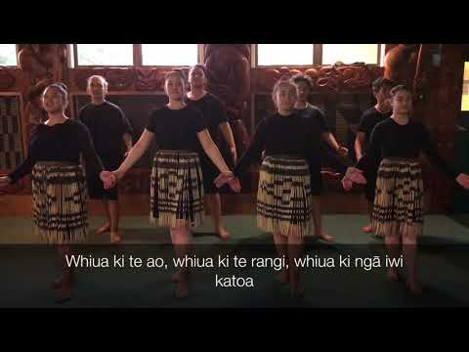
Learn this beautiful waiata - Whakaronga
WAIATA
SING
Practice actions with the video

Slide 18
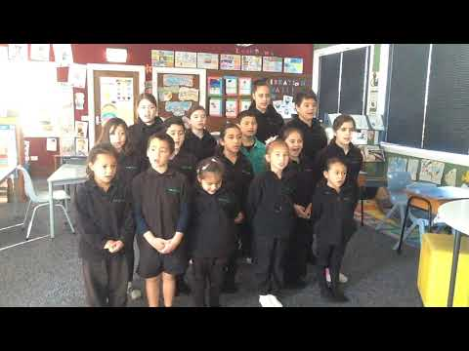
Waiata with Taoroa School
WAIATA
SING
Sing along with Taoroa School

Slide 19
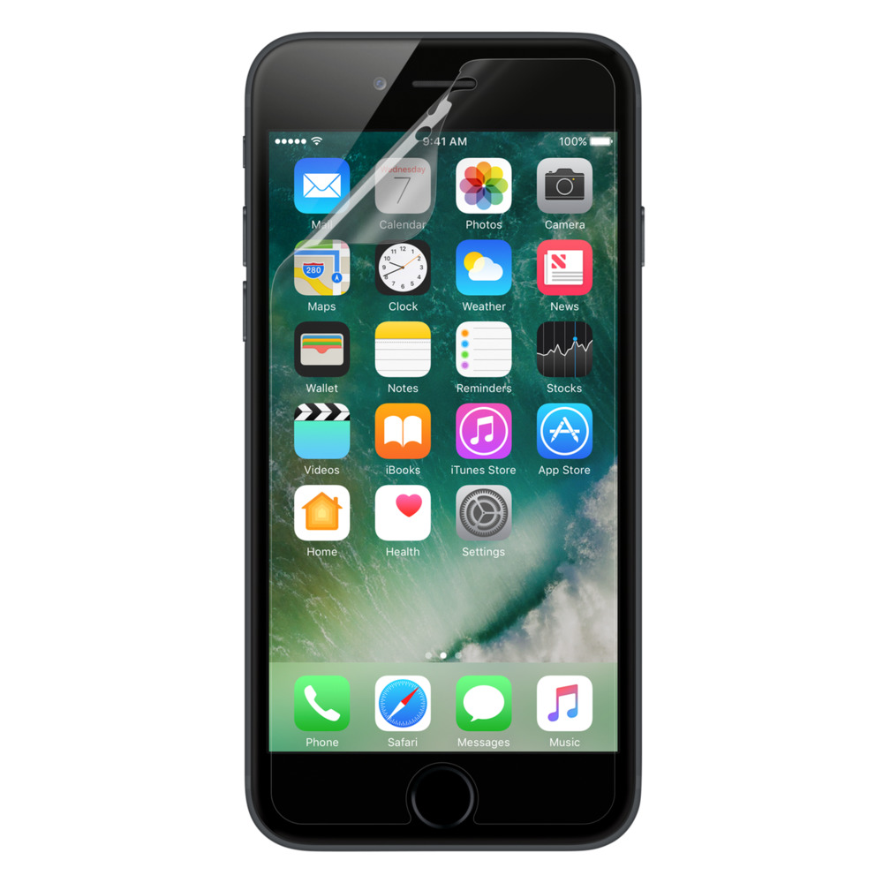
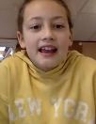


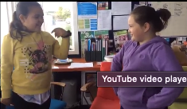

Make a recording of your kōrero and share with us!
If you want, make your clip famous by having it featured on our resource for schools around Aotearoa!
Tag us on Facebook or Insta @KotuiAkoVLN
There are many ways to record!
TOHA
SHARE
On a device
Record one, two or all of the phrases!
Seesaw activity for teachers

Slide 20

Want to learn with us?
Learn te reo & kapa haka online
Weekly online Zoom sessions and independent activities
Tamariki can learn as a class with their kaiako or in small groups
Kaiako and tauira have continued access to tailored resources
Programmes are levelled for beginners (NZC L1) through to intermediate (L4)
https://www.kotuiako.school.nz/

Slide 21
E rere ana ngā mihi mahana ki a koutou katoa.
Thanks to the kura, ākonga & kaiako who shared their video.
We hope you enjoy these resources and they are helpful in your reo Māori journey.
“Hīkina a tātou ākonga, kia haere kōtui tātou ki tua”.
Walk hand-in-hand with us to uplift our learners and safeguard the future.
HEI KONEI RĀ
SEE YOU AGAIN

