Slide 1
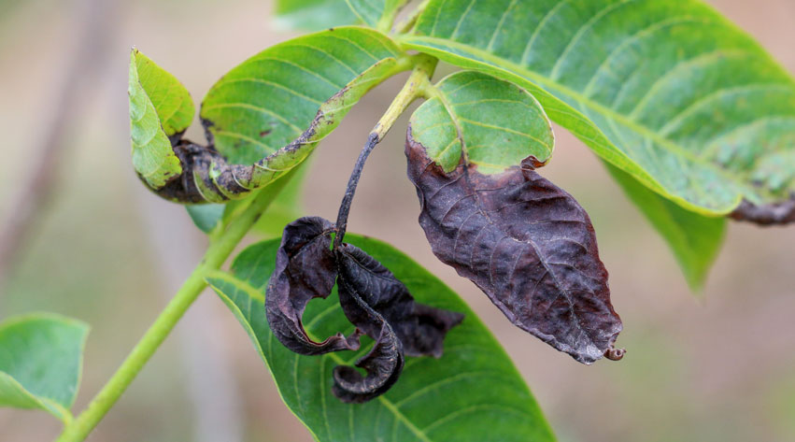
Effect of Frost on Plants
Notes:
Created from the NZASE article by Mike stone
You will find student questions in the presenter notes
Image https://www.notcutts.co.uk/garden-advice/problems-pests/cold-and-frost-damage/?srsltid=AfmBOorGvfpRc8J4ghsv5K1dHMiRrFUY7C_spsi7rv59HKE5dZh119zw

Slide 2
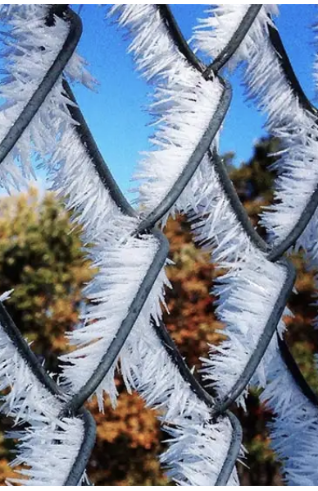
What is a frost?
Ice crystals forming on a solid surface, usually as a thin film
Frost forms when temperatures drop below freezing point (0 ºC)
Tend to form
  at the start or end of winter
  when the sky is cloudless and the air is still
Some types (based on appearance)
  Hoar frost – a fine, feathery, or needle-like coating on exposed surfaces like trees, grass, and fences
  Black frost – no ice crystals as the air is too dry
Notes:
How do we know when it is a frosty morning, what do we see, feel?
What problems can black frosts cause for drivers?
What type of frost is illustrated?
Image https://weather.com/science/weather-explainers/news/hoarfrost-explained

Slide 3
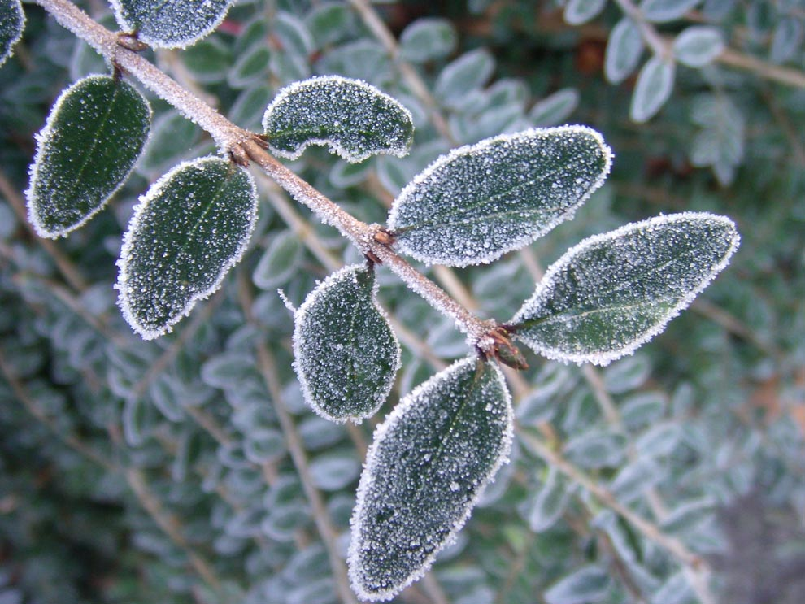
Other types of frosts (based on cause)
Radiation frosts – caused by heat being lost from the ground to the atmosphere on still clear nights
  The air gets warmer with height (instead of getting colder as is usual), so this is called a temperature inversion
  The temperature at ground level & on plant surfaces drops significantly.
  Most common type of frost in NZ
Advection frosts – caused by cold winds
Notes:
This way of typing frosts is based on how they form
What do we mean by radiation?
Image: https://images.nationalgeographic.org/image/upload/v1638889867/EducationHub/photos/frost-on-leaves.jpg

Slide 4
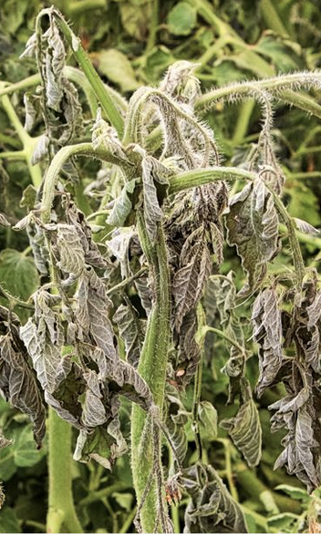
Frost harms plants
Ice crystals form in the cell cytoplasm, bursting the cell membrane. This results in symptoms of frost damage:
Black scorching and brown patches on leaves, especially new and young growth
Initially, this may only appear on the leaf edges, but soon spreads
Plants collapse or appear wilted or water-soaked
Damage to blossom and young fruit, which may drop prematurely
Young and small plants killed
This reduces the leaf surface area available for photosynthesis, limiting plant growth.
Notes:
Why might these effects be greater in Soft-stemmed plants cf woody plants?

Slide 5
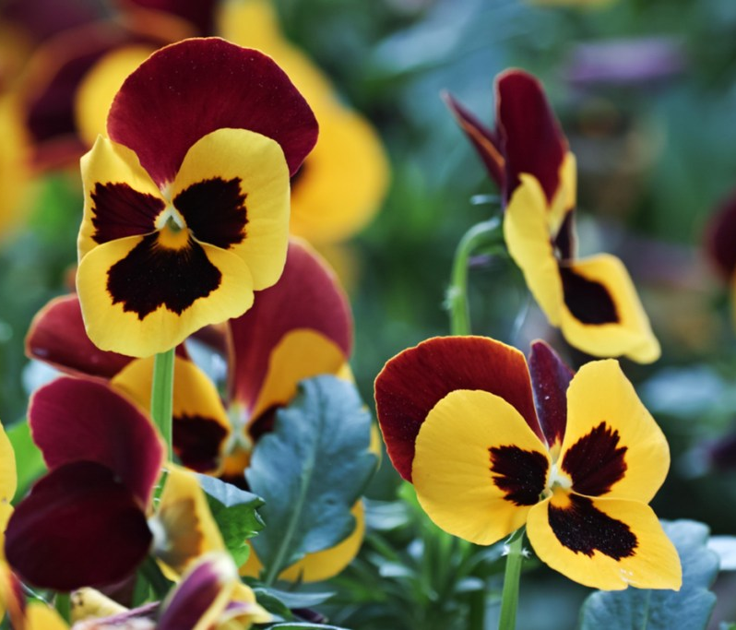
Not all plants need protection
E.g. perennials, bulbs, roses, small trees, woody shrubs & other woody plants
These plants need cold temperatures to help them fully enter dormancy,
They will tolerate temperatures at or just below freezing with minimal damage.
Notes:
Examples of perennials, bulbs, small trees, woody shrubs & other woody plants?

Slide 6
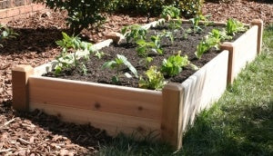
Protecting plants from frost – 1 position
Position plants
away from frost pockets (places where cold air naturally collects eg the lowest point on sloping ground or against a barrier)
near gaps in a fence or hedge to improve cold air drainage
in raised beds to keep the plants above the cold air

Slide 7
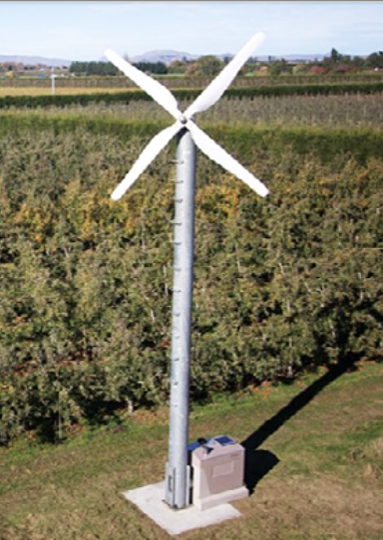
Protecting plants from frost – 2 heat
Use fans, windmills or helicopters to force the warm air layer above the crop down onto the plants.
Water the plant directly (2.5 mm/h). As water freezes it releases latent heat of fusion, keeping the plant above freezing point
Water a frost cloth on a really cold night to provide an ice blanket that insulates the plants beneath
Protect crops under a cover to trap heat. E.g. a cloth or plastic sheet draped over a plastic, wooden or wire frame
Notes:
What do we know about frost pots? Why don’t we use them now?
Orchardists used to burn diesel or wood in pots, but this fuels global warming and makes problematic smoke.
Image: NZ Frost Fans.

Slide 8
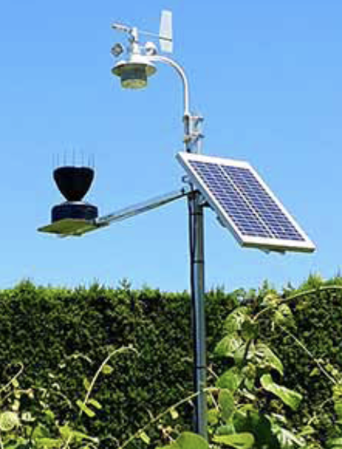
Monitoring low temperatures
in frost-prone areas
sensors in the canopy detect low temperatures and send an alarm to the farmer’s phone.
farmer goes into the field, using probes to check the temperature of leaves and buds on plants in low-lying areas.
protection measures can be started, monitored through the night and turned off when no longer needed.
Notes:
\Image: Solar-powered temperature sensors, Metris.

Slide 9

Prevention – 1. position
Grow hardy crops in frost-prone areas, other plants in frost-free sites
Grow plants on a north-facing slope, as they are generally warmer.
Plant in rows orientated parallel to the slope.
Plant near bodies of water (coastal, lake and river areas are always warmer).

Slide 10
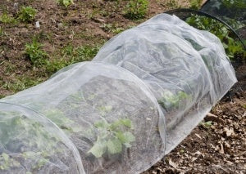
Prevention – 2 plant management
Manipulate flowering times by staging sowing time, & mixing long and short season varieties.
Plant frost-tender saplings in late spring so that they can be well settled and hardened off before the cooler temperatures of autumn. Frost- tolerant species can be planted early.
Use permeable shelter belts to ensure wind movement.
Apply nitrogen-rich fertilisers only after temperatures have risen, the plant is actively growing and the risk of frost has passed.
Ensure tender garden plants are over-wintered safely in greenhouses.
Delay the pruning of damaged tissue until after the risk of frost has passed, so no new growth is exposed to frost damage.
Notes:
Why the fertiliser advice?
Image: https://www.palmers.co.nz/blogs/gardening-inspiration/keeping-your-garden-warm-in-winter

Slide 11
Susceptibility of fruit & vegetables to frost injury
Frost-Tender | Frost-tolerant | Hardy
Will be damaged or die | Appearance will suffer but will survive. | Winter growth will stop but will survive with little visible damage
Apricot | Apples | Beetroot
Asparagus | Broccoli | Brussel sprout
Banana | Carrot | Cabbage
Berries | Celery | Dates
Capsicum | Grapes | Kale
Cucumber | Orange | Kohlrabi
Lettuce | Parsley | Parsnip
Plums | Peas | Turnip
Potatoes | Pears
Tomatoes | Pumpkin
Zucchini | Spinach

