Slide 1
Whakatauki
Notes:
Whakatauki (proverbs) play a large role within Maori culture. They are used as a reference point and guidelines, often merging holistic perspectives with underlying messages

Slide 2
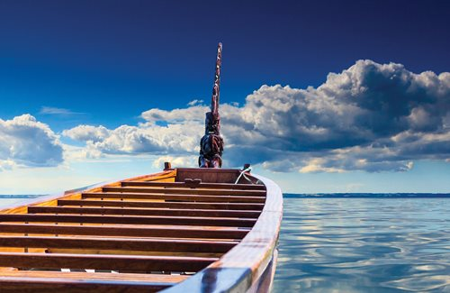
Ko te pae tawhiti whāia kia tata, Ko te pae tata whakamaua kia tīna
Seek out distant horizons, and cherish those you attain
Notes:
[Seek out distant horizons, and cherish those you attain]
This encourages people to have vision, and to strive to bring that vision closer to a realisation. What has already been achieved must be strengthened and nurtured. It is difficult to say what is impossible for the dreams of yesterday are the hopes of today and the realities of tomorrow. A person must be ever determined to find ways of creating benefits for other humans.

Slide 3
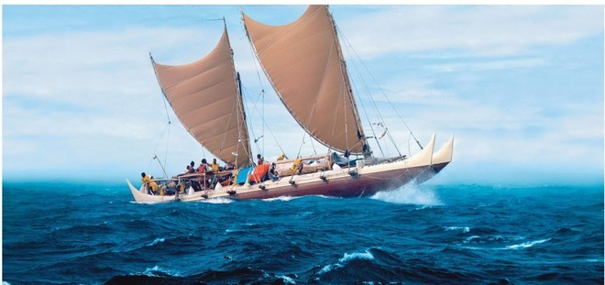
He moana pukepuke e ekengia e te waka
Rough oceans can be navigated by a canoe.
Notes:
Any challenges that we face can be navigated successfully with the appropriate support, direction and guidance.

Slide 4
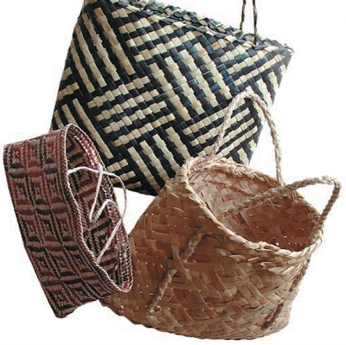
Three baskets / kete of knowledge
Tāne, the god of the forest, collected three baskets of knowledge from the outer world and brought them back to the world of mortals. The three baskets – te kete-tuatea (basket of light, present knowledge), te kete-tuauri (basket of darkness, things unknown), and te kete-aronui (basket of pursuit, the knowledge humans seek) – must be in balance for us to live harmoniously on Earth.
Notes:
Instead of whakatuaki.
How does this relate to the science curriculum and typical current practice?
Different types of knowledge
Balance of science content and NoS
Ngā Kete E Toru o Te Wānanga

Slide 5
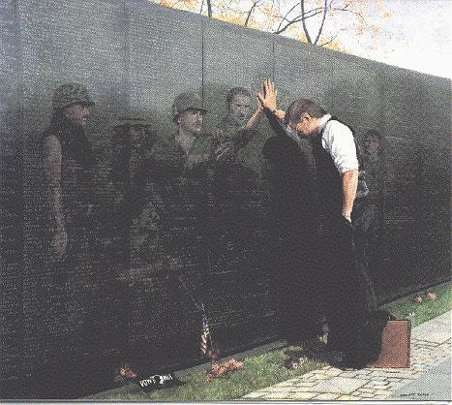
Titiro whakamuri kokiri whakamua
Look back and reflect so you can move forward
Notes:
Us. But also students

Slide 6
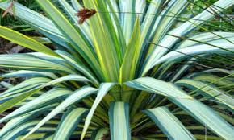
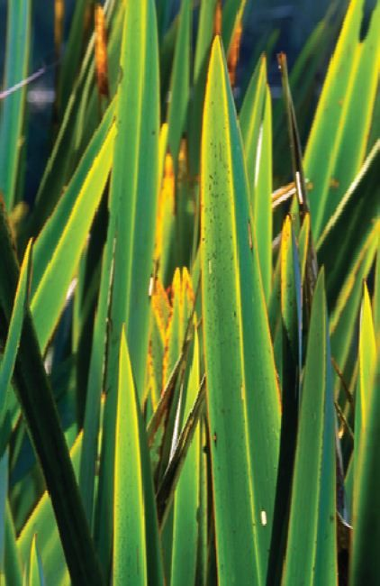
Tungia te ururua, kia tupu whakaritorito te tupu
o te harakeke
Set fire to the scrub that the flax plants may shoot forth young evergreen shoots.
In order to improve outcomes we may need to leave some ways behind so we can do things differently

Slide 7

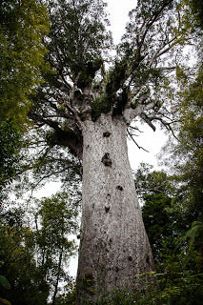
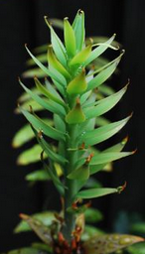
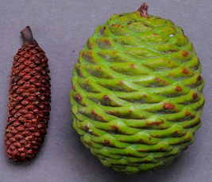
Hapaitia te ara tika pumau ai te rangatiratanga mo nga uri whakatipu.
Foster the pathway of knowledge to strength, independence and growth for future generations.

Slide 8
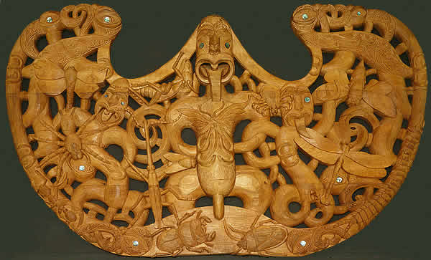
Mā te whakaaro nui e hanga te whare; mā te mātauranga e whakaū
Big ideas create the house; knowledge maintains it
Notes:
Whakatauki from p 28 curriculum
The pare is 1.5 x 0.9 m in size (pare = door lintel)
carved from recycled kauri over 100 years old
carved in the style of Ngāti Whātua by Denis Conway, a student of the late Henare Toka;
over the main doorway entrance to the NZ arthropod collection at Landcare, St Johns, Ak
13 Arthropods 8? manaia with paua eyes what is the big picture here?
Manaia = mythological creatures, part human, part animal eg. (bird head, man body)
Ask Where do you think this pare is found?
What do you see here?
Why might they want a carving such as this over their doorway – what is the big picture

Slide 9
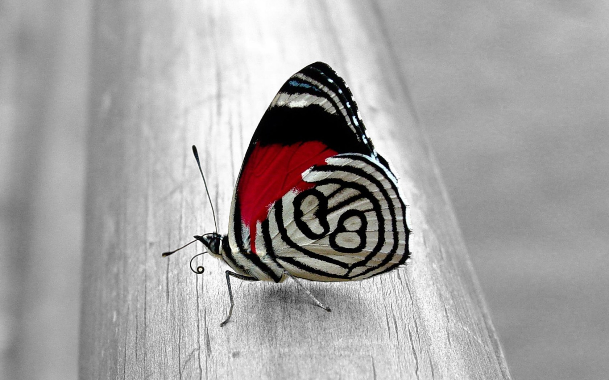
Ki te ahurei o te tamaiti arahia o tatou mahi
Let the uniqueness of the child guide our work.
Notes:
From literacy NZ

Slide 10
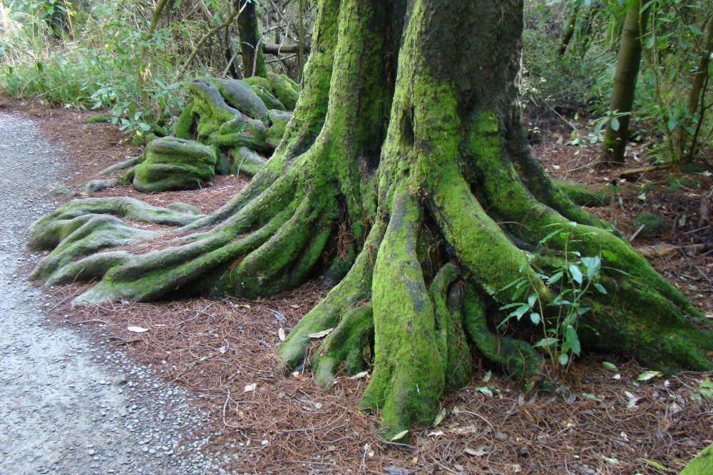
E tipu ai te aka tangata, me uru Kahikatea.
A grove of Kahikatea stands strong because of the intertwined root system

Slide 11
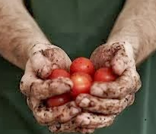
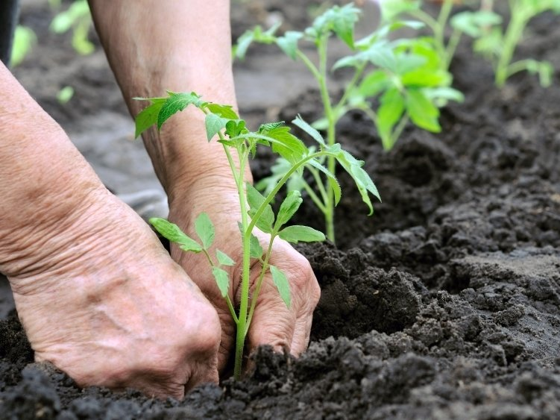
Whakatauki
He kai kei aku ringa
There is food at the end of my hands
Notes:
Said by a person who can use their abilities and resources to create success

Slide 12
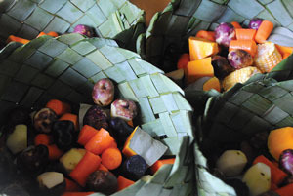
Nau te rourou, naku te rourou, ka ora ai te tangata
With your basket and my basket, we will feed the people
Notes:
The proverb suggests that if we pool our ideas, with equal respect for all parties, we will get a superior result and everyone will benefit.
Rourou = basket to hold hangi food, here veges
We all bring knowledge and skills and experiences to our learning and if we are prepared to share those many will benefit, those here today but also our departments back at school. This is a workshop for leaders – HoFs, HoDs, TiCs or aspirants. We have a responsibility to take this learning back to our departments and share it with them.
LETS SHARE WITH OUR TABLE WHAT WE BROUGHT

Slide 13
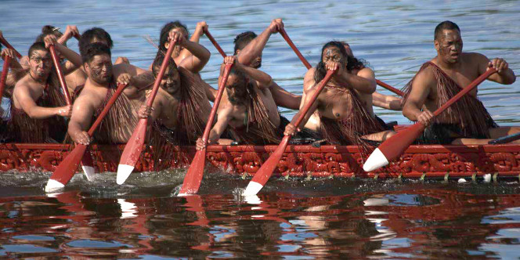
He waka eke noa
A canoe which we are all in with no exception
Notes:
This Whakatauki is also about the collective consciousness that affirms belonging in a group
Waka - often used as a metaphor for a journey
- when we are in a waka, there is unity in a shared purpose.
Lessons - maintaining balance
the canoe moves faster in deep water but you may feel out of your depth
the possibility of tipping out is always present, in a waka have to help each other get back in

Slide 14
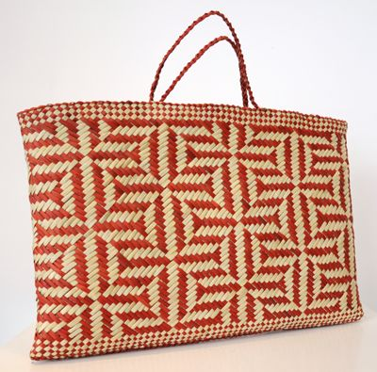
Ko koe ki tena, ko ahau ki tenei kiwai o te kete
You at this handle, me at this handle of the basket – of knowledge

Slide 15

Mā pango mā whero ka oti te mahi
Work together to finish the task, red (chiefs) and black (the tribe) together
Notes:
Whakatauki (proverbs) play a large role within Maori culture. They are used as a reference point and guidelines, often merging holistic perspectives with underlying messages

Slide 16
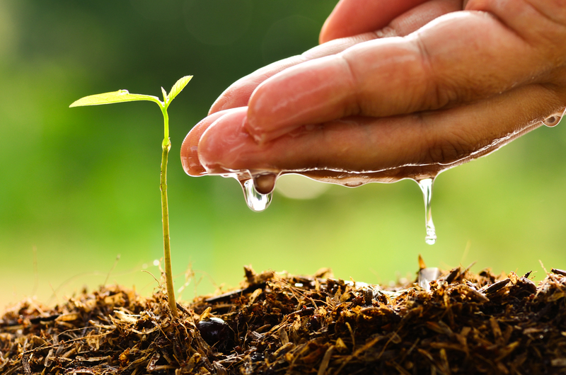
Poipoia te kakano kia puawai
Nurture the seed and it will blossom

Slide 17
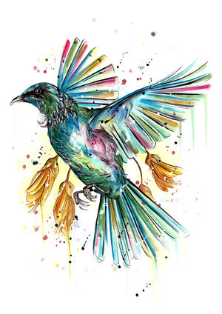
Me te huruhuru ka rere te manu
Adorn this bird with feathers to enable it to fly

Slide 18
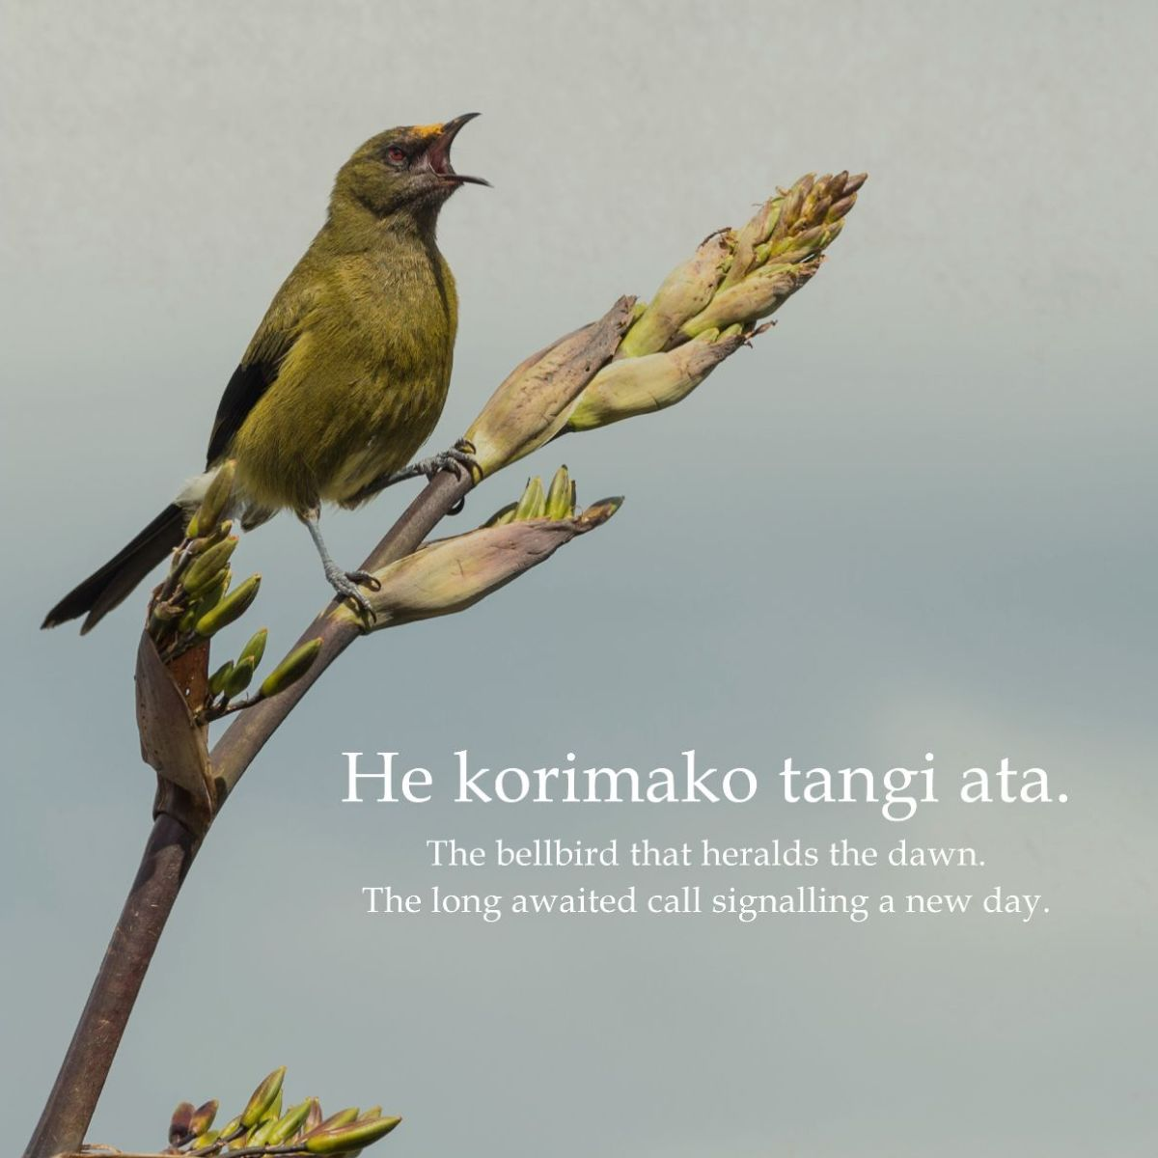

Slide 19
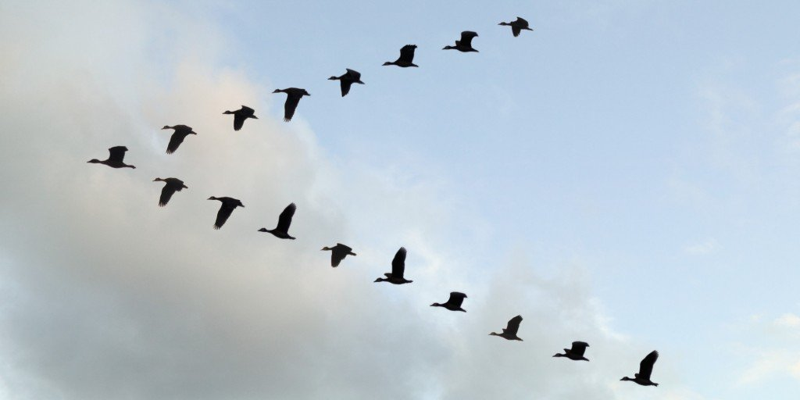
Mā mua ka kite a muri, Mā muri ka ora a mua.
Those who lead give sight to those who follow;
Those who follow give life to those who lead.

