Slide 1
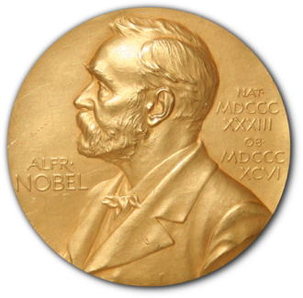
Nobel Prize in Physiology or Medicine 2025
Peripheral immune tolerance
Notes:
By Mike Stone
Sources:
https://www.ncbi.nlm.nih.gov/books/NBK279364/ and https://www.nobelprize.org/prizes/medicine/2025/press-release/

Slide 2
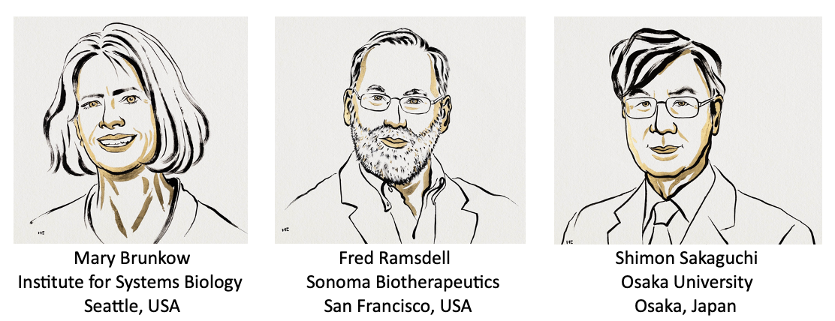
These three scientists receive about $400,000 USD each for discovering how our immune system is kept in check. As well as spurring further research they have laid the groundwork for the development of new treatments for cancer and autoimmune diseases, amongst others.

Slide 3
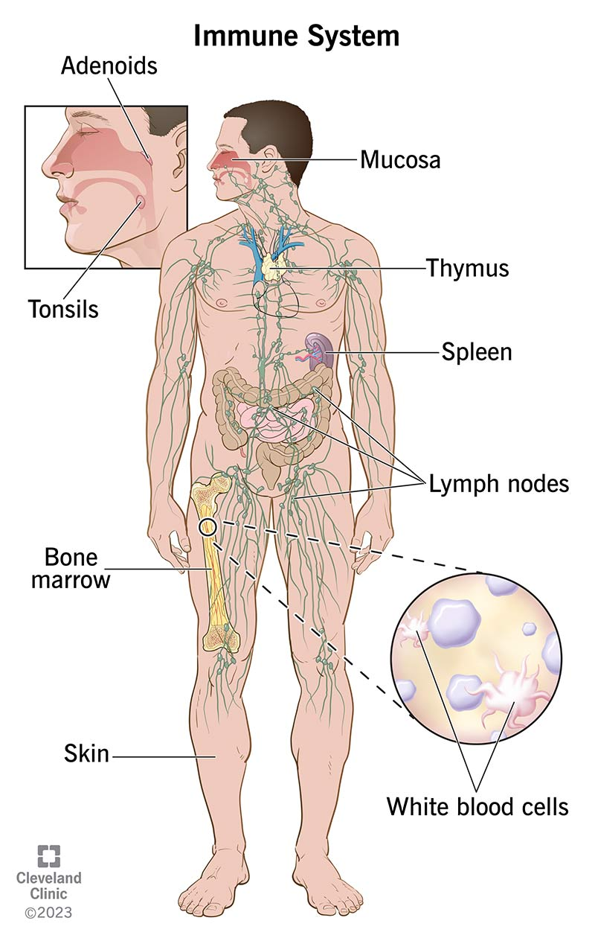
The Immune System
This system of the body has many components, all trying to keep us well.
Our immune system has 3 main jobs
Fight-disease-causing germs (pathogens) eg bacteria, fungi, viruses and larger parasites.
Recognise and neutralise harmful substances from the environment
Fight disease-causing changes in our body, eg. cancer
Notes:
Image: https://my.clevelandclinic.org/health/body/21196-immune-system

Slide 4
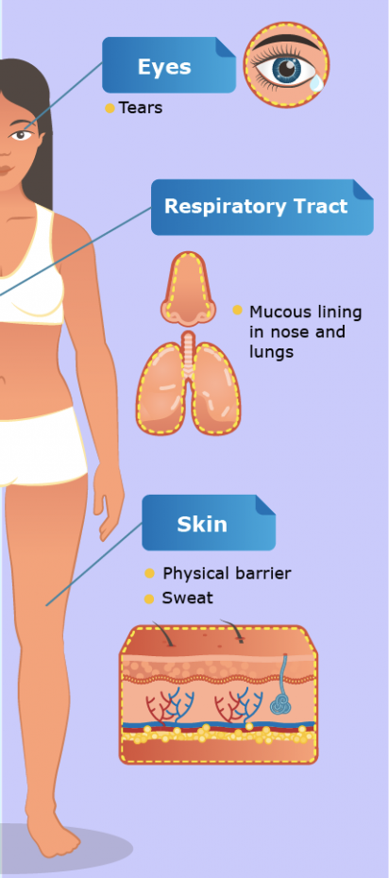
The First Line of Defence
Skin provides a physical barrier.
waterproof
secretes an oil that kills bacteria.
Openings are protected by
mucous membranes - trap pathogens which are then expelled.
tears and saliva - contain enzymes to break down cell membranes
Stomach acid - destroys pathogens too.
Notes:
Image: https://letstalkscience.ca/educational-resources/stem-explained/immune-response

Slide 5
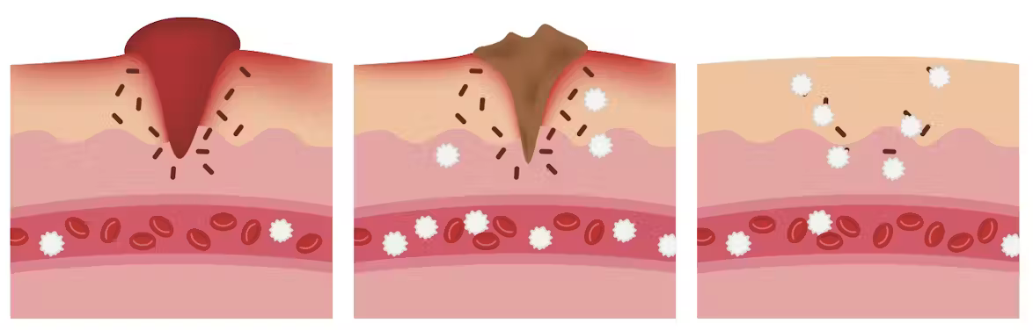
The Second Line of Defence
If the skin is cut open:
Platelets + fibrin → clot → scab → heals
Pathogens enter the skin tissue
Special White Blood Cells called phagocytes enter the skin tissue and attack the pathogens (surround & destroy) → inflammation
A high body temperature (fever) can stop pathogens growing.
This immune response is the same regardless of the pathogens involved.
Notes:
In this imager what are the black lines and the white stars?
Where do the platelets come from?
What is fibrin? A protein fibre in the blood
Image: https://theconversation.com/curious-kids-how-do-wounds-heal-118603

Slide 6
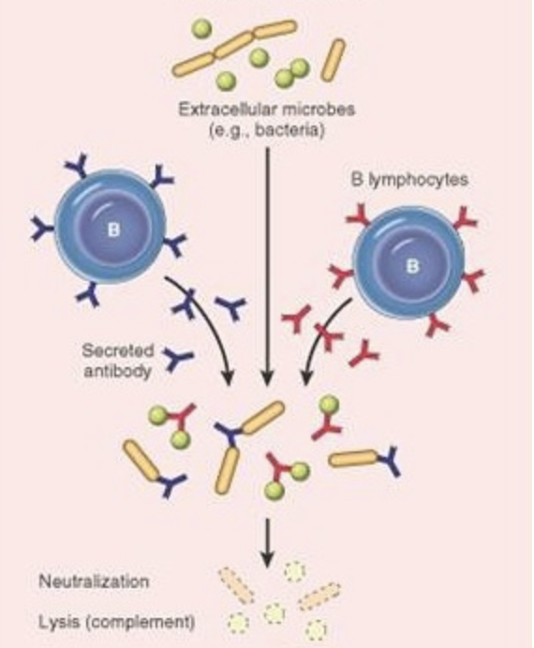
The Third line of Defence
If pathogens get into the blood then they need a targeted response, specific to the pathogen.
We can develop this targeted immunity the first time we get the disease or in a vaccine.
There are several different components:
B cells are special white blood cells (lymphocytes) that make antibodies, specific to the pathogen
Antibodies latch on to the matching proteins on the surface of the pathogen to target the pathogen for destruction
T cells are lymphocytes that destroy the targeted pathogen
Notes:
Image: https://www.biologyexams4u.com/2013/01/humoral-immune-response-or-antibody.html

Slide 7

Keeping the immune system in check
The immune system is designed to destroy alien cells
But some pathogens have developed similarities to human cells as a form of camouflage
So how does the immune system determine what it should attack and what it should defend?
This year’s three Nobel laureates identified the immune system’s security guards,
regulatory T cells prevent immune cells from attacking our own body.
This protection is called immune tolerance.
Notes:
Image: https://www.nobelprize.org/prizes/medicine/2025/popular-information/

Slide 8
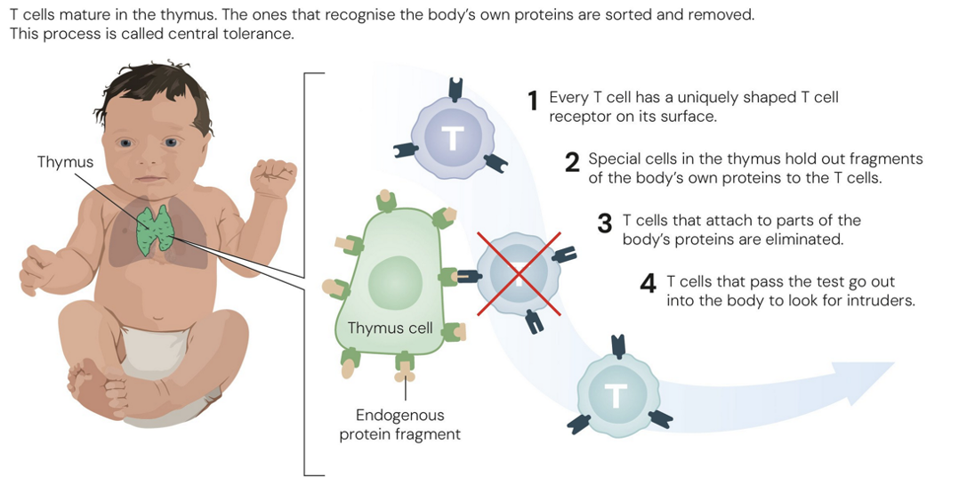
Central Tolerance
In 1995 this is what scientists thought protected our body from the immune system. And it does, but that’s not the only system operating.
Notes:
In 1995 this is what scientists thought protected our body from the immune system.
Image: https://www.nobelprize.org/uploads/2025/10/popular-medicineprize2025-figure3.jpg

Slide 9
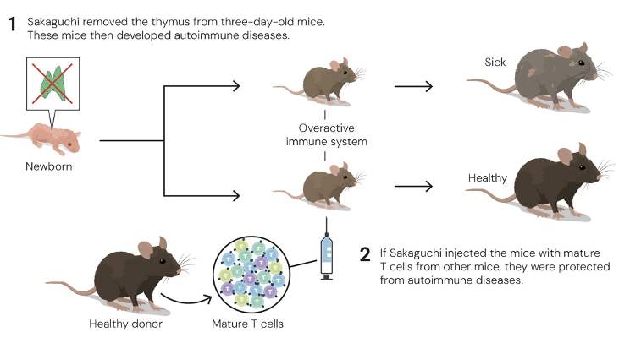
1995 Shimon Sakaguchi
Sakaguchi showed that the immune system is more complex and discovered a previously unknown class of T cells, which protect the body from autoimmune diseases.
Notes:
Image: https://www.nobelprize.org/uploads/2025/10/popular-medicineprize2025-2.pdf

Slide 10
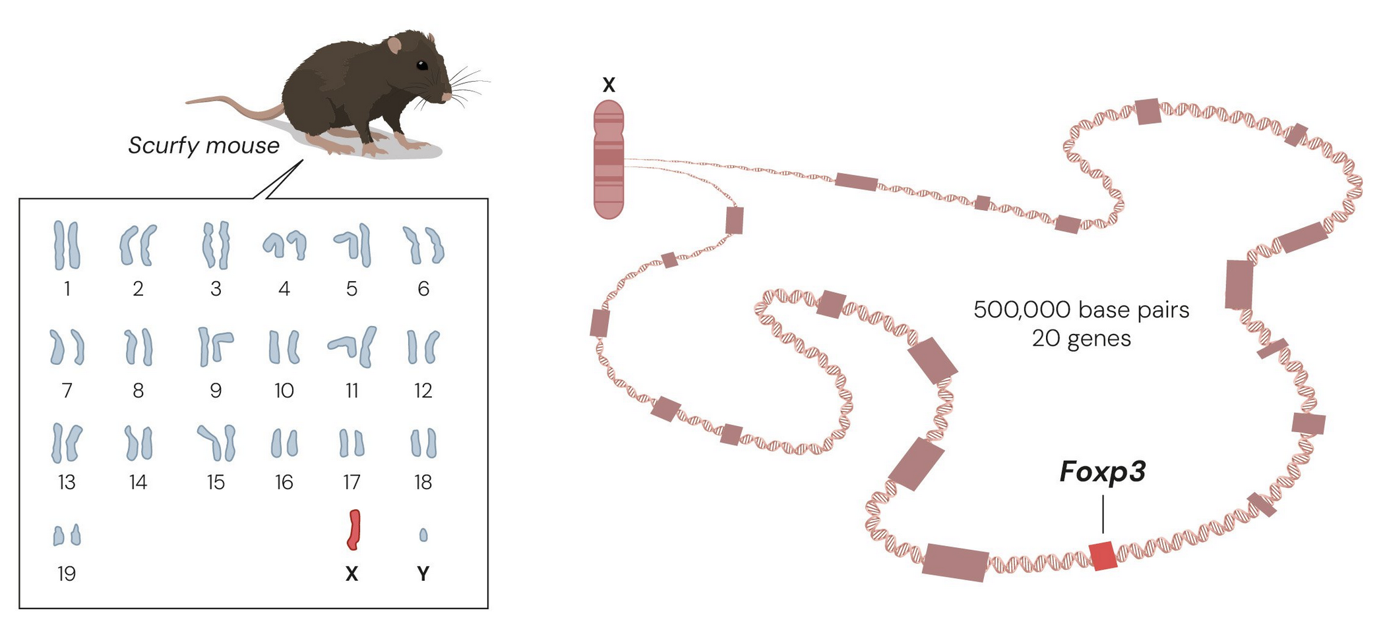
2001 Mary Brunkow and Fred Ramsdell
discovered that scurfy mice were particularly vulnerable to autoimmune diseases because they have a mutation in a gene named Foxp3.
showed that mutations in the human equivalent of this gene cause a serious autoimmune disease, IPEX
Notes:
Image: https://www.nobelprize.org/uploads/2025/10/popular-medicineprize2025-figure6.jpg

Slide 11
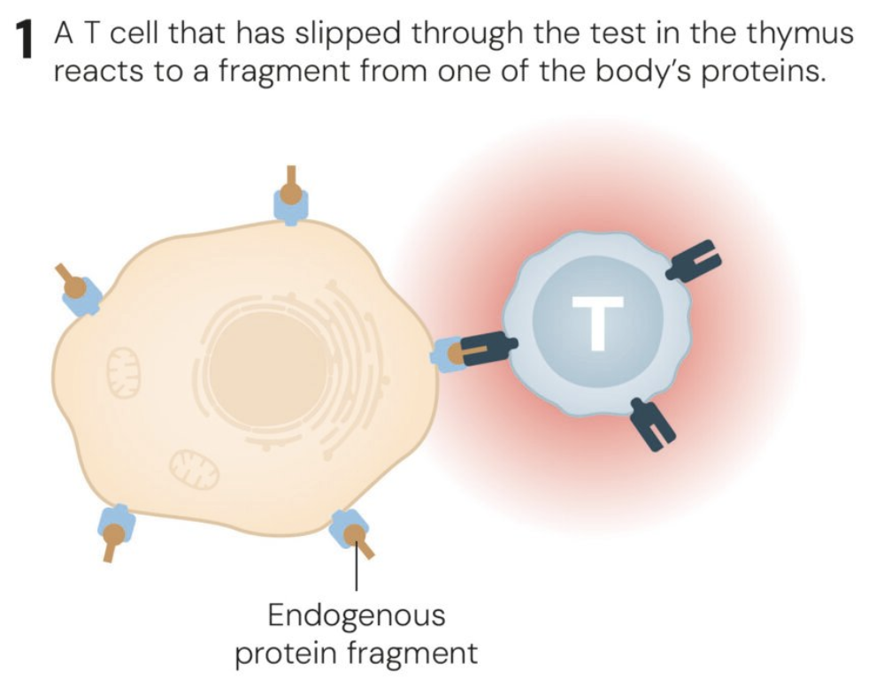
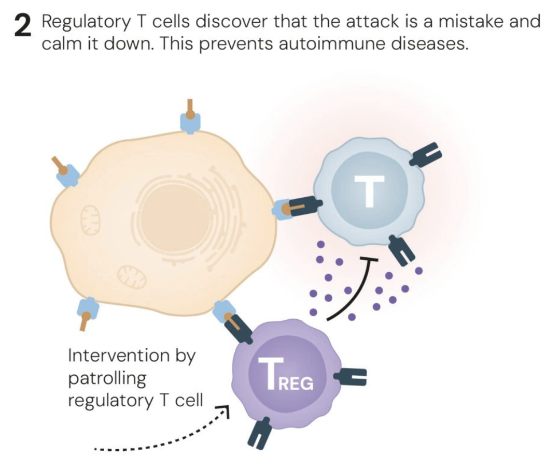
2003 Shimon Sakaguchi
Linked the two discoveries
Proved that the Foxp3 gene governs the development of the cells he identified in 1995.
These cells, now known as regulatory T cells, monitor other immune cells and ensure that our immune system tolerates our own tissues.
Notes:
Image: https://www.nobelprize.org/images/175983-large-2x.jpg

Slide 12
Applications
The laureates’ discoveries
launched the field of peripheral tolerance
are spurring the development of medical treatments for cancer and autoimmune diseases.
may also lead to more successful transplantations.
Several of these treatments are now undergoing clinical trials.

