Slide 1
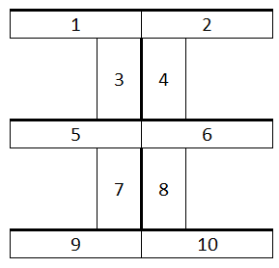



Whainga/LI: Process & communicate L2 Chemistry information by completing Jeopardy to reflect on the material you do & don’t understand
Mahia/Do Now
Move the tables into the following arrangement.

Slide 2

Level 2 Chemistry Edition
With your host: Ms Garlick

Slide 3

Lewis Structure, Shape & Polarity | Enthalpy and Solids | Organic | Equilibrium | Acids & Bases
100 | 100 | 100 | 100 | 100
200 | 200 | 200 | 200 | 200
300 | 300 | 300 | 300 | 300
400 | 400 | 400 | 400 | 400
500 | 500 | 500 | 500 | 500

Slide 4
Lewis Structure, Shape & Polarity - 100
Draw the Lewis structure of NH₃.

Slide 5
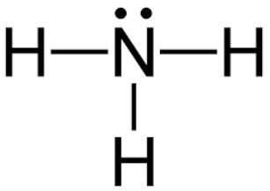

Lewis Structure, Shape & Polarity – 100
Notes:
https://study.com/cimages/multimages/16/ab9d659b-4e3a-4d72-b2e3-7a81ad0d18f1_ammonia.jpg

Slide 6
Lewis Structure, Shape & Polarity - 200
What is the shape of BF₃?

Slide 7
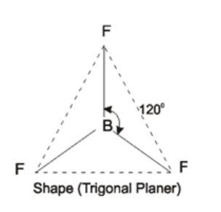
Lewis Structure, Shape & Polarity – 200
Trigonal planar
Notes:
https://qph.fs.quoracdn.net/main-qimg-4177a53b18df4e7390937209f3acdf5d

Slide 8
Lewis Structure, Shape & Polarity - 300
What would the bond angle and shape be for H₂S?

Slide 9
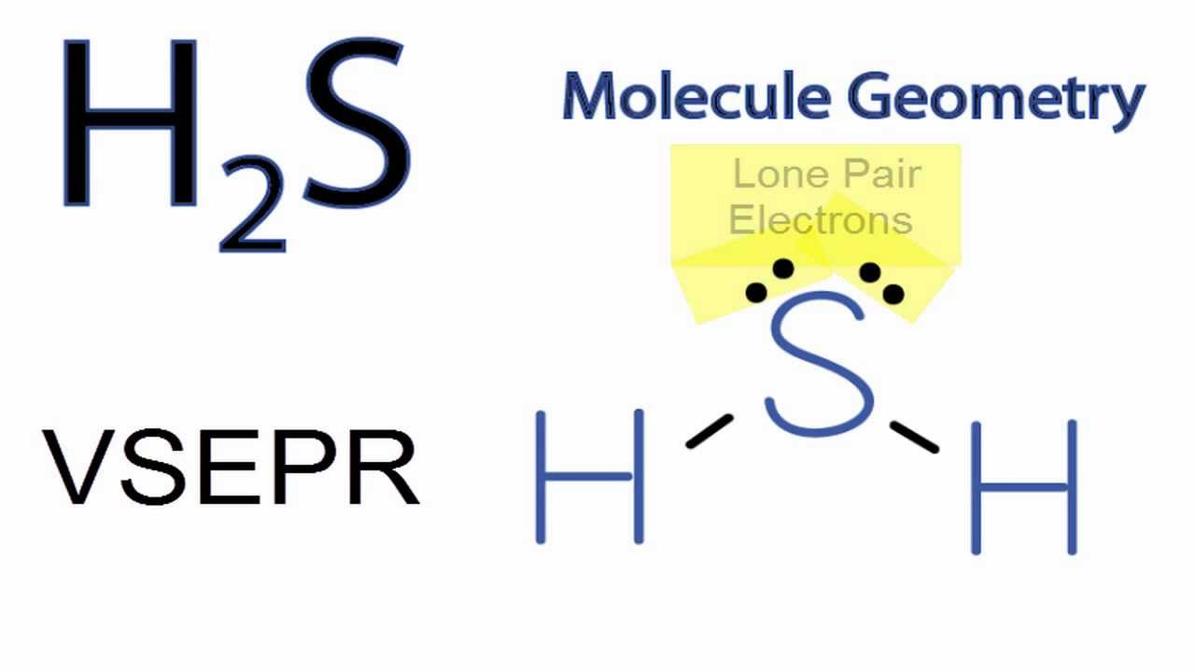
Lewis Structure, Shape & Polarity – 300
Bond angle = 109.5⁰
Shape = Bent
Notes:
https://i.ytimg.com/vi/FL-rGZEtEG8/maxresdefault.jpg

Slide 10

Lewis Structure, Shape & Polarity - 400
The Lewis structures for hydrogen cyanide and carbon dioxide have been provided for you. Identify the polarities of BOTH molecules.

Slide 11

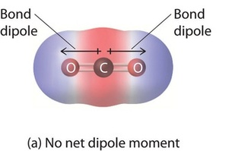
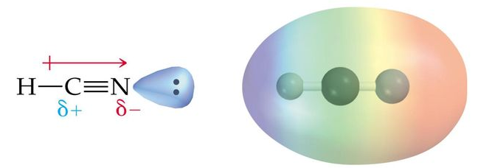
Lewis Structure, Shape & Polarity – 400
Notes:
https://qph.fs.quoracdn.net/main-qimg-395e09bc846b9a1023e8f53065d8b152
https://slideplayer.com/slide/13115925/79/images/81/Worked+Example+4.13+Cont.+Solution%3A.jpg

Slide 12
Lewis Structure, Shape & Polarity - 500
H₂S and NH₃ both have the same bond angle but different shapes. Why is that? Your answer needs to state the bond angle and shapes.

Slide 13
Lewis Structure, Shape & Polarity – 500
Bond angle for both is 109.5⁰. H₂S is bent and NH₃ is trigonal pyramid.
They have the same bond angle because both have four regions of electron density. However, the shapes are different because H₂S has two bonded regions of electron density, where as NH₃ has three.

Slide 14
Enthalpy and Solids - 100
I am a solid that has a melting point of 44 ⁰C and a boiling point of 280 ⁰C . I cannot conduct electricity and I am not soluble in water.
What type of solid am I?

Slide 15
Enthalpy and Solids – 100
Covalent Molecular

Slide 16
Enthalpy and Solids - 200
Respiration is the process by which energy is released from glucose, which is shown by the equation below.
C₆H₁₂O₆ + 6 O₂ → 6 CO₂ + 6 H₂O
Is this reaction endothermic or exothermic?
CHECK

Slide 17
Enthalpy and Solids – 200
It releases energy (ATP), thus respiration is an exothermic reaction.

Slide 18
Enthalpy and Solids - 300
Explain why ionic solids can only conduct electricity in if molten or dissolved in water. Make sure you use the correct vocabulary and define the requirements to conduct electricity.

Slide 19
Enthalpy and Solids – 300
In order to be able to conduct electricity, there needs to be a free charged particle in the form of electrons or ions. Ionic solids have their ions locked in a 3D lattice, thus not being able to conduct electricity. If it is melted or dissolved in water, the ions are mobile, thus it can conduct electricity.

Slide 20
Enthalpy and Solids - 400
Identify if the evaporation of water is an endothermic or exothermic reaction. Justify why and identify the bonds being made/broken.

Slide 21
Enthalpy and Solids – 400
The evaporation of water is an endothermic reaction. This is because it needs energy to break the intermolecular (hydrogen) bonds to evaporate.

Slide 22
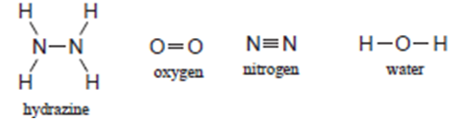
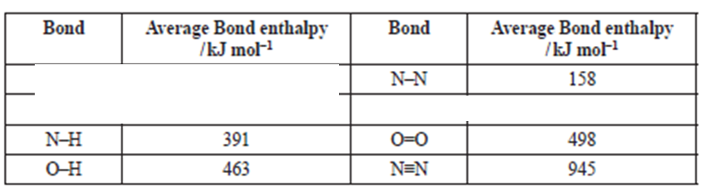
Enthalpy and Solids - 500
Calculation the energy released from burning hydrazine (N₂H₄) from the equation and values below.
N₂H₄ + O₂ → N₂ + 2 H₂O

Slide 23
Enthalpy and Solids – 500
2200 – 2797
= -577 kJ mol⁻¹

Slide 24
Organic - 100
Draw the following compound.
2-hydroxyl propanoic acid

Slide 25

Organic – 100
2-hydroxyl propanoic acid

Slide 26

Organic - 200
Name the following compound.

Slide 27
Organic – 200
3-methyl butan-2-ol

Slide 28
Organic - 300
Draw and label the primary, secondary, and tertiary structural formulae for the following molecular formula.
C₄H₉Cl

Slide 29
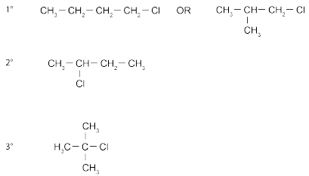
Organic – 300
C₄H₉Cl

Slide 30

Organic – 400
Justify if the following alkene can form geometric isomers. Your answer needs to include the requirements to form geometric isomers.

Slide 31
Organic – 400
In order to form a geometric isomer, there needs to be a double bond and each carbon in the double bond needs to have to different things attached to it. In this example, there are two hydrogens attached to one carbon in the double bond, thus it cannot form geometric isomers.

Slide 32
Organic - 500
When but-1-ene is reacted to form bromobutane, C₄H₉Br, two organic products are formed.
What is the name of the reagent required for this reaction, the type of reaction, and the names of the two products?

Slide 33
Organic – 500
Reagent required = HBr
Type of reaction = Addition
Major product = 2-bromobutane
Minor product = 1-bromobutane

Slide 34
Equilibrium - 100
Write the equilibrium constant for the following reaction.
2 SO₂ (g) + O₂ (g) ←→ 2 SO₃ (g)

Slide 35

Equilibrium – 100
2 SO₂ (g) + O₂ (g) ←→ 2 SO₃ (g)

Slide 36
Equilibrium - 200
In the following reaction, why would it is important for an industrial plant to continue to remove the SO₃ being formed?
2 SO₂ (g) + O₂ (g) ←→ 2 SO₃ (g)

Slide 37
Equilibrium – 200
To maximum the production of SO_{3.} By removing SO_{3,} equilibrium is constantly stressed to promote the forward reaction.

Slide 38
Equilibrium - 300
Predict what would be the effect on the concentration of SO₃ if the reaction is carried out in a larger reaction vessel and justify why.
2 SO₂ (g) + O₂ (g) ←→ 2 SO₃ (g)

Slide 39
Equilibrium – 300
2 SO₂ (g) + O₂ (g) ←→ 2 SO₃ (g)
A larger vessel would decrease the pressure. To counteract this change, the reaction will go in the direction with more moles of gas. In this case, it will reverse since the reactants have 3 moles of gas and the products have 2 moles. Overall this means that the SO₃ concentration will decrease.

Slide 40
Equilibrium - 400
2 SO₂ (g) + O₂ (g) ←→ 2 SO₃ (g)
What would the concentration of O₂ be if…
Kc | 4.32
SO₂ | 0.100 mol L⁻¹
SO₃ | 0.0930 mol L⁻¹

Slide 41
Equilibrium – 400
O₂ = 0.200 mol L⁻¹

Slide 42
Equilibrium - 500
2 SO₂ (g) + O₂ (g) ←→ 2 SO₃ (g)
Kc at 450 ⁰C > Kc at 600 ⁰C
Justify if the reverse reaction is endothermic or exothermic.

Slide 43
Equilibrium – 500
A larger Kc means at a lower temperature, means there the 450 ⁰C equilibrium has more products than the 600 ⁰C equilibrium.
So decreasing the temperature promotes the forward reaction, which would be an exothermic reaction.
That means the reverse reaction is endothermic.

Slide 44
Acids & Bases - 100
If a solution has a pH of 10.8, what is it’s hydronium (H₃O⁺) concentration?

Slide 45
Acids & Bases – 100
1.58 x 10⁻¹¹ mol L⁻¹

Slide 46
Acids & Bases - 200
What is the conjugate base in the following equation?
C₂H₅COOH + H₂O ←→ C₂H₅COO⁻ + H₃O⁺
#1 #2 #3 #4

Slide 47
Acids & Bases – 200
C₂H₅COOH + H₂O ←→ C₂H₅COO⁻ + H₃O⁺
#1 #2 #3 #4
#3 is the conjugate base.

Slide 48
Acids & Bases - 300
If sodium ethanoate (CH₃COONa) is dissolved into water, would it be an acid or base?

Slide 49
Acids & Bases – 300
It is a base.
CH₃COONa → CH₃COO⁻ + Na⁺
CH₃COO⁻ + H₂O ←→ CH₃COOH + OH⁻

Slide 50
Acids & Bases - 400
Calculate the pH of a 2.96 x 10⁻⁴ mol L⁻¹ solution of potassium hydroxide (KOH).

Slide 51
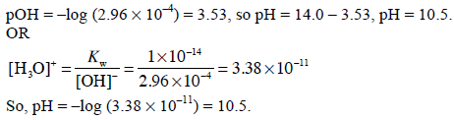
Acids & Bases – 400

Slide 52
Acids & Bases - 500
How it is possible that both ethanoic acid (CH₃COOH) and nitric acid (HNO₃) can both have the concentration of 0.200 mol L⁻¹, but different pH values?
Which would have the higher pH and why?

Slide 53
Acids & Bases – 500
In theory, since they both have the same concentration, they should both have the same hydronium concentration. However, nitric acid fully dissociates and ethanoic acid does not. This limits the concentration of hydronium in the ethanoic acid, giving it a higher pH than nitric acid.

Slide 54
FINAL JEOPARDY
CATEGORY: Rate of Reaction
You can bet anywhere between 0 and 500 points.
But remember, if you’re wrong, you lose what you bet.

Slide 55

FINAL JEOPARDY
An experiment was carried out testing the effect of acid temperature on the rate of reaction with magnesium.
One was carried out at 25 ⁰C and the other at 50 ⁰C.
Draw a graph comparing the rate of hydrogen gas production.

Slide 56
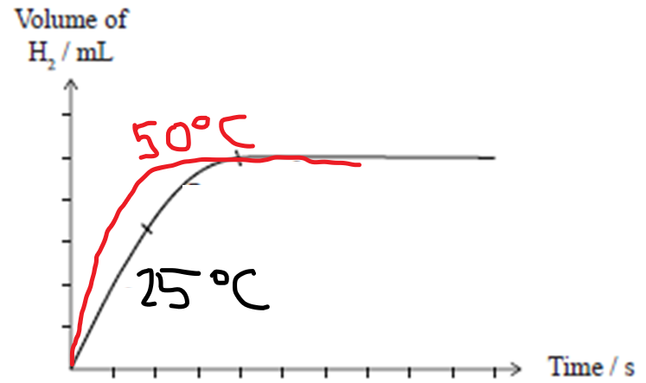
FINAL JEOPARDY

